Slide 1
Data Preparation for Neuroimagers: BIDS, mriqc, and fmriprep
Dr. Kyle Kurkela
kkurkela@bu.edu
Research Computing Services
Information Services & Technology
Boston University

Slide 2
Resources
Tutorial Slides and a Recording of today’s tutorial will be made available
Code and example data are available here:
https://rcs.bu.edu/examples/imaging/tut_dataprep_scc/
Questions? Comments? Concerns?
help@scc.bu.edu
kkurkela@bu.edu
mcmains@bu.edu

Slide 3
Assumptions
This tutorial is aimed at a beginner level.
However, I will assume that you have a basically level of comfort within a Linux environment.
The Research Computing Services team has many resources for learning Linux:
A 20 min Introduction to Linux:
https://www.bu.edu/tech/support/research/training-consulting/rcs-tutorial-videos-and-third-party-tutorials/intro-linux-20min/
A 2 hr Introduction to Linux and the SCC:
https://www.bu.edu/tech/support/research/training-consulting/rcs-tutorial-videos-and-third-party-tutorials/intro-scc/
Linux on the SCC Cheat Sheet:
http://scv.bu.edu/documents/Linux_SCC_CheatSheet.pdf

Slide 4
Learning Objectives
By the end of this tutorial, you should …
have a basic understanding of the two major file formats for neuroimaging data: DICOM and NIFTI.
have a basic understanding of how neuroimaging data is organized in BIDS.
be able to convert DICOM files to NIFTI files using dcm2niix.
be able to convert DICOM files to BIDS formatted NIFTI files using dcm2bids.
Have a basic understanding of batch jobs on the SCC
be able to run a quality assurance routine using MRIQC on the SCC.
be able to run a preprocessing routine using FMRIPREP on the SCC.

Slide 5
Workshop Overview
Connecting to the SCC
Organizing Data on the SCC with dcm2bids
The Brain Imaging Data Structure (BIDS)
Batch Job 101
Assessing the quality of your data with mriqc
Preprocessing your data with fmriprep
Notes:
Ok great. Now that we know a little bit about what the SCC is, lets take a look at

Slide 6
Workshop Overview
Connecting to the SCC
Organizing Data on the SCC with dcm2bids
The Brain Imaging Data Structure (BIDS)
Batch Job 101
Assessing the quality of your data with mriqc
Preprocessing your data with fmriprep

Slide 7
Getting an SCC Account
Today we will be using tutorial accounts. These accounts are temporary and will be inaccessible after today’s workshop
All users of the SCC must be on a Research Project headed by a full-time BU Faculty member with some exceptions:
Some academic classes
3 Month Trial Accounts for “trying out” the SCC
Please see for more detailed information:
https://www.bu.edu/tech/support/research/account-management/

Slide 8
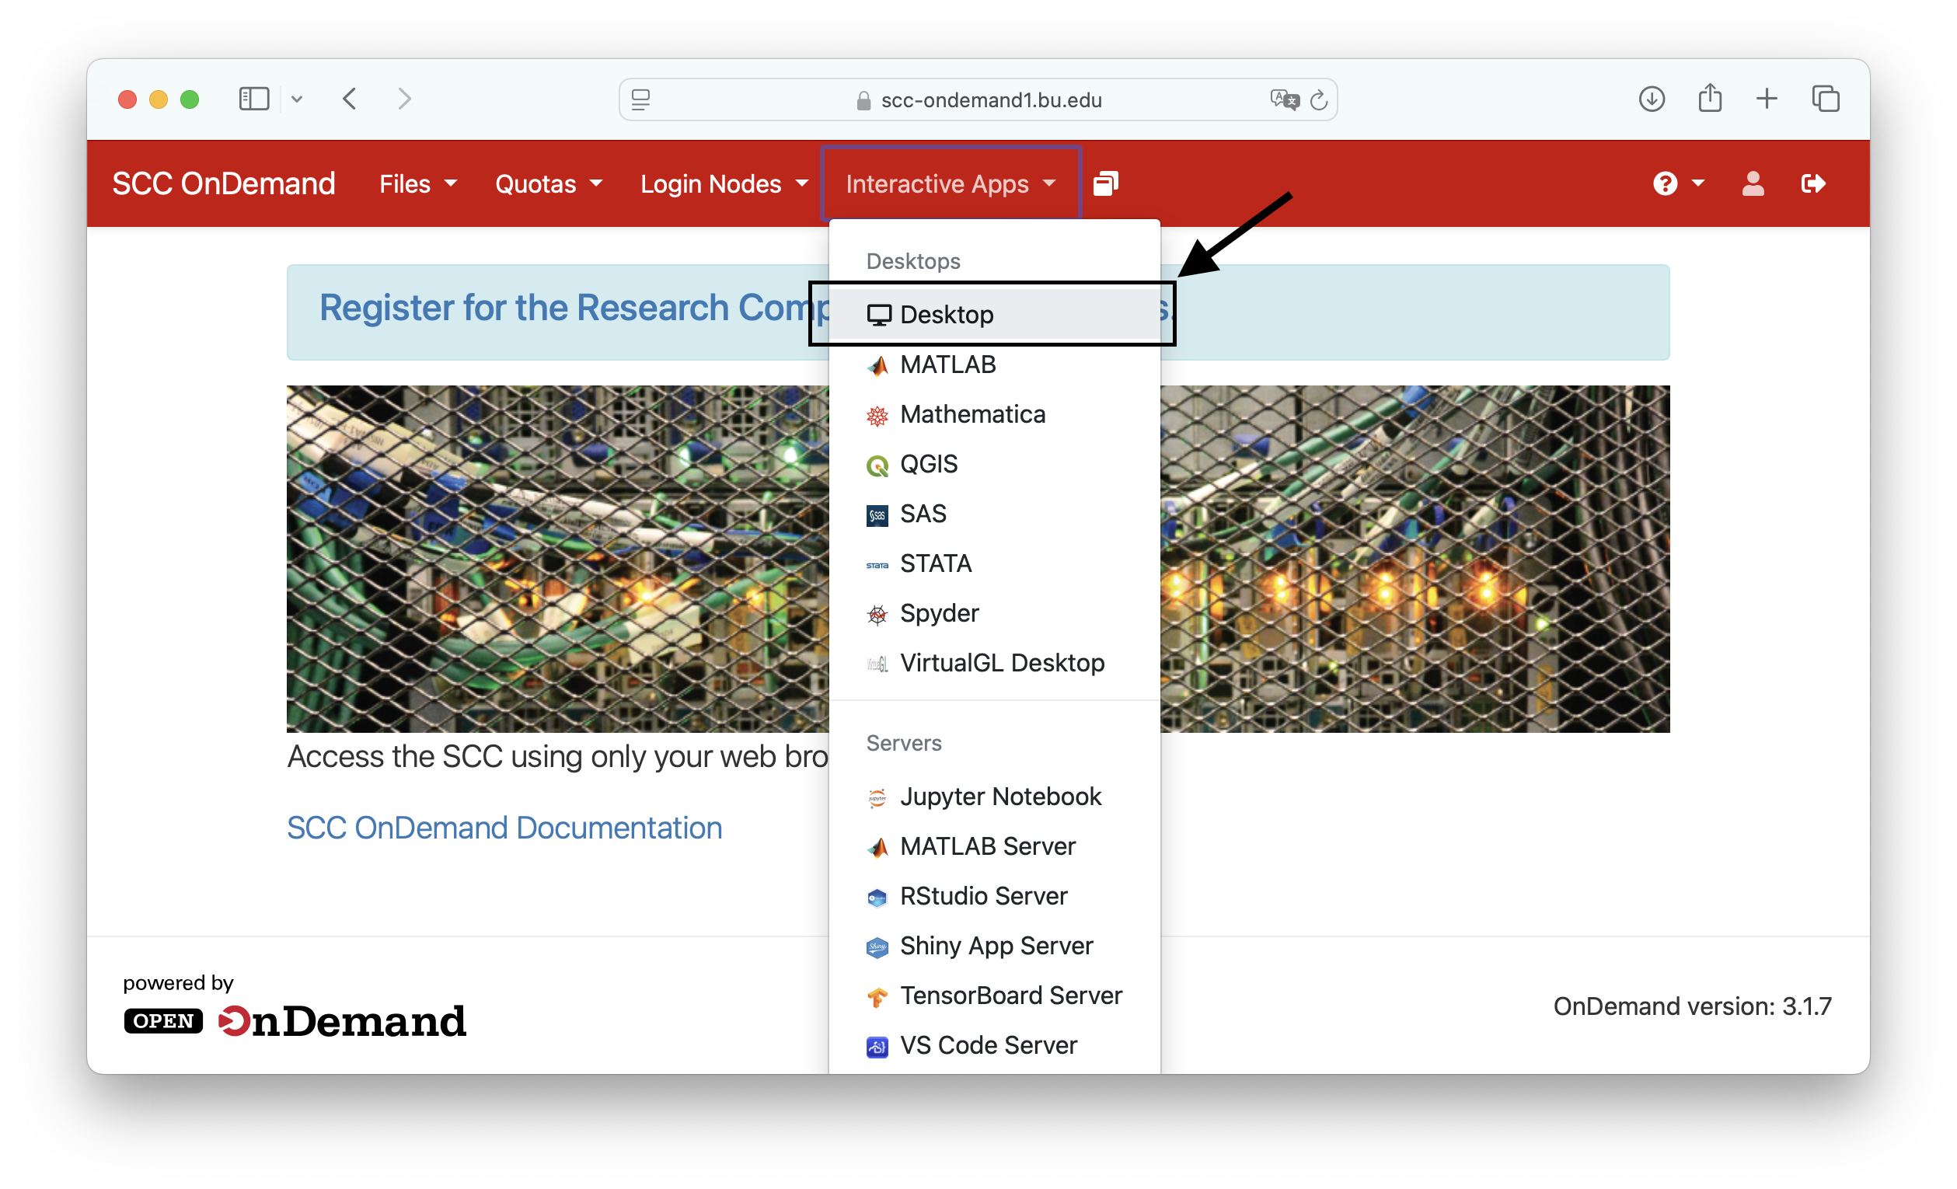
Accessing Tutorial Accounts
Open a web browser
Go to scc-ondemand-tutorial.bu.edu
Username: tuta#
Password: ******
Click “Interactive Apps”
Click “Desktop”

Slide 9
Copy the tutorial data
Open up a terminal window and follow along with me.
NOTE: all commands used in today’s tutorial will be in a publicly accessible text file notes.txt
https://rcs.bu.edu/examples/imaging/tut_dataprep_scc/notes.txt
Notes:
“Click Launch”
Open up a terminal
Run cp command

Slide 10
Workshop Overview
Connecting to the SCC
Organizing Data on the SCC with dcm2bids
The Brain Imaging Data Structure (BIDS)
Batch Job 101
Assessing the quality of your data with mriqc
Preprocessing your data with fmriprep

Slide 11
Workshop Overview
Connecting to the SCC
Organizing Data on the SCC with dcm2bids
The Brain Imaging Data Structure (BIDS)
Batch Job 101
Assessing the quality of your data with mriqc
Preprocessing your data with fmriprep

Slide 12
MRI Data 101 -- DICOM
Magnetic Resonance Imaging (MRI) data largely stored in DICOM format
DICOM
Standard medical image format used by most human imaging scanners.
Very rich meta data.
Supports both 2D and 3D images (Some 3D images are stored as a sequence of 2D images).
Not very conducive for image processing.
Relatively difficult to compress.
See for more information:
https://www.dicomstandard.org
https://dicom.innolitics.com/ciods/mr-image

Slide 13
Explore the DICOM files
Let’s return to SCC OnDemand and explore the data a little bit, inspecting the headers of one of the DICOM files. Follow along with me…
NOTE: all commands used in today’s tutorial will be in a publicly accessible text file notes.txt
https://rcs.bu.edu/examples/imaging/tut_dataprep_scc/notes.txt

Slide 14
MRI Data 101 -- NIFTI
Raw DICOM image files are usually converted to one of several different file formats for further processing and analysis.
NIFTI
Most popular – the research standard format
Relatively limited meta-data
Represents 3D volumes (or 4D – i.e., 3-D volumes over time) in a single file
Easily compressed to reduce storage space
Examples: sub_001.nii, subject_001.nii.gz
Freesurfer, FSL, AFNI, SPM, CONN
Notes:
Is this too much information?
[[Brian]] Format as a table.

Slide 15
DICOMs -> NIFTIs
Let’s convert the DICOM files we just looked at to NIFTI files and explore them a bit closer. Follow along with me…
NOTE: all commands used in today’s tutorial will be in a publicly accessible text file notes.txt
https://rcs.bu.edu/examples/imaging/tut_dataprep_scc/notes.txt

Slide 16
MRI Data Organization
MRI data is numerous and complex – you need an organization system!
In the good-old-days, every research group, institution, lab would have their own idiosyncratic organization systems. It was a nightmare.
BIDS came to the rescue!
Notes:
BIDS is basically the dewey decimal system of MRI data.
Imagine three different libraries – Katia’s Library, Josh’s Library, Andy’s Library.
Katia likes to organize her library by the country of origin of the author – Russian authors, English authors, American authors, etc. Katia likes to read books from authors from different countries.
Josh likes to organize his library in alphabetical order by title. He doesn’t particular care about the authors and remembers books by their titles.
Andy. Boy oh boy Andy. Andy’s library is a complete mess. He just randomly throws books onto the shelves of his library? Like a madman. No organization whatsever. Its amazing anyone can find books in his library.
Now say someone – Let’s call him Brian – comes along and needs to find a very specific book from this library for his research. How long do you think it will take Brian to find the book he is looking for from Katia, Josh, and Andy’s libraries? A long freaking time. He needs to learn two different organization systems AND he needs to figure out what the hell is wrong with Andy.
Wayyy back in the day, libraries instituted the dewey decimal system for organizing books on their shelves. The system became universal, making Brian’s task of finding books much much easier when traveling from library to library.
MRI data was much like this for several years – I have first hand experience.

Slide 17
The Brain Imaging Data Structure (BIDS)
BIDS – a universal organization system for brain imaging data
Organizes data into subfolders for data types nested within sessions nested within subjects with specific meta data files required at different stages of a hierarchy depending on data type
Please see the BIDS data format manual, associated website, and associated paper for further details
Manual: https://bids-specification.readthedocs.io/en/stable/
Website: https://bids.neuroimaging.io/specification.html
Paper: Gorgolewski, K. J., Auer, T., Calhoun, V. D., Craddock, R. C., Das, S., Duff, E. P., ... & Poldrack, R. A. (2016). The brain imaging data structure, a format for organizing and describing outputs of neuroimaging experiments. Scientific data, 3(1), 1-9.
Notes:
The Dewey Decimal System for organizing MRI data.
The system is way too complex to cover in a single 2-hour session. I will go over some of the basics – please refer to the documentation that I have listed here for much more detailed information on the BIDS system.

Slide 18
The Brain Imaging Data Structure (BIDS)
What does a BIDS formatted dataset look like? What are the basics?
Let’s take a look at some publicly available ones on OpenNeuro
https://openneuro.org
Notes:
A subdirectory for each subject
Meta data text files as:
1. Unformatted text
2. JSON formatted text
3. TSV formatted text

Slide 19
The Brain Imaging Data Structure (BIDS)
How do I get my data into BIDS format?
Manually renaming and placing files into subdirectories
Automatically using your preferred programming language
Example: R Script from Kyle’s GithubRepo
Using a software package to automate the process:
There are a number packages – Kyle’s favorite and recommended tool is dcm2bids
Notes:
1. Show what I mean by manual – file explorer, renaming files and moving into folders. Please don’t do this.
2. You can write a script using basic copy/move/create file commands to organize a dataset into bids. Example from my Github repository. Please don’t do this.
3. Use a software package to do it for you!

Slide 20
Software Spotlight: dcm2bids
How do I get my data into BIDS format?
dcm2bids
One of a vast array of software packages designed to organize your MRI data into a bids format
Relies on the very popular dcm2nix software package to convert DICOM → NIFIT AND performs data organization all in one go
You need to carefully design a config.json file to sort your scans into the appropriate BIDS datatypes

Slide 21
DICOMs -> NIFTIs -> BIDS
Let’s convert our example DICOM data into a bids formatted dataset. Follow along with me…
NOTE: all commands used in today’s tutorial will be in a publicly accessible text file notes.txt
https://rcs.bu.edu/examples/imaging/tut_dataprep_scc/notes.txt

Slide 22
Creating a dcm2bids config file
The trickiest part about using dcm2bids is creating the config file.
The config file is a json text file that tells dcm2bids how to map header information from the DICOM file to the appropriate BIDS information
For example, which DICOM files represent an ANAT image? A BOLD images? A FMAP image?

Slide 23
Does your dataset meet the BIDS guidelines?
How do you know if your datasets meets BIDS guidelines?
You can use the BIDS validator.
Available as a locally installable utility and as an online web browser utility
Web Utility: https://bids-standard.github.io/bids-validator/
Notes:
My suggested workflow for putting the finishing touches on your dataset is to iteratively check it with the BIDS validator.

Slide 24
Workshop Overview
Connecting to the SCC
Organizing Data on the SCC with dcm2bids
The Brain Imaging Data Structure (BIDS)
Batch Job 101
Assessing the quality of your data with mriqc
Preprocessing your data with fmriprep

Slide 25
Workshop Overview
Connecting to the SCC
Organizing Data on the SCC with dcm2bids
The Brain Imaging Data Structure (BIDS)
Batch Job 101
Assessing the quality of your data with mriqc
Preprocessing your data with fmriprep

Slide 26


Two Types of Jobs on the SCC
Interactive Jobs
Batch Jobs
Have a user interface, allow you to point, click, and type to interact with software, data, etc.
You create them with SCC OnDemand
AKA “Non-interactive”
Scripts that run without your active input.

Slide 27
Batch Job on the SCC – 101
All batch jobs require a batch script -- a text file that has all the commands that you want to run during your non-interactive session.
Batch jobs are submitted by using the qsub command

Slide 28
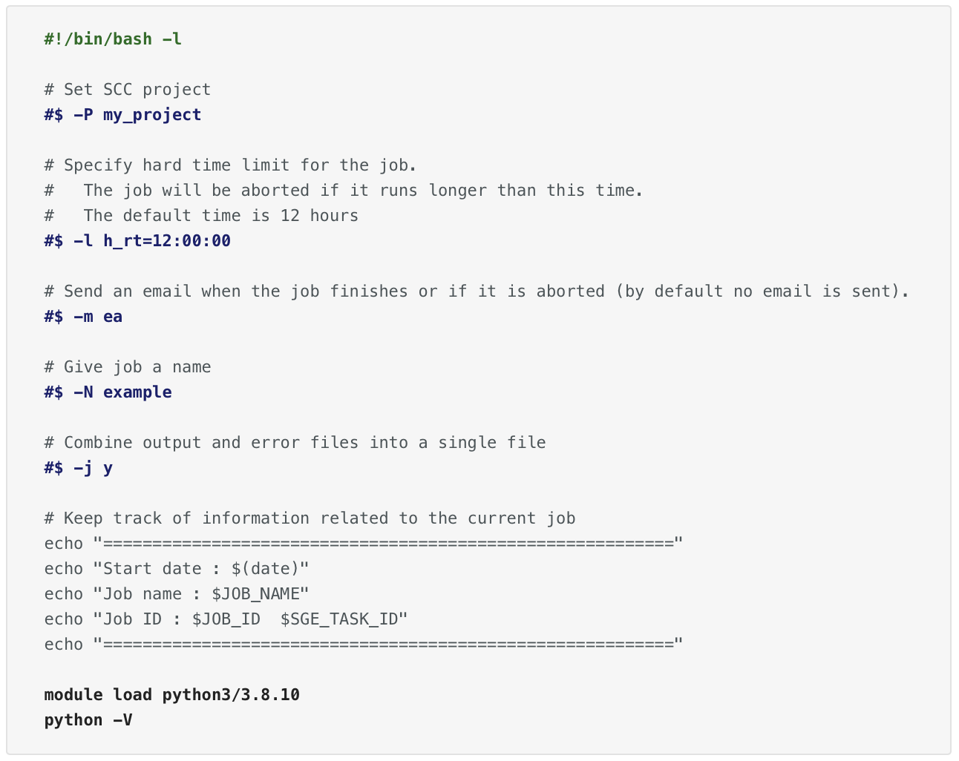
Example batch script
Batch scripts are a type of bash script – a text file with commands you would normally run in the terminal.

Slide 29
Example batch script
Bash scripts always start with this opening.
Importantly, batch scripts also need to add the -l flag.
Let’s the computer know that this is bash code.

Slide 30
Example batch script
These are comments. Otherwise ignored by the computer.
Comments always begin with “#”.
Supposed to help the programmer understand what is going on.

Slide 31
Example batch script
These are job directives.
They are options sent to the job scheduler.

Slide 32
Example batch script
This is the code that you want to run on the SCC.
Typically, you want to load a software package with a module load command and then do something with it.

Slide 33
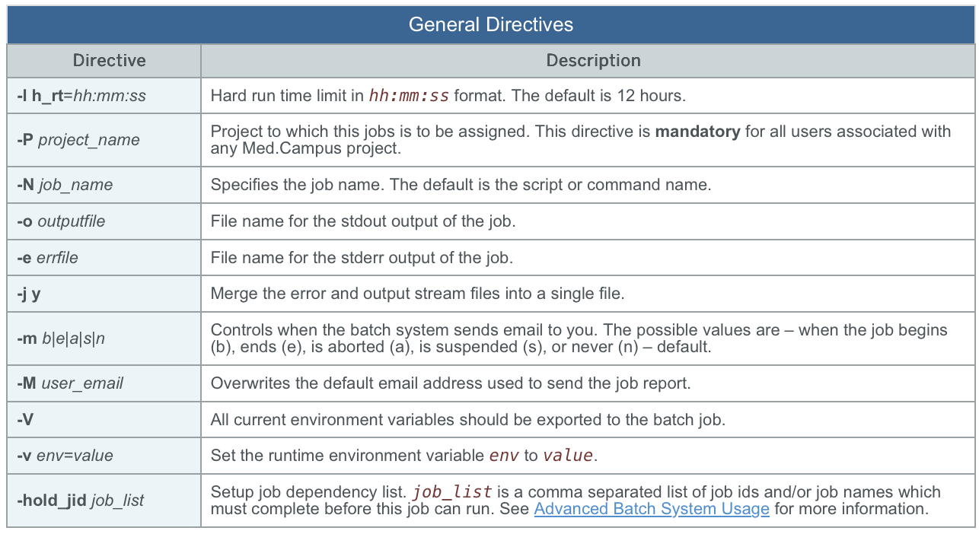
General Batch Job Directives
This table lists some of the most common batch job directives
Many should be straight forward

Slide 34
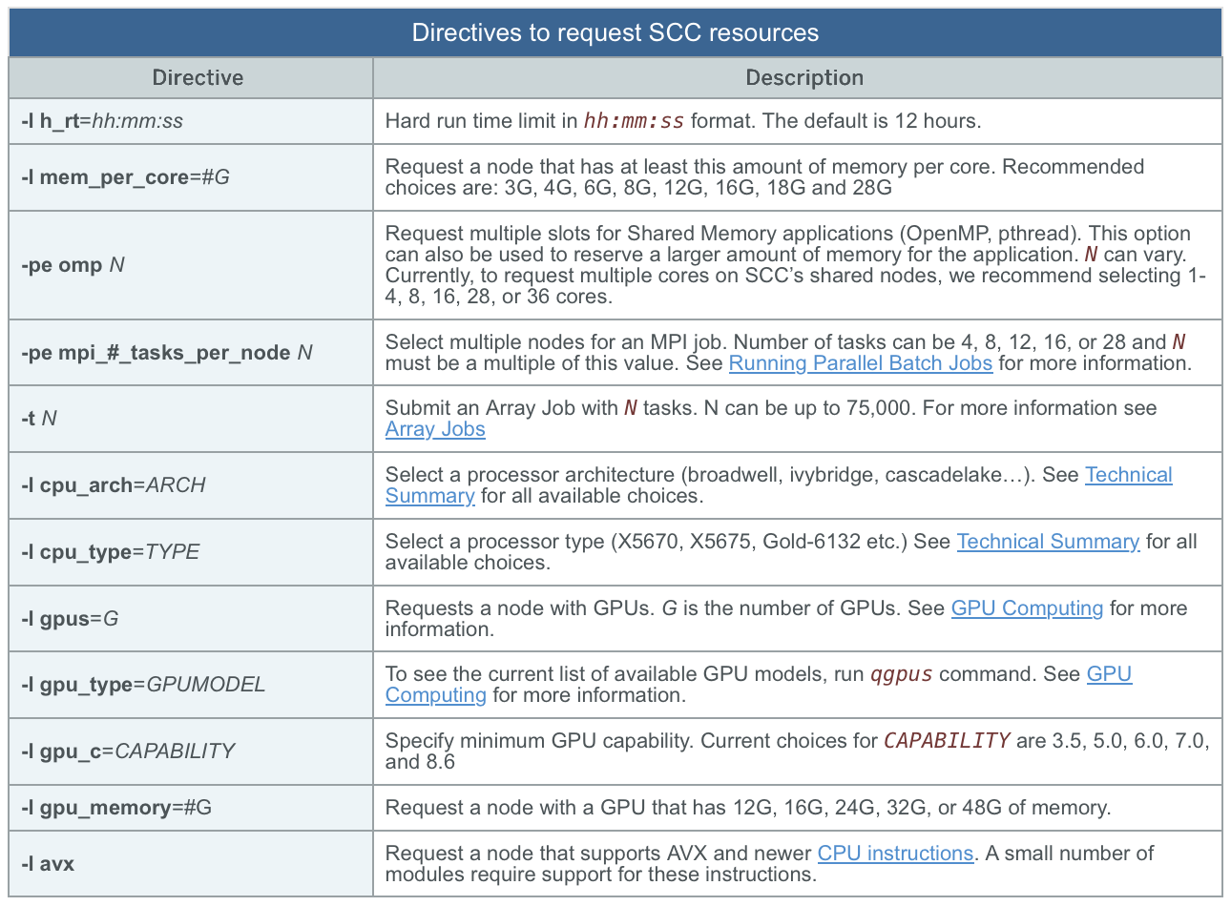
Resource Batch Job Directives
This table lists batch job directives related to computational resources.
Tells the job scheduled what type of computer you want
For example, one with lots of memory? One with lots of cores? One with a gpu? A particular cpu chip?

Slide 35
Resource Batch Job Directives
The most important ones for our purposes will be mem_per_core, pe omp

Slide 36
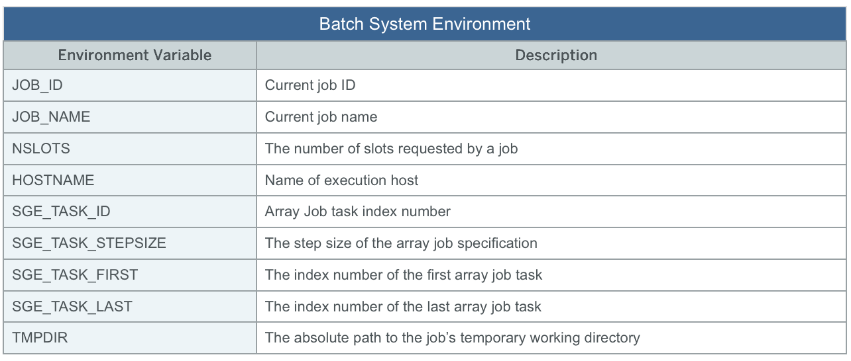
Environmental Variables
Not specific to batch jobs, environmental variables are variables that are defined within a terminal that often change how programs function.
The table to the right lists the environmental variables that the batch job system defines for us

Slide 37
Environmental Variables
Useful ones for us will be the NSLOTS and TMPDIR variables.

Slide 38
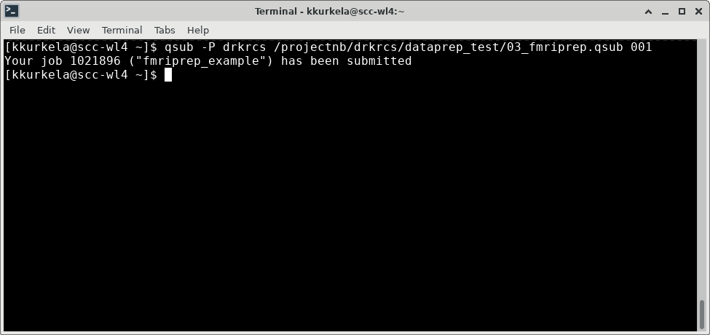
SCC Batch Job on the SCC – qsub
qsub [options] [batch_script.qsub] [arguments sent to batch_script.qsub]

Slide 39
SCC Batch Job on the SCC – qsub
Additional options for job submission.
This example overwrites the –P flag in your qsub script and runs the job with the project “drkrcs” instead.
See qsub –help for more options.
Most of the time you will not need these.

Slide 40
SCC Batch Job on the SCC – qsub
The full path to your batch script.

Slide 41
SCC Batch Job on the SCC – qsub
You can put additional input arguments to your bash script here.
These input options are available via the “$1” variable.

Slide 42
SCC Batch Job on the SCC – qsub
The commands output will tell you what your job ID number is and the name of your job is.

Slide 43
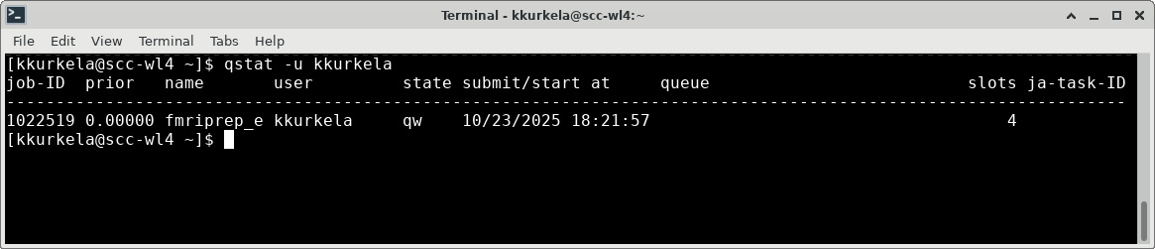
Checking the status of your batch job
qstat –u yourusername

Slide 44
Checking the status of your batch job
Output lists an entry for each of your jobs.
The most common job statuses are queued (qw), running (), or complete ().
It will also list the queue and the computer where your job is currently running.

Slide 45
Workshop Overview
Connecting to the SCC
Organizing Data on the SCC with dcm2bids
The Brain Imaging Data Structure (BIDS)
Batch Job 101
Assessing the quality of your data with mriqc
Preprocessing your data with fmriprep

Slide 46
Workshop Overview
Connecting to the SCC
Organizing Data on the SCC with dcm2bids
The Brain Imaging Data Structure (BIDS)
Batch Job 101
Assessing the quality of your data with mriqc
Preprocessing your data with fmriprep

Slide 47
Assessing your Data
Now that you have your data organized, how do you know if it is any good?
In neuroimaging, there are several common data quality concerns including but not limited to:
Singal dropout, typically near the sinuses and ear canals
Magnetic Field Inhomogeneities
Participant motion
Notes:
typo "signal" [[attish]]

Slide 48
Software Spotlight – MRIQC
MRIQC is a BIDS compatible software package that will create a nicely formatted html report giving a snapshot overview of the quality of an MRI scan
MRIQC is designed to use the best performing tools from other MRI software packages with minimal data processing time
Once your data in compliance with BIDS, the running of the software package is straightforward!
https://mriqc.readthedocs.io/en/latest/

Slide 49
MRIQC
Let’s take a closer look at an example batch script for running MRIQC on the SCC. Follow along with me…
NOTE: all commands used in today’s tutorial will be in a publicly accessible text file notes.txt
https://rcs.bu.edu/examples/imaging/tut_dataprep_scc/02_mriqc.qsub
https://rcs.bu.edu/examples/imaging/tut_dataprep_scc/notes.txt

Slide 50
MRIQC Parameters Deep Dive

Slide 51
An Example MRIQC Individual Report
Let’s take a closer look at an example output report:
T1 and T2 Images:
https://mriqc.readthedocs.io/en/latest/reports/smri.html
BOLD Images:
https://mriqc.readthedocs.io/en/latest/reports/bold.html

Slide 52
Workshop Overview
Connecting to the SCC
Organizing Data on the SCC with dcm2bids
The Brain Imaging Data Structure (BIDS)
Batch Job 101
Assessing the quality of your data with mriqc
Preprocessing your data with fmriprep

Slide 53
Workshop Overview
Connecting to the SCC
Organizing Data on the SCC with dcm2bids
The Brain Imaging Data Structure (BIDS)
Batch Job 101
Assessing the quality of your data with mriqc
Preprocessing your data with fmriprep

Slide 54
Preprocessing your Data
Now that your data are organized and are of high quality, how do you prepare the data for analysis?
Typically, in MRI studies you want to perform a set of data processing steps prior to analyzing your data. They include:
Brain extraction and defacing
Motion correction
Slice timing correction
Smoothing
Registration and Normalization
There are many different preprocessing pipelines each with their own algorithms
How do you choose which software package to use? Which ones are the best?

Slide 55
Software Spotlight – FMRIPREP
FMRIPREP is a BIDS compatible software package that creates a preprocessing pipeline from all the best performing parts of other commonly used MRI processing software
For example: a smoothing algorithm from SPM, a normalization algorithm from AFNI, etc, etc.
FMRIPREP offers a ton of options for tinkering with its internals
Like MRIQC, creates nicely formatted html reports on the success (or failure) of the preprocessing pipeline
Once your data is following BIDS, running FMRIPREP is easy!

Slide 56
FMRIPREP
Let’s return once again to the SCC and examine a batch script designed to run fmriprep. Follow along with me…
NOTE: all commands used in today’s tutorial will be in a publicly accessible text file notes.txt
https://rcs.bu.edu/examples/imaging/tut_dataprep_scc/notes.txt

Slide 57
An Example FMRIPREP Report
Lets take a look at an example output report for FMRIPREP:
https://fmriprep.org/en/stable/outputs.html

Slide 58
Additional Web Resources
Research Computing Support Pages
www.bu.edu/tech/support/research/
Software Packages Available on the SCC
www.bu.edu/tech/support/research/software-and-programming/software-and-applications/
Brain Imaging Data Standard
bids.neuroimaging.io
dcm2bids
unfmontreal.github.io/Dcm2Bids/3.2.0/
MRIQC
mriqc.readthedocs.io/en/latest/
FMRIPREP
fmriprep.org/en/stable/

Slide 59
Please open the following link in a web browser and fill out our survey!
http://scv.bu.edu/survey/tutorial_evaluation.html
Let us know how we did, how we can improve, and what types of workshops and tutorials you would like to see in the future

