Slide 1
The CONN Toolbox for Functional Connectivity Part1
Dr. Kyle Kurkela
kkurkela@bu.edu
Research Computing Services
Information Services & Technology
Boston University
Notes:
Today will be a introduction to the conn toolbox. A part 1.
There is a LOT to learn with this toolbox.

Slide 2
Workshop Overview
What is the CONN toolbox?
Workshop Setup
CONN GUI Overview
Setup
Denoising
First Level Analysis
Batch Scripting and Parallel Processing

Slide 3
Workshop Overview
What is the CONN toolbox?
Workshop Setup
CONN GUI Overview
Setup
Denoising
First Level Analysis
Batch Scripting and Parallel Processing

Slide 4
The CONN Toolbox
A popular, open source, SPM/MATLAB based, computation, display, and analysis platform for performing functional connectivity analysis of functional magnetic resonance imaging (fMRI) data.
Has a nice GUI and is (relatively) easy to use.

Slide 5
The CONN Toolbox
What can you do in CONN?
Data preprocessing
Alignment, slice timing correction, outlier identification, segmentation and normalization, smoothing
Denoising
Regressing out confounds, temporal band-passing
Functional Connectivity Analyses
Seed based, ROI-to-ROI, Graph theory, Dynamic Connectivity, gPPI, etc.
There are a TON of features, many of which we will not get to today

Slide 6
Workshop Overview
What is the CONN toolbox?
Workshop Setup
CONN GUI Overview
Setup
Denoising
First Level Analysis
Second Level Analysis
Batch Scripting and Parallel Processing

Slide 7
Workshop Overview
What is the CONN toolbox?
Workshop Setup
CONN GUI Overview
Setup
Denoising
First Level Analysis
Second Level Analysis
Batch Scripting and Parallel Processing

Slide 8
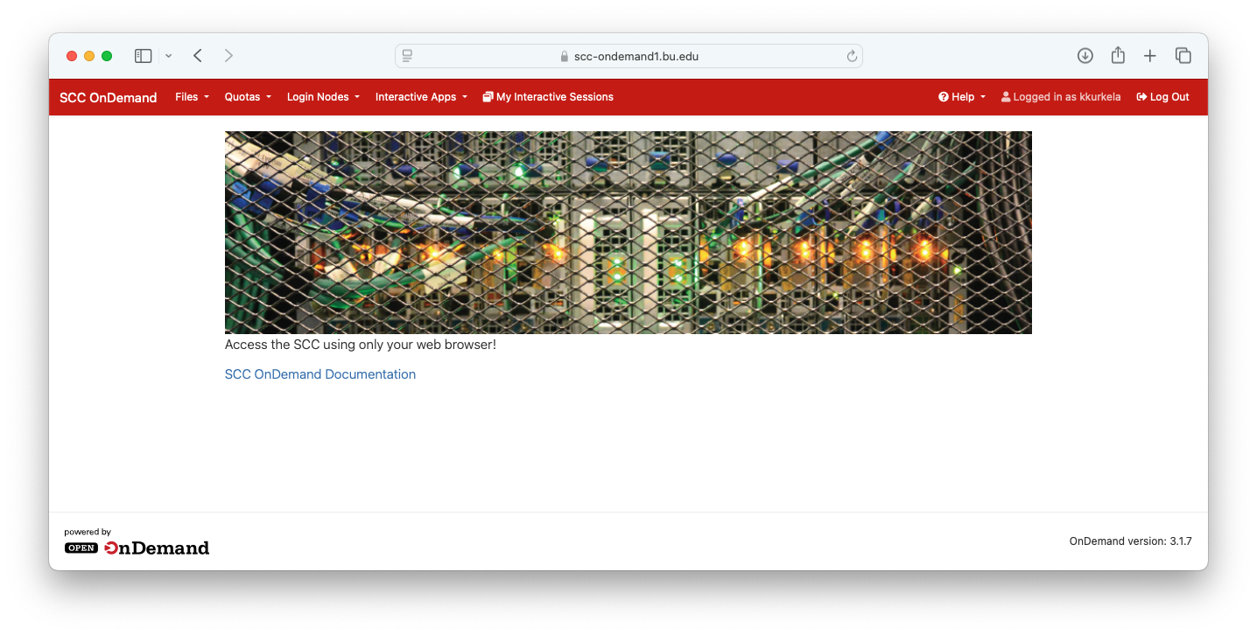
Accessing the SCC
If you DO NOT have an SCC account…
Open a web browser
Go to scc-ondemand-tutorial.bu.edu
Username: tuta#
Password: ******
If you DO have an SCC account…
Open a web browser
Go to scc-ondemand.bu.edu

Slide 9
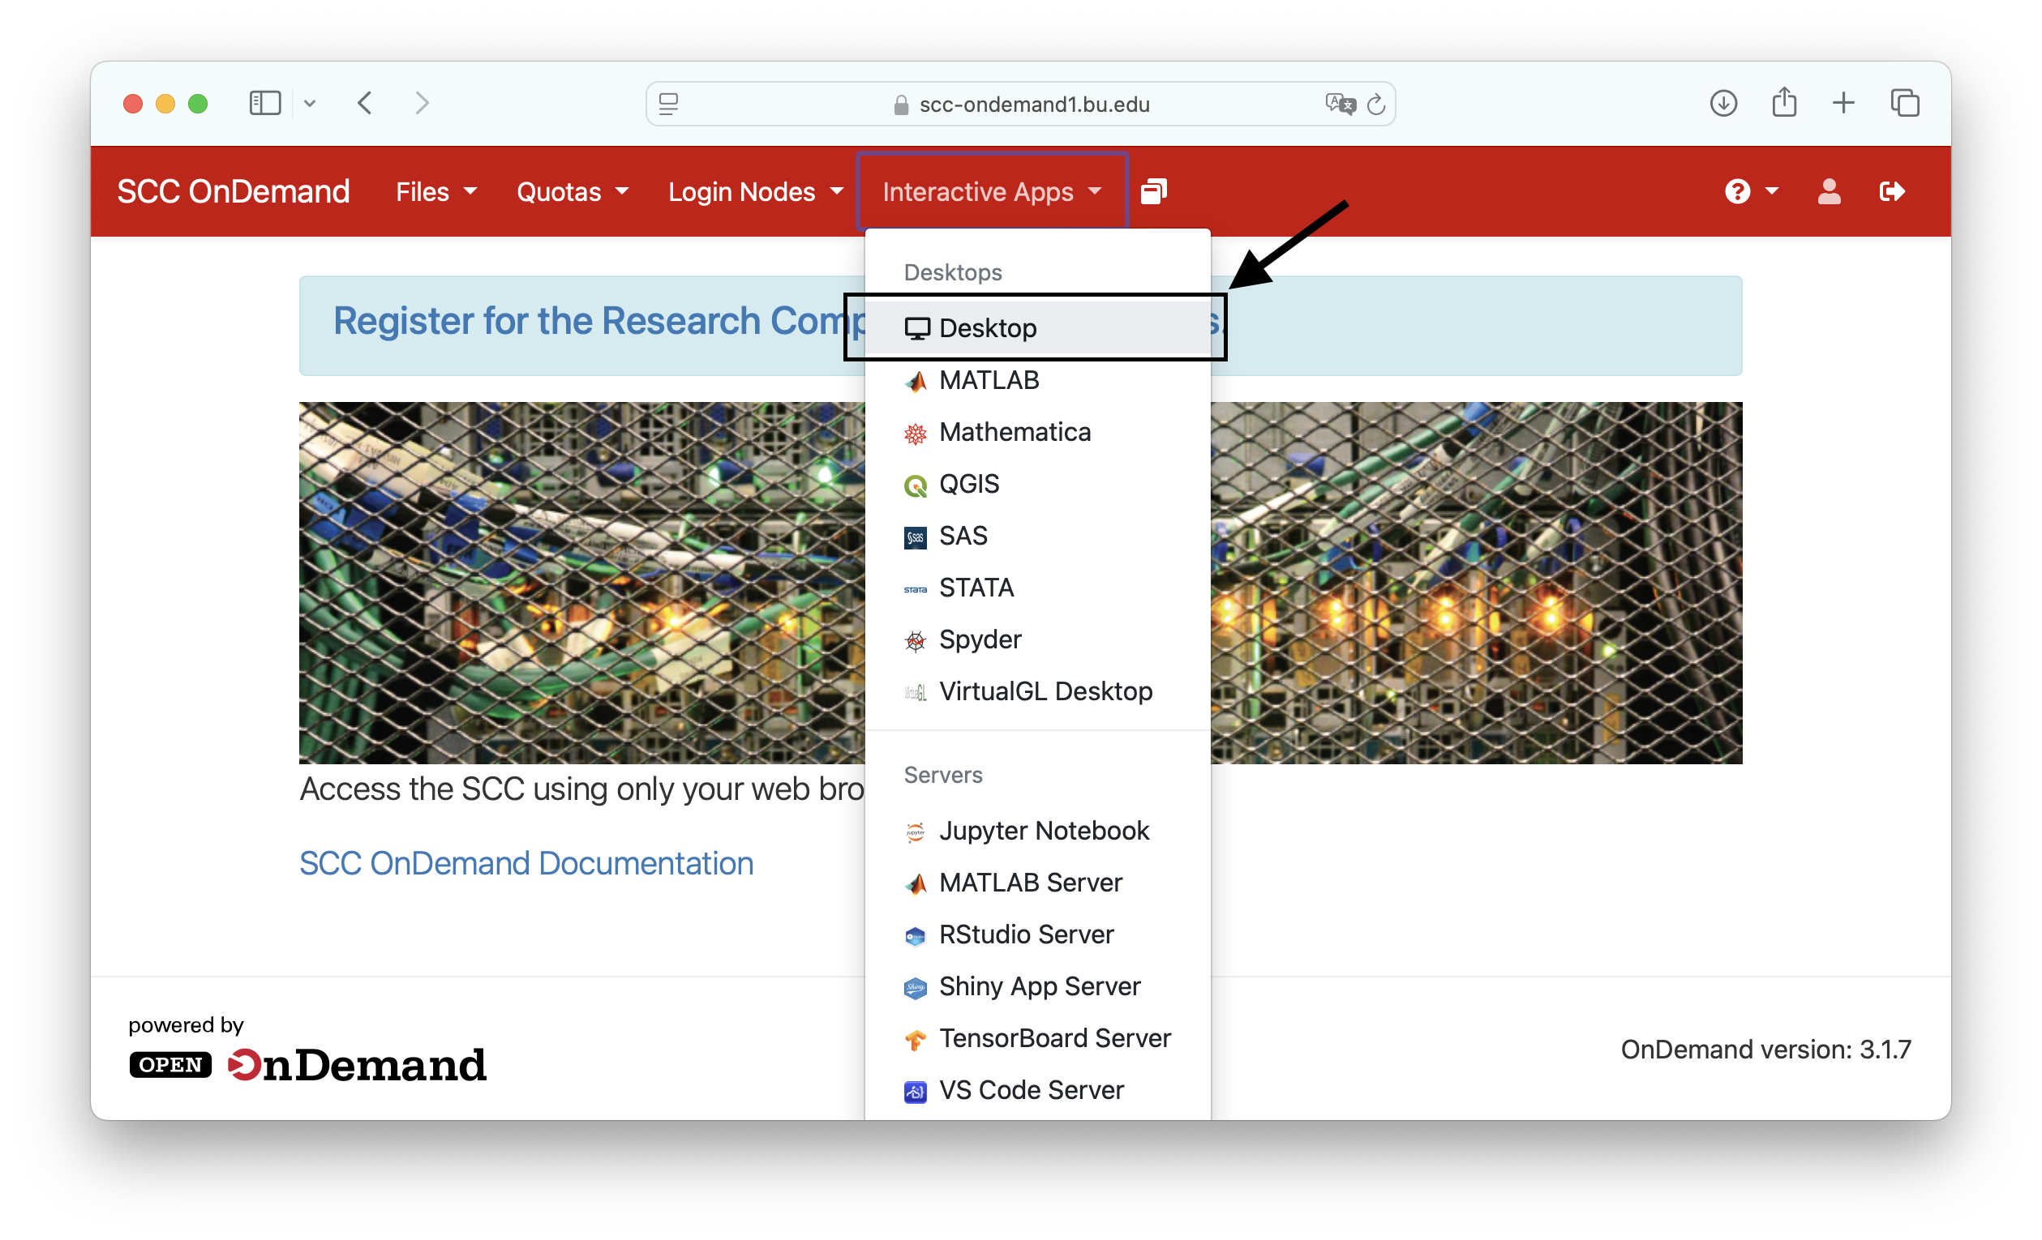
Configure and launch a desktop sesion
Click “Interactive Apps”
Click “Desktop”

Slide 10
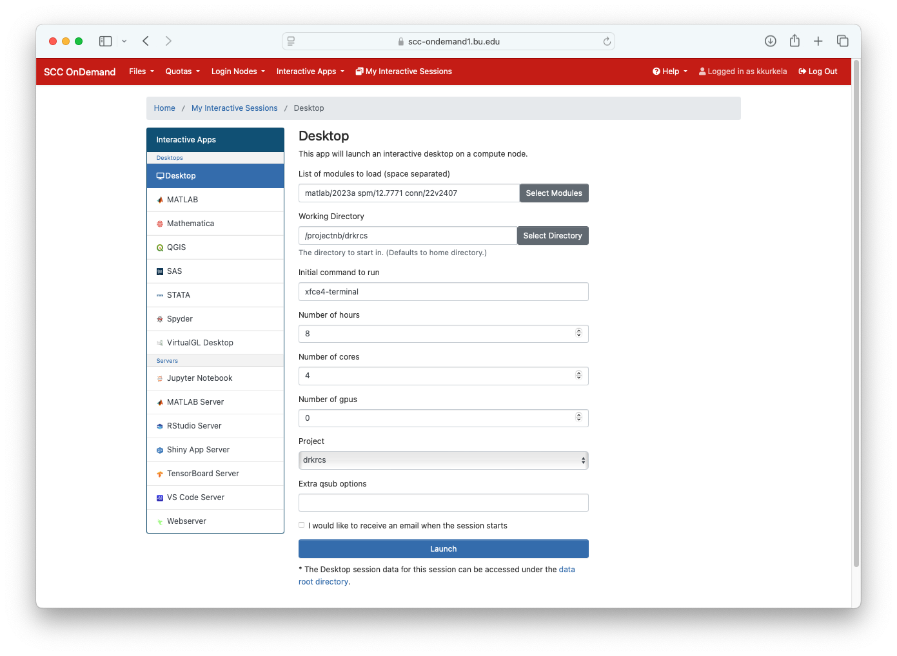
Configure and launch a desktop session
Select the modules:
matlab/2023a
spm/12.7771
conn/22v2407
Select a working directory (preferable a project directory)

Slide 11
Configure and launch a desktop session
Set the number of hours to 8
Set the number of cores to 1

Slide 12
Configure and launch a desktop session
Make sure number of gpus is set to 0
Select a project to attribute this job to

Slide 13
Configure and launch a desktop session
Click “launch” to request an interactive desktop job with these parameters

Slide 14
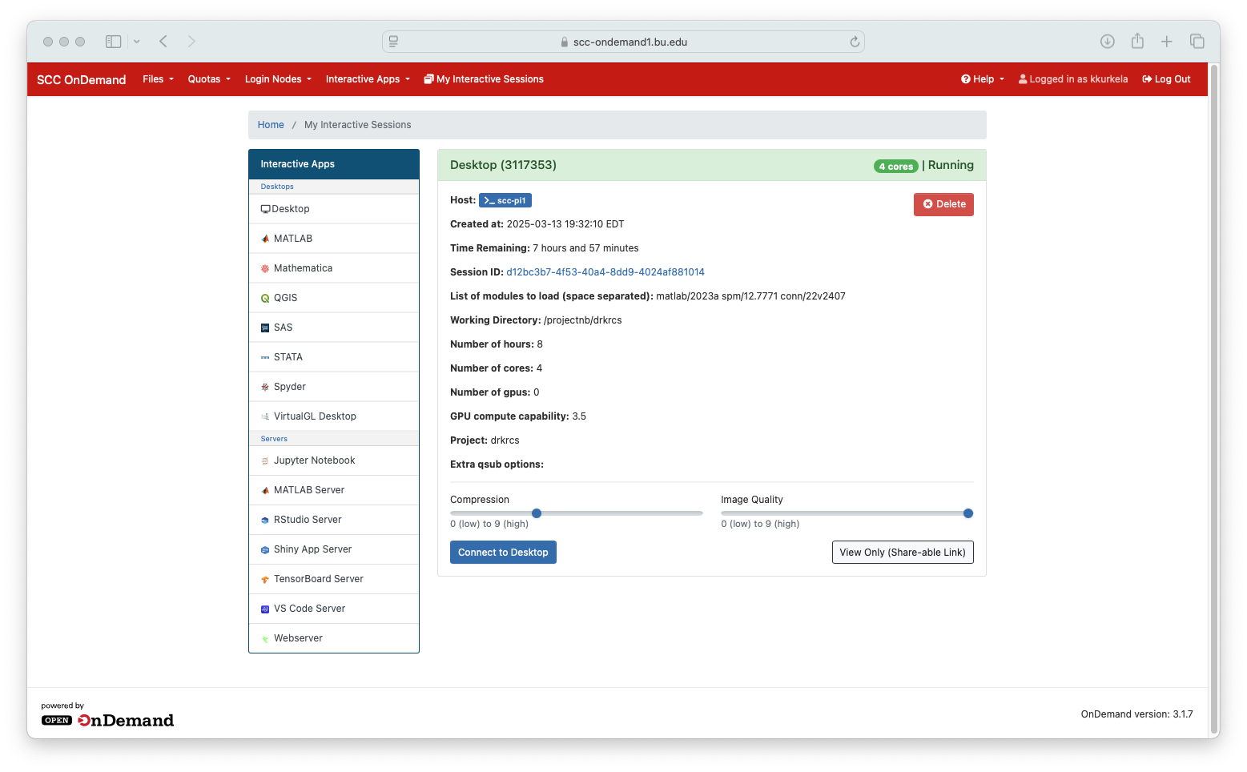
Wait for the job to queue
Wait for the job to queue. This may take a minute or two.
Click “connect to desktop”

Slide 15
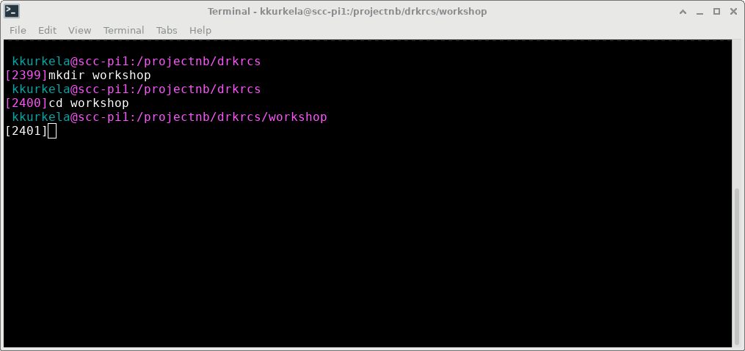
Create a workshop directory
Create a new directory where you will work in
> mkdir conn_workshop
Change the working directory
> cd conn_workshop

Slide 16
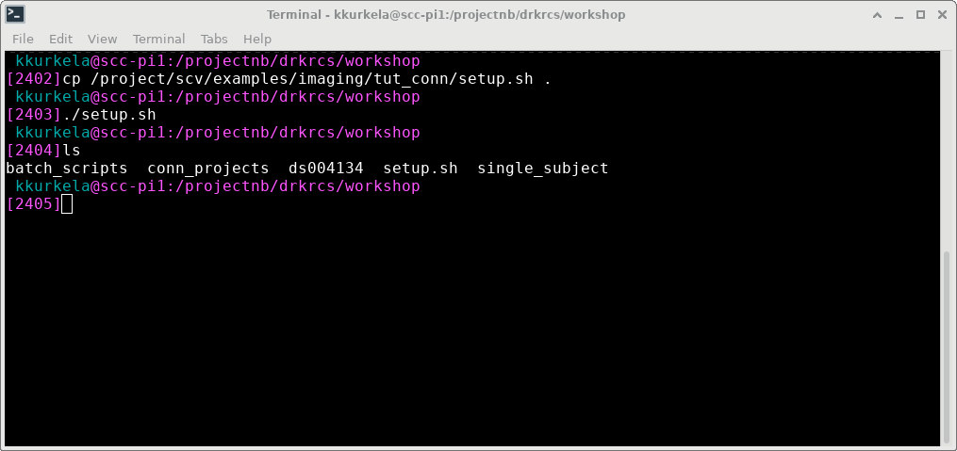
Run the setup command
copy the setup scripts
> cp
Run the setup script
> ./setup.sh
Make sure that your directory looks like mine
> ls

Slide 17
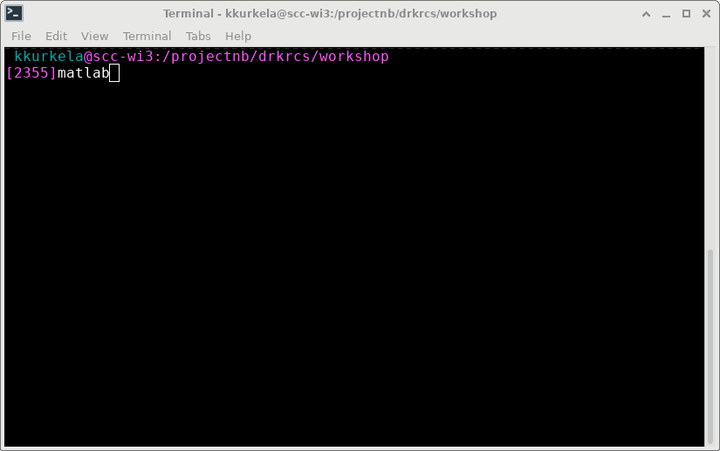
Launch MATLAB
Launch matlab:
> matlab

Slide 18
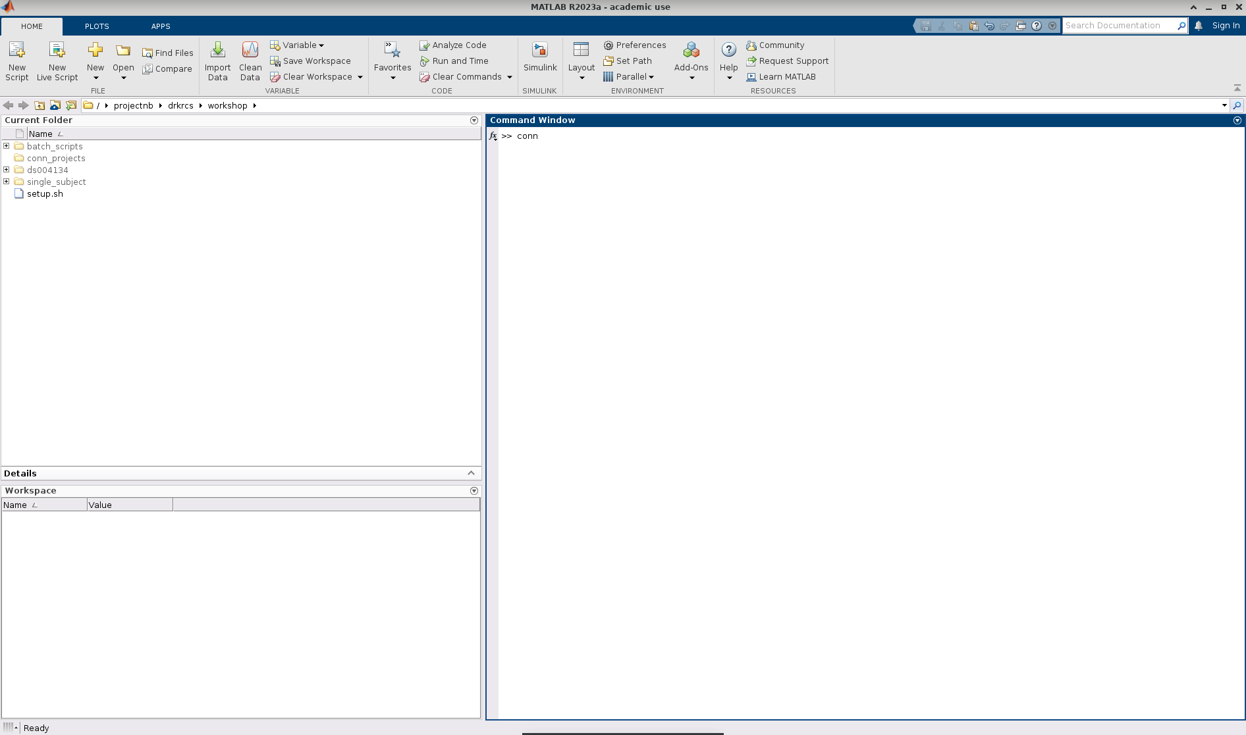
Launch CONN
Within the MATLAB command window:
>> conn

Slide 19
Workshop Overview
What is the CONN toolbox?
Workshop Setup
CONN GUI Overview
Setup
Denoising
First Level Analysis
Batch Scripting and Parallel Processing

Slide 20
Workshop Overview
What is the CONN toolbox?
Workshop Setup
CONN GUI Overview
Setup
Denoising
First Level Analysis
Batch Scripting and Parallel Processing

Slide 21
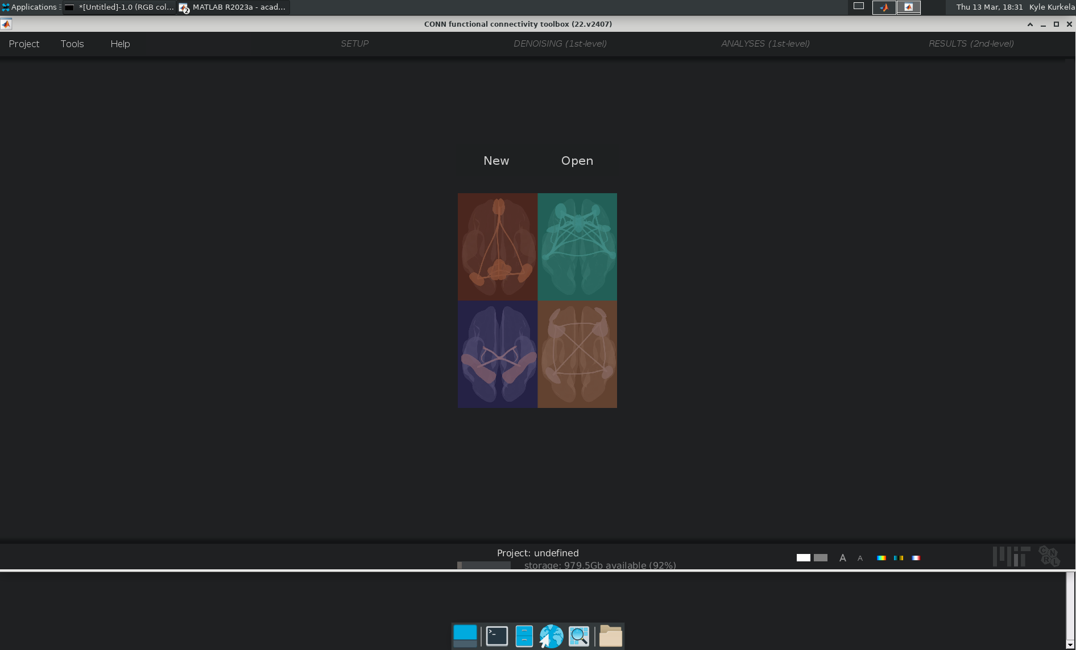
The CONN GUI
Notes:
Overview – what everything is
Project dropdown = how to open, save, close, and import data into a conn project.
Tools Dropdown = various tools. Main ones I used are GUI options and HPC options.
Help Dropdown = Takes you to CONN’s help resources.
Setup – Results (2nd level) tabs = these tabs become visible once you ”run” the previous section. “Setup” becomes available once you create a project, Denoise once you run setup, etc.

Slide 22
Processing options. Only become available once you run the previous step
Open, create new, close, or import data into a new conn ”project”
Links to online documentation
Misc tools and configuration settings

Slide 23
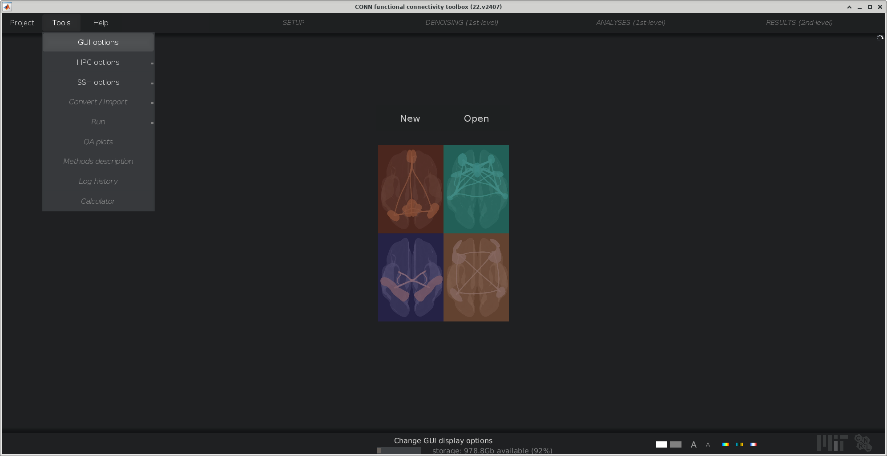
GUI Options
Notes:
Step 1: Increase the size of the text under tools
Tools Dropdown --> GUI Options → Type 14 in the GUI font size (pts): box. Hit apply to apply it.
Feel free to play around with the other options. You can change the background for example to be a light or dark theme. I like the dark theme.

Slide 24
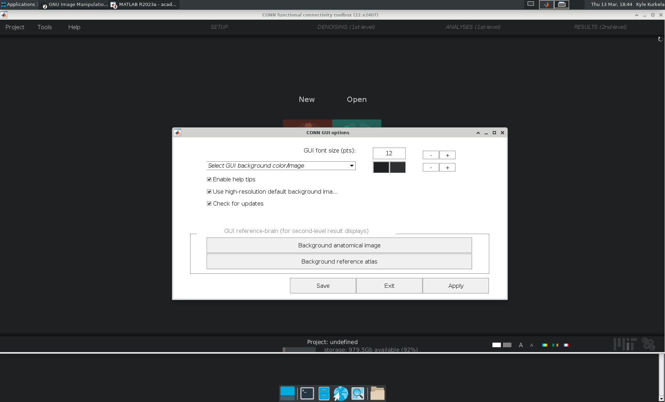
GUI Options
Notes:
Step 1: Increase the size of the text under tools
Tools Dropdown --> GUI Options → Type 14 in the GUI font size (pts): box. Hit apply to apply it.
Feel free to play around with the other options. You can change the background for example to be a light or dark theme. I like the dark theme.

Slide 25
Workshop Overview
What is the CONN toolbox?
Workshop Setup
A Walk around the CONN GUI
Setup
Denoising
First Level Analysis
Batch Scripting and Parallel Processing

Slide 26
Workshop Overview
What is the CONN toolbox?
Workshop Setup
A Walk around the CONN GUI
Setup
Denoising
First Level Analysis
Batch Scripting and Parallel Processing

Slide 27
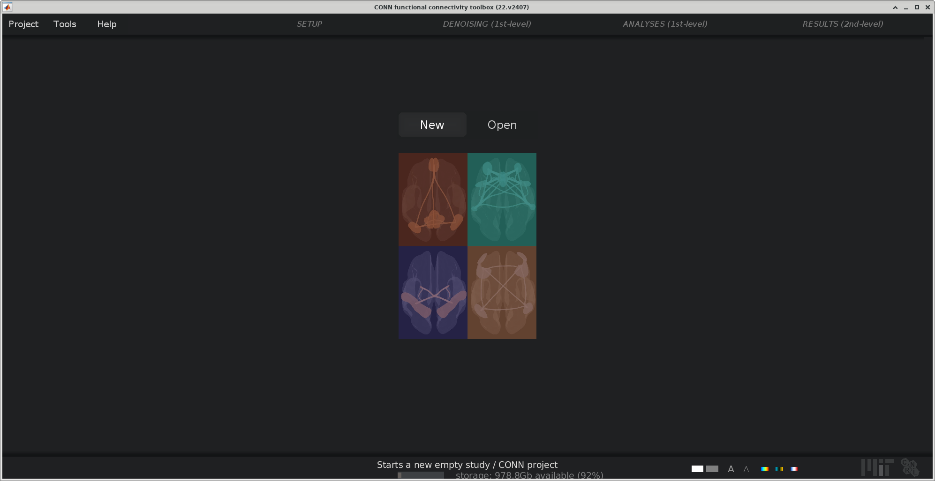
Create a blank project
Select “New”
Save the the project’s conn.mat file as “conn_blank.mat” to the “con_projects” directory.
Notes:
Create a new blank project using Project → New (Blank).
Talk about how the GUI is responsive, show how new subjects and sessions are dynamically added.
Show how you can import a single T1 image and functional images using the import interfaces.
Only show how to do Structural and Functional using the import interfaces – quickly move on to import tools
Go to “Project” → “Close” to close this project. Do not save.

Slide 28
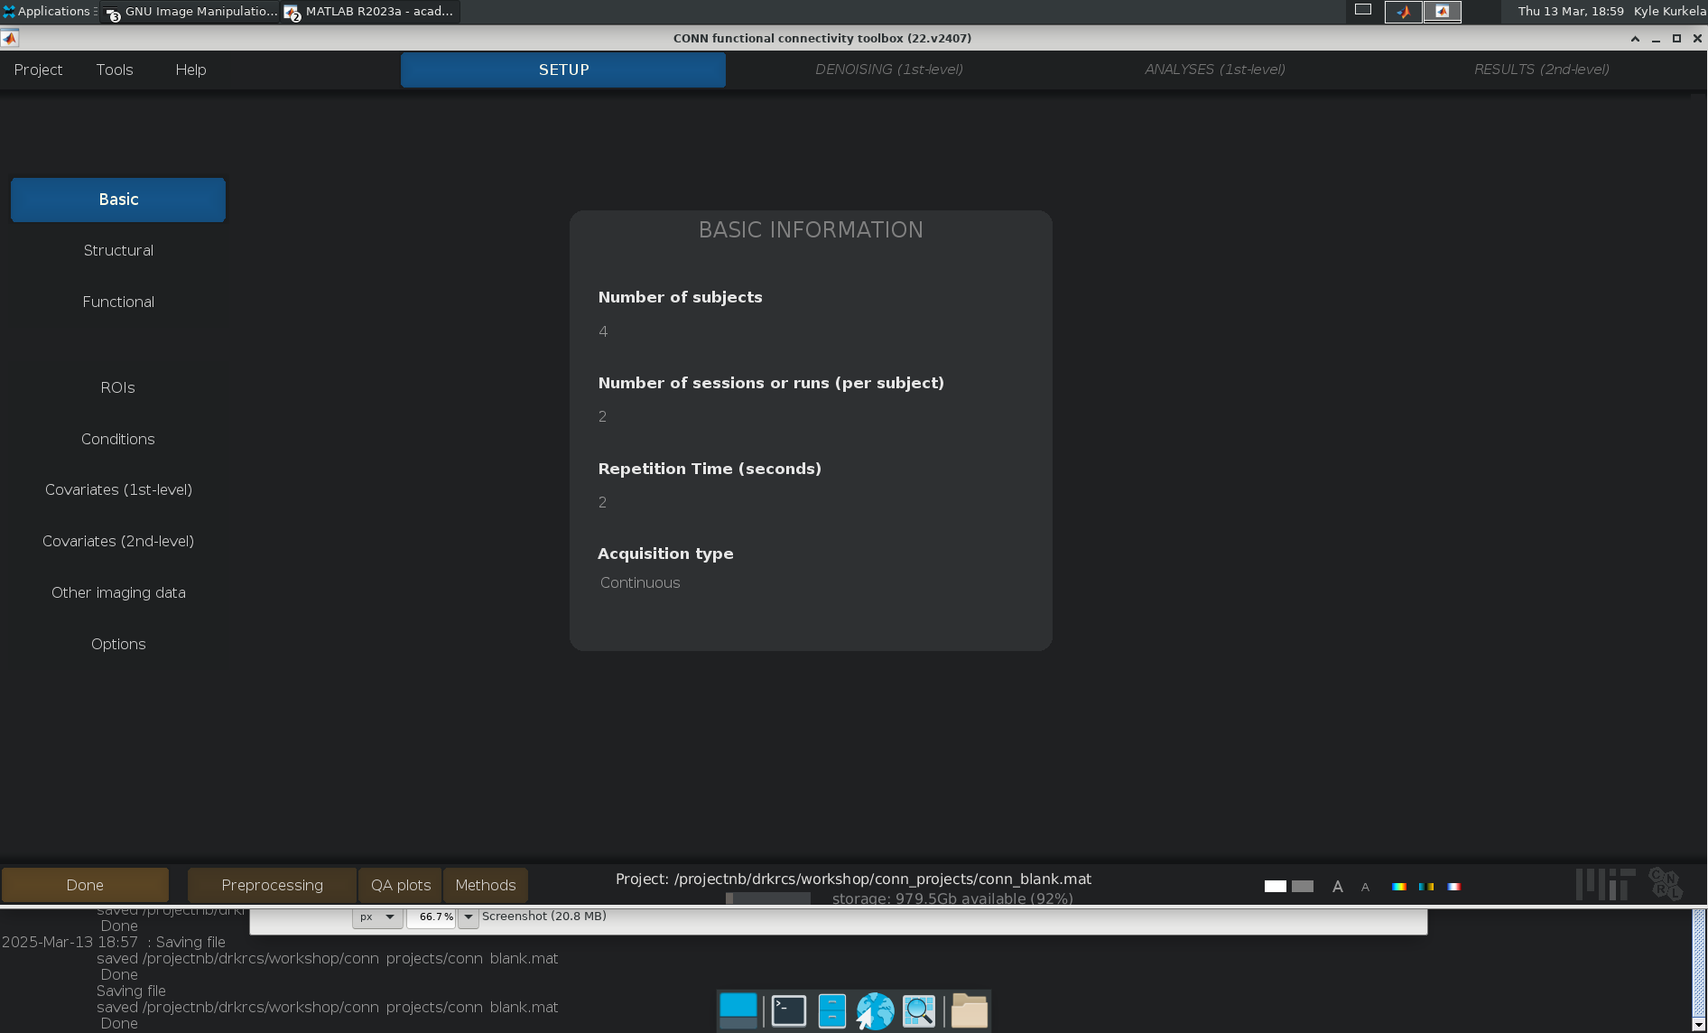
The Setup Tab – Basic
Try setting the number of subjects to 4
Setting the number of sessions to 2
Notes:
The Basic tab holds options:
Number of subjects, number of sessions per subject, RT, and Acquision
What is neat about this GUI is that it is “live”. As soon as you select an option, it will update other areas of the interface accordingly. To understand what I mean, lets navigate to the structural tab. Observe that there is only one subject. If we add a second subject in the basic tab and then navigate back to the structural tab, you will see a new field for subject 2.
Only additional thing to note here is that you can set RT to NaN to have it try to automatically read the TR from BIDS json sidecar files. More on that to come.
For now, everyone switch the number of subjects to 4 and the number of sessions per subject to 2.
Observe how the Number of session field now becomes a vector. Each entry corresponds to a subject from left to right.

Slide 29
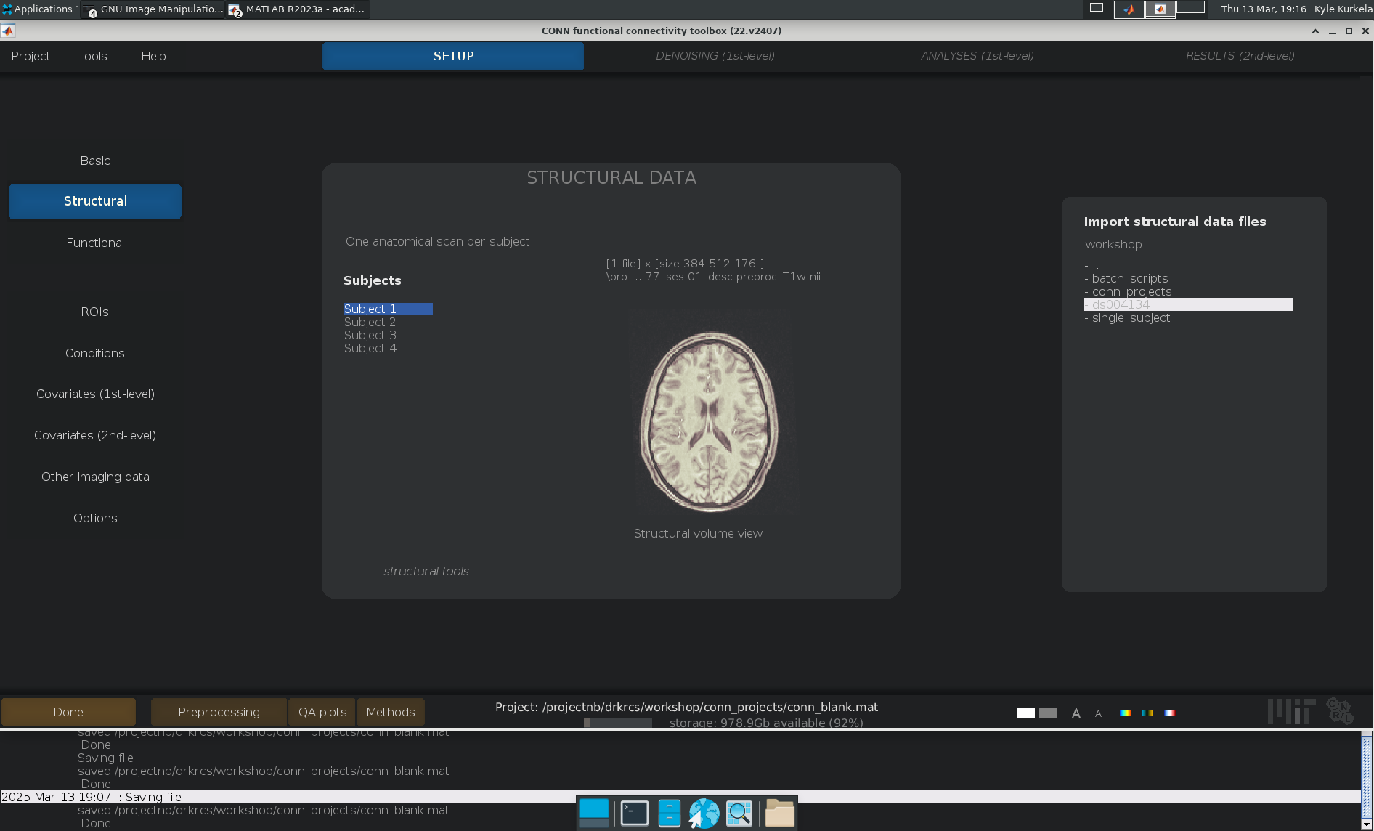
The Setup Tab – Structural
Use the import tool to assign the anatomical T1w images to our four subjects
Play around with some of the viewing tools
Notes:
Create a new blank project using Project → New (Blank).
Talk about how the GUI is responsive, show how new subjects and sessions are dynamically added.
Show how you can import a single T1 image and functional images using the import interfaces.
Only show how to do Structural and Functional using the import interfaces – quickly move on to import tools
Go to “Project” → “Close” to close this project. Do not save.

Slide 30
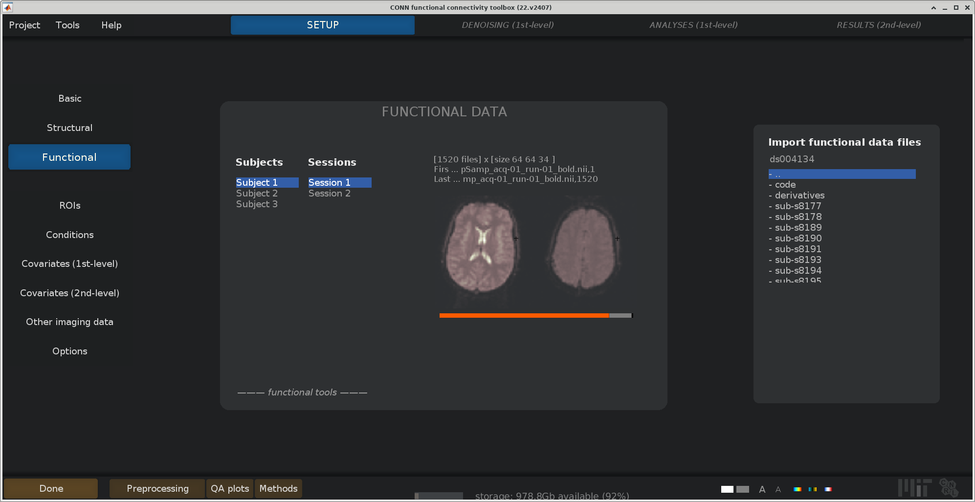
The Setup Tab – Functional
Use the import tool to assign the functional scan runs to each subject/session
Advanced import tool usage
Play around with some of the viewing tools
Notes:
You can use a combination of the “find” and the “filter” commands to automatically pull out all files matching a particular regular expression.
Create a new blank project using Project → New (Blank).
Talk about how the GUI is responsive, show how new subjects and sessions are dynamically added.
Show how you can import a single T1 image and functional images using the import interfaces.
Only show how to do Structural and Functional using the import interfaces – quickly move on to import tools
Go to “Project” → “Close” to close this project. Do not save.

Slide 31
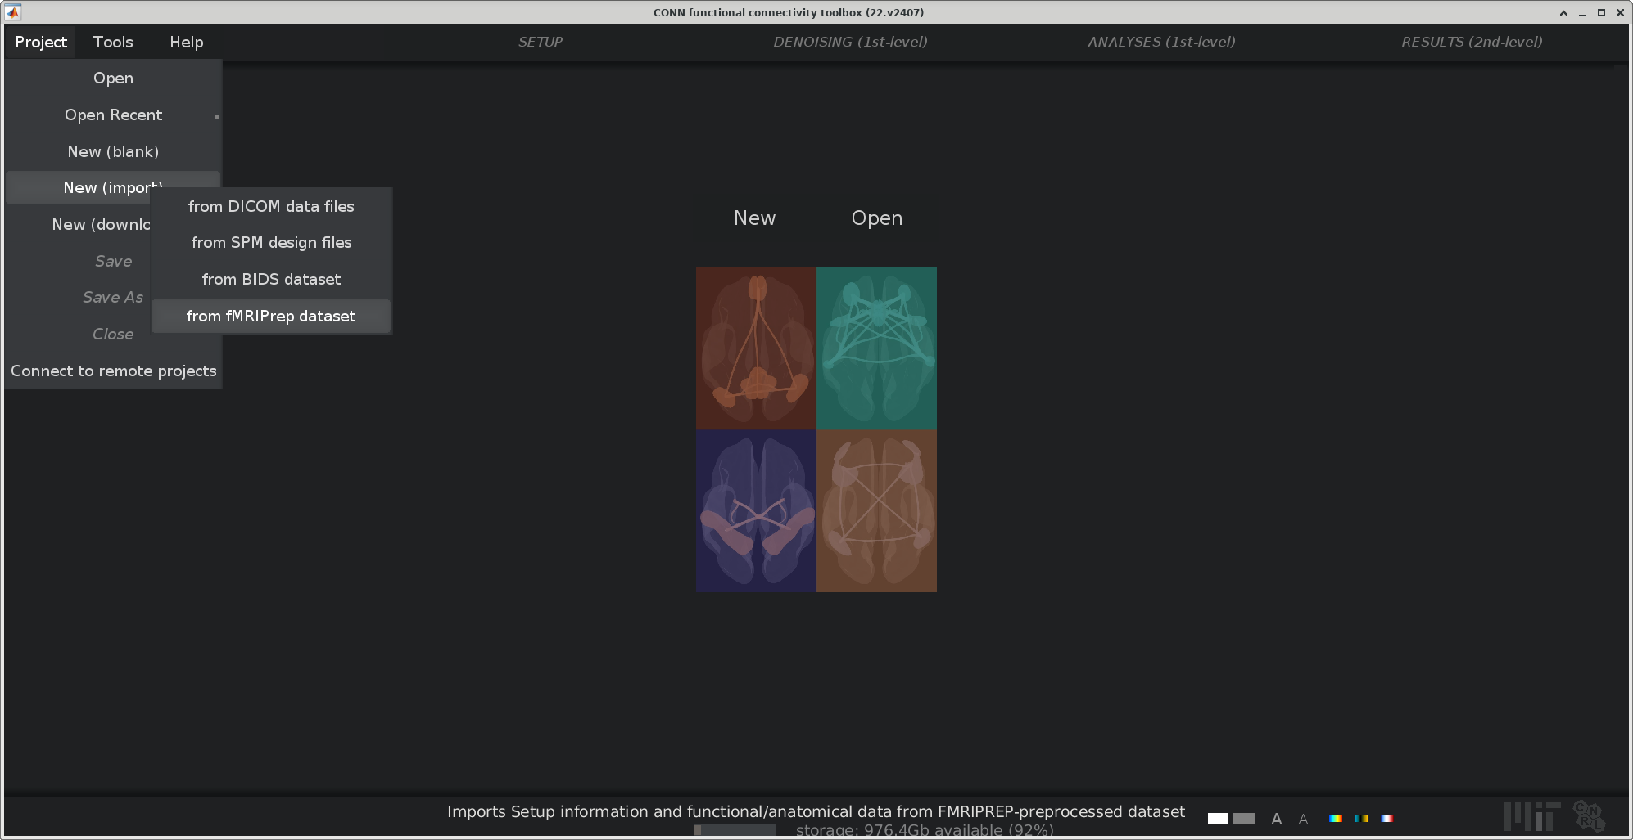
Project import tools -- FMRIPREP
Project
New (Import)
From fMRIPrep dataset
Notes:
Strengths:
Automatically imports subject specific masks, nuisance regressors
Does not load in the “task.tsv” for conditions
1. “Project” -> “New (Import)” -> “from fMRIprep dataset”
2. Save a project conn_*.mat file where ever you like
3. Navigate to the fmriprep folder with the “single_subject” directory:
”single_subject” ---> “derivatives” ---> “fmriprep”
4. Hit select
5. Hit OK to proceed
6. Underneath the “import” option select “import selected files” the other options create unnecessary copies of your data in my opinion.
7. Select blue ”import”
8. Hit OK to proceed
You data has been imported!!
9. Make sure to save your project

Slide 32
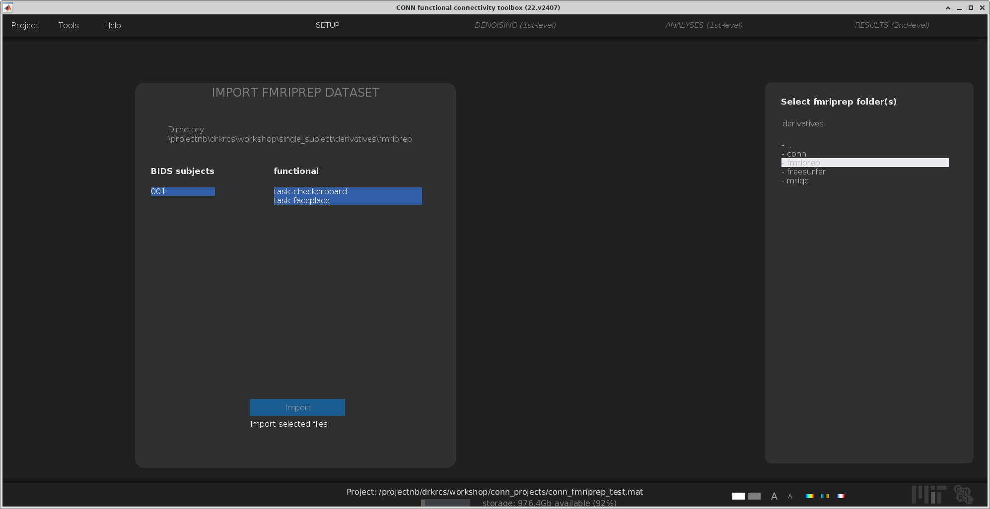
Project import tools -- FMRIPREP
Use conn’s file/directory selector tool to select our example data’s fmriprep directory:
./ds/derivatives/fmriprep
Highlight the directory and hit select
Hit OK to proceed
Make sure “import selected files” option is selected
Hit blue import button
Hit OK to proceed
Notes:
Strengths:
Automatically imports subject specific masks, nuisance regressors
Does not load in the “task.tsv” for conditions
1. “Project” -> “New (Import)” -> “from fMRIprep dataset”
2. Save a project conn_*.mat file where ever you like
3. Navigate to the fmriprep folder with the “single_subject” directory:
”single_subject” ---> “derivatives” ---> “fmriprep”
4. Hit select
5. Hit OK to proceed
6. Underneath the “import” option select “import selected files” the other options create unnecessary copies of your data in my opinion.
7. Select blue ”import”
8. Hit OK to proceed
You data has been imported!!
9. Make sure to save your project

Slide 33
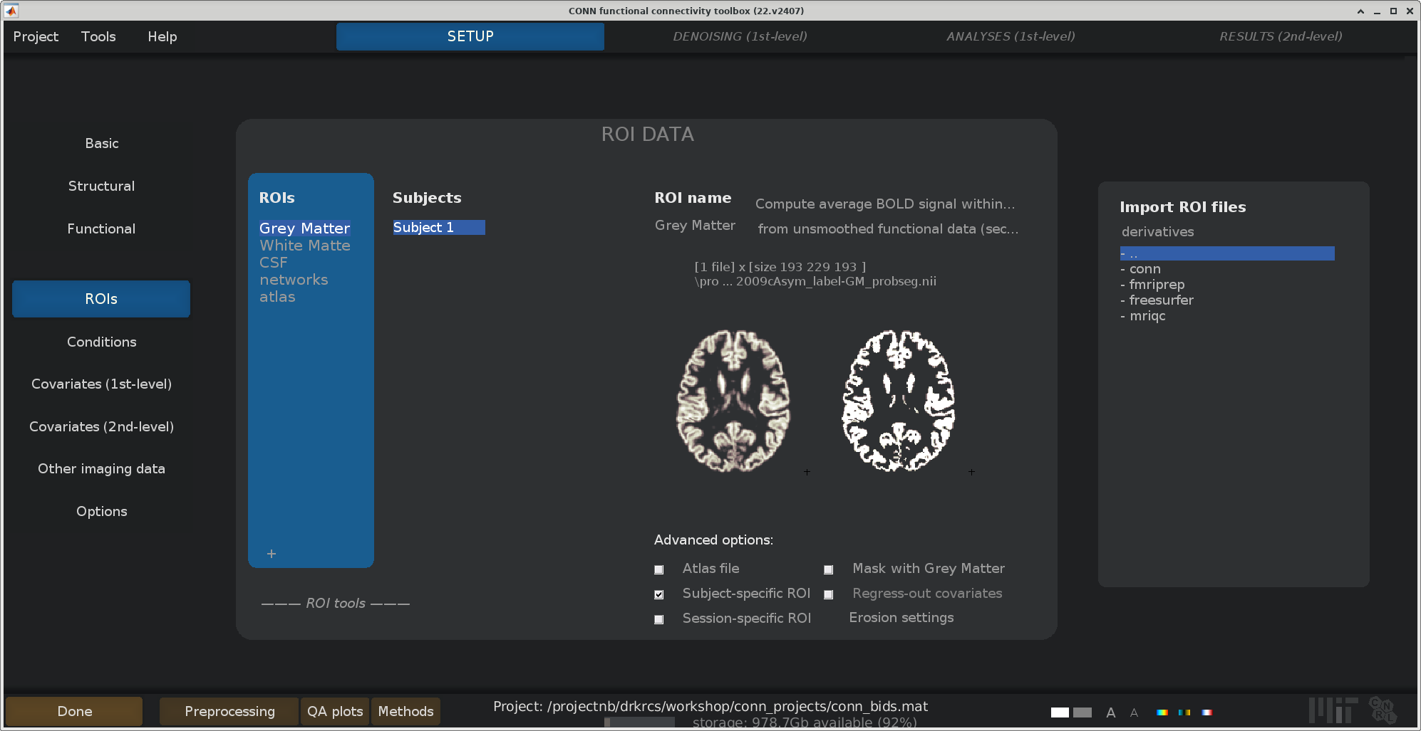
Setup --ROIs
No changes needed
This tab allows you to upload more ROI images and atlases
For example, for my dissertation, I used the Schafer Atlas

Slide 34
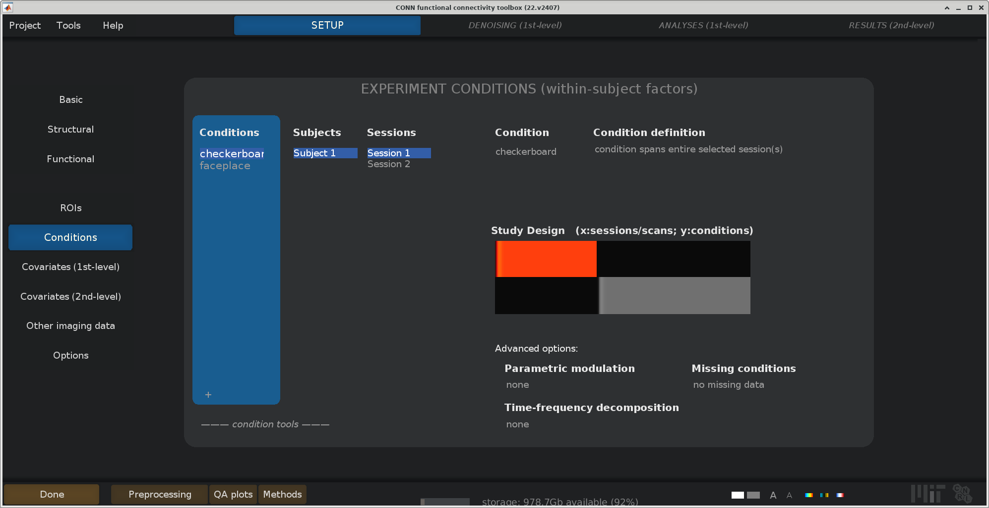
Setup --Conditions
No changes needed
There are not events files for my small, 1 subject example dataset

Slide 35
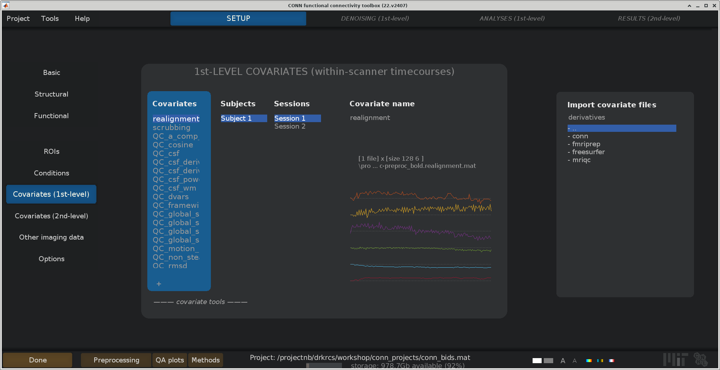
Setup–Covariates (1st-Level)
The really nice thing about the fmriprep import tool is that it automatically loads in fmriprep’s nuisance regressors!
There should be nothing to change here

Slide 36
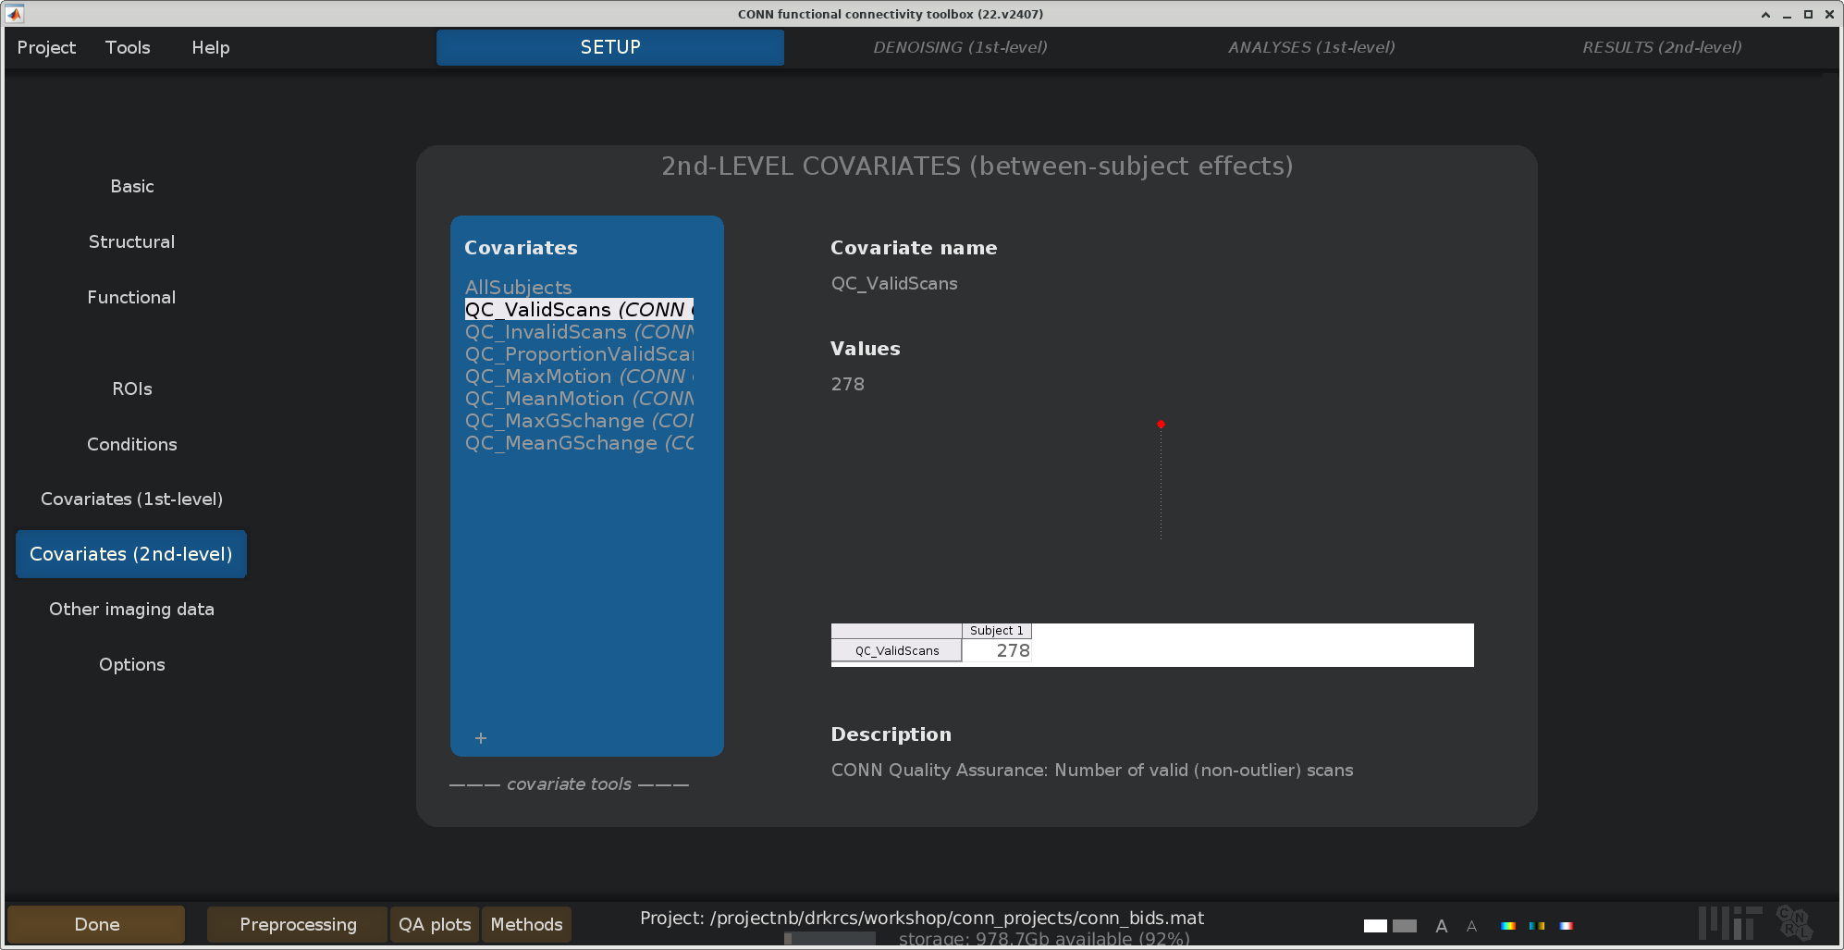
Setup–Covariates (2nd-Level)
The FMRIPREP import tool also automatically creates several second level regressors based on QC measures
You can enter other between subjects covariates here
E.g., age, gender, education
We will leave this be for our tutorial

Slide 37
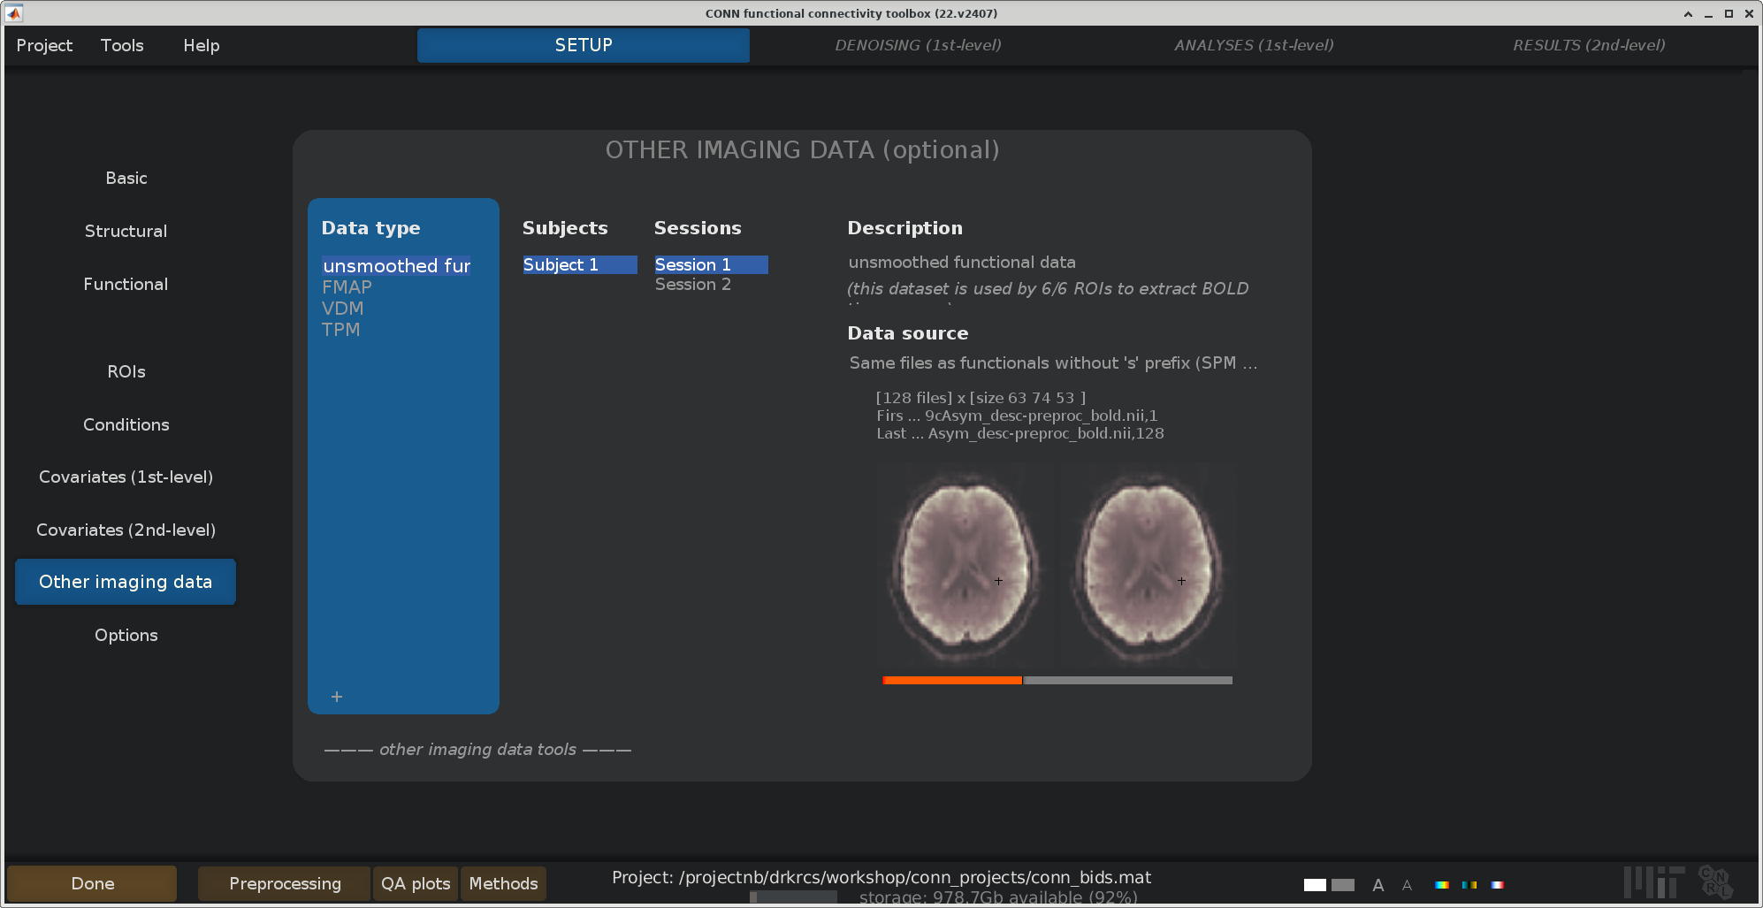
Setup–Other imaging data
You can attach other data to your project, including field maps, displacement maps, and the like
Some of this data is used by CONN’s preprocessing pipelines. I have rarely used it
We can leave this be for now

Slide 38
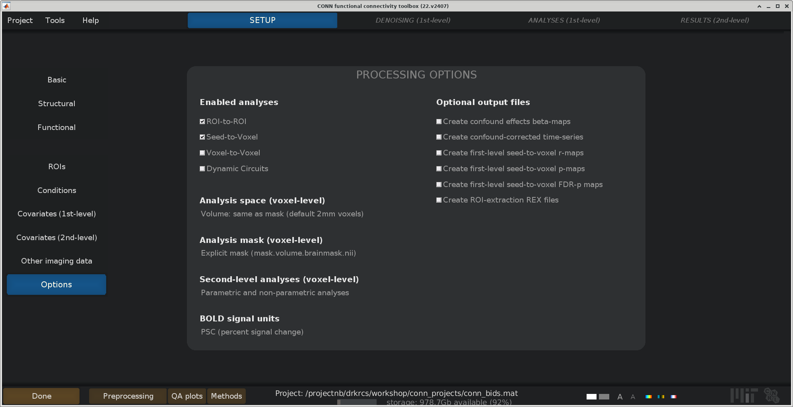
Setup–Options
By default, CONN enables all analyses
Voxel-to-voxel analyses can be computationally intensive. Let’s run ROI-to-ROI and Seed-to-Voxel analyses
Other options you could change here could be utilizing subject specific brain masks (Analysis mask) and checking the boxes to write out intermediate steps (Optional output files)

Slide 39
Run Setup
Run CONN’s setup routine (mainly importing data from NIFTI/text into MATLAB *.mat files) by pressing “done”

Slide 40
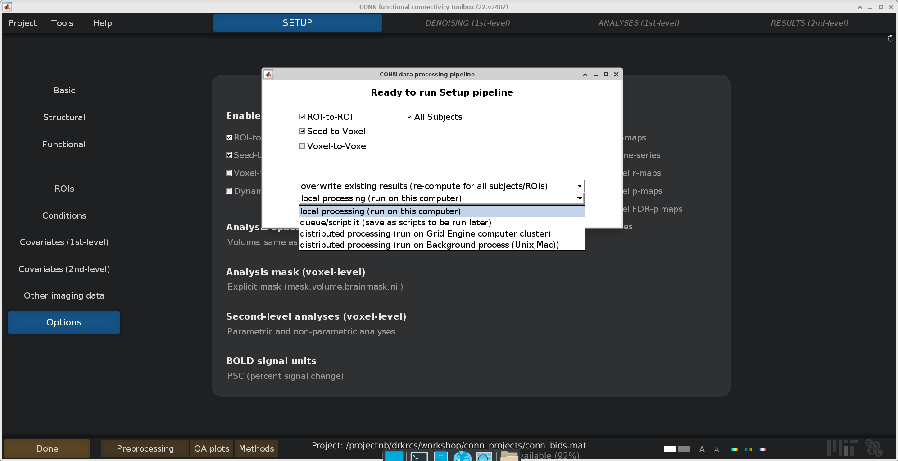
Run Setup
After hitting done on any of CONN’s processing steps, you will be presented with this dialogue box.
The import option is the last one:
local processing – use 1 core on this computer. Run serially. Slowest option
queue/script –generates a matlab script to run this
Notes:
Hit “Done”
Hit “local proceeding (run on this computer)”
A note on how conn does processing.
You have 3 options:
1. Submit these as batch scripts
2. Use the resource on the node that you are on
3. Use just a single node
When should you take advantage of distributed processing? When you have a LOT of subjects.
Hit “Start”. Will take a few minutes

Slide 41
Run Setup
Distributed (parallel) processing options:
Grid Engine computer cluster = this option will automatically break your project up into N “chunks” and create a batch job for each “chunk”. It then submits these jobs to the SCC’s scheduler and waits for them to finish
Background process (Unix, Mac) = utilizes the cores of the current computer. Runs each of N “chunks” of subjects on a different cpu. Can be used on an interactive desktop job with sufficient resources
Notes:
Hit “Done”
Hit “local proceeding (run on this computer)”
A note on how conn does processing.
You have 3 options:
1. Submit these as batch scripts
2. Use the resource on the node that you are on
3. Use just a single node
When should you take advantage of distributed processing? When you have a LOT of subjects.
Hit “Start”. Will take a few minutes

Slide 42
Workshop Overview
What is the CONN toolbox?
Workshop Setup
A Walk around the CONN GUI
Setup
Denoising
First Level Analysis
Batch Scripting and Parallel Processing

Slide 43
Workshop Overview
What is the CONN toolbox?
Workshop Setup
A Walk around the CONN GUI
Setup
Denoising
First Level Analysis
Batch Scripting and Parallel Processing

Slide 44
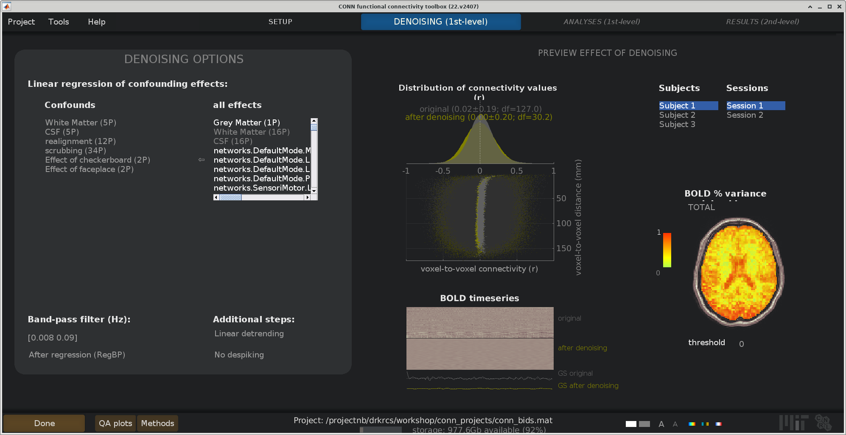
The Denoising Tab
The denoising tab will become available once the setup process finishes running
The tab contains various figures previewing the effect of denoising
The only change we will make here is to add global signal to the list of confounds to perform global signal regression (somewhat controversial)
Notes:
Be able to explain when to include task effects at this point. Point to chapter two of my dissertation.
Explain global signal regression.
Have people add global signal regression to their analysis.
“Hit Done” to run denoising

Slide 45
Run Denoising
To run denoising, select done in the bottom left corner
You will get the same computation options dialogue as before
Notes:
Hit “Done”
Hit “local proceeding (run on this computer)”
A note on how conn does processing.
You have 3 options:
1. Submit these as batch scripts
2. Use the resource on the node that you are on
3. Use just a single node
When should you take advantage of distributed processing? When you have a LOT of subjects.
Hit “Start”. Will take a few minutes

Slide 46
Workshop Overview
What is the CONN toolbox?
Workshop Setup
A Walk around the CONN GUI
Setup
Denoising
First Level Analysis
Second Level Analysis
Batch Scripting and Parallel Processing

Slide 47
Workshop Overview
What is the CONN toolbox?
Workshop Setup
A Walk around the CONN GUI
Setup
Denoising
First Level Analysis
Second Level Analysis
Batch Scripting and Parallel Processing

Slide 48
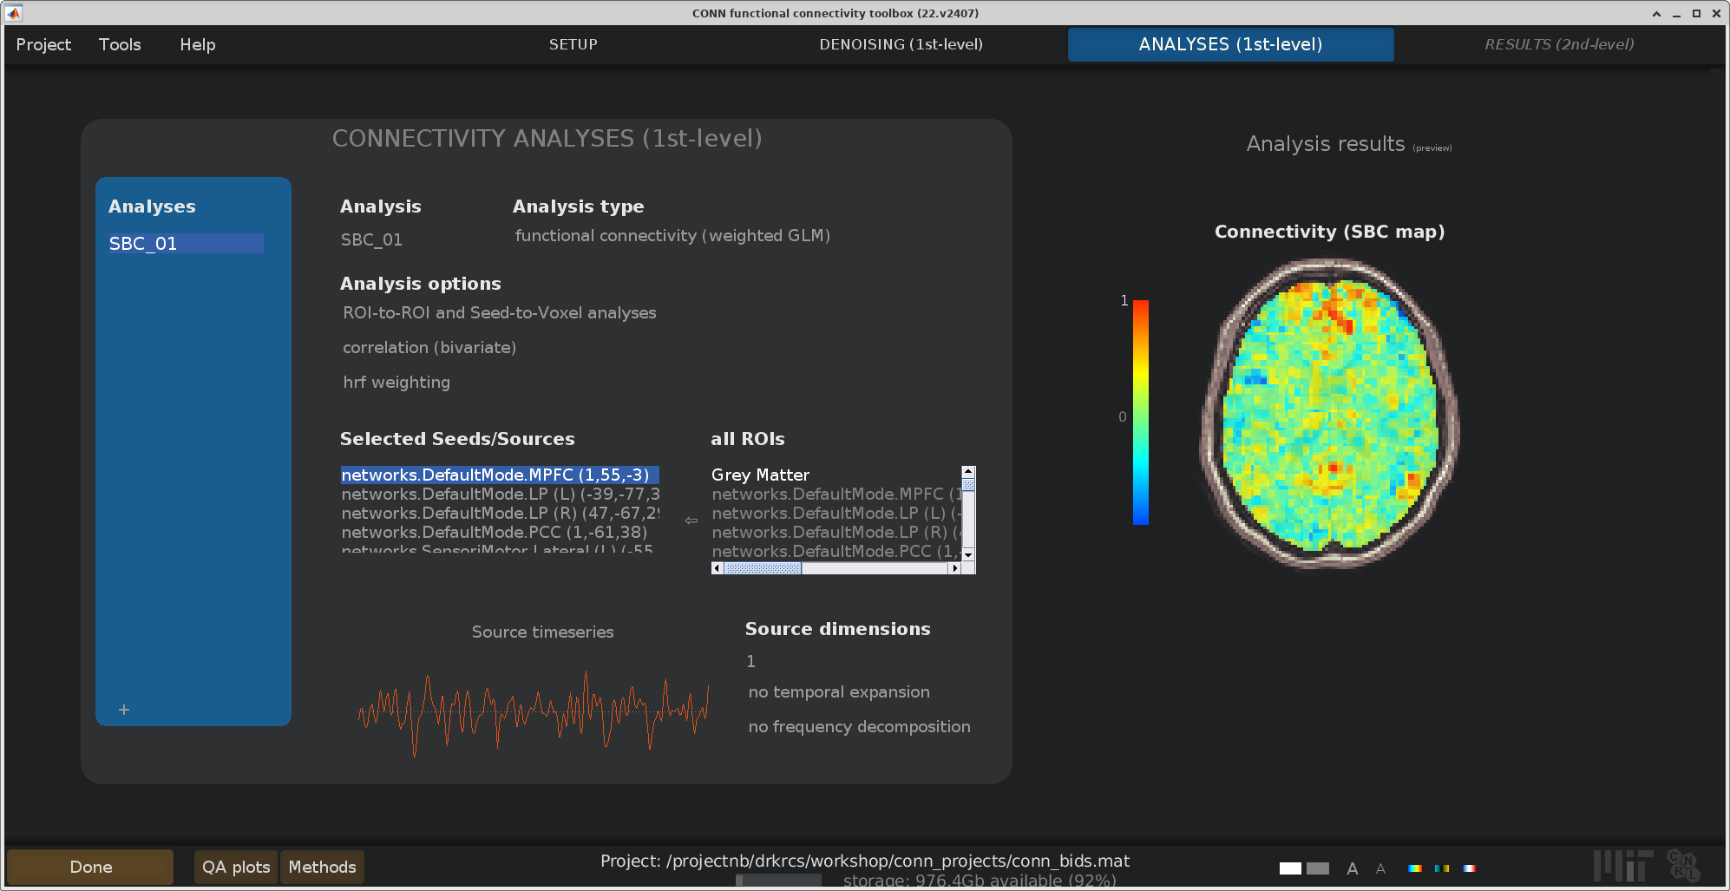
First level
Like with denoising, CONN will preview the results of certain analyses
Let’s select correlation (bivariate), no weighting, and use the network ROIs
Notes:
Be able to explain when to include task effects at this point. Point to chapter two of my dissertation.
Explain global signal regression.
Have people add global signal regression to their analysis.
“Hit Done” to run denoising

Slide 49
Run First Level
To run a first-level analysis, select done in the bottom left corner
You will get the same computation options dialogue as before
Notes:
Hit “Done”
Hit “local proceeding (run on this computer)”
A note on how conn does processing.
You have 3 options:
1. Submit these as batch scripts
2. Use the resource on the node that you are on
3. Use just a single node
When should you take advantage of distributed processing? When you have a LOT of subjects.
Hit “Start”. Will take a few minutes

Slide 50
Workshop Overview
What is the CONN toolbox?
Workshop Setup
A Walk around the CONN GUI
Setup
Denoising
First Level Analysis
Second Level Analysis
Batch Scripting and Parallel Processing

Slide 51
Workshop Overview
What is the CONN toolbox?
Workshop Setup
A Walk around the CONN GUI
Setup
Denoising
First Level Analysis
Second Level Analysis
Batch Scripting and Parallel Processing

Slide 52
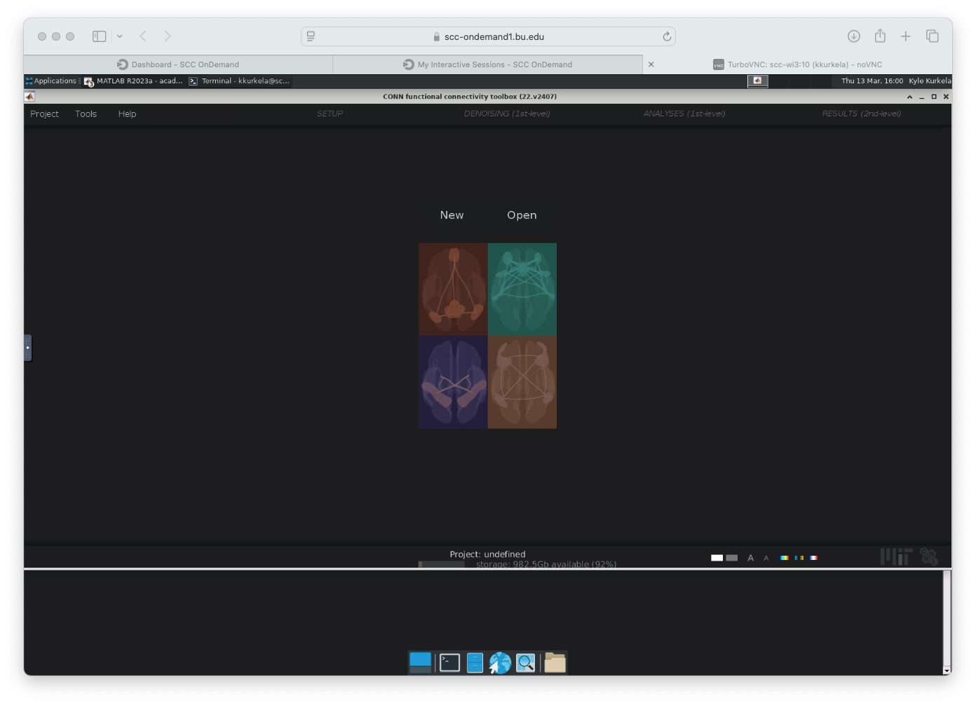
Second level
Notes:
Be able to explain when to include task effects at this point. Point to chapter two of my dissertation.
Explain global signal regression.
Have people add global signal regression to their analysis.
“Hit Done” to run denoising

Slide 53
Run second level
Notes:
Hit “Done”
Hit “local proceeding (run on this computer)”
A note on how conn does processing.
You have 3 options:
1. Submit these as batch scripts
2. Use the resource on the node that you are on
3. Use just a single node
When should you take advantage of distributed processing? When you have a LOT of subjects.
Hit “Start”. Will take a few minutes

Slide 54
Workshop Overview
What is the CONN toolbox?
Workshop Setup
A Walk around the CONN GUI
Setup
Denoising
First Level Analysis
Batch Scripting and Parallel Processing

Slide 55
Workshop Overview
What is the CONN toolbox?
Workshop Setup
A Walk around the CONN GUI
Setup
Denoising
First Level Analysis
Batch Scripting and Parallel Processing

Slide 56
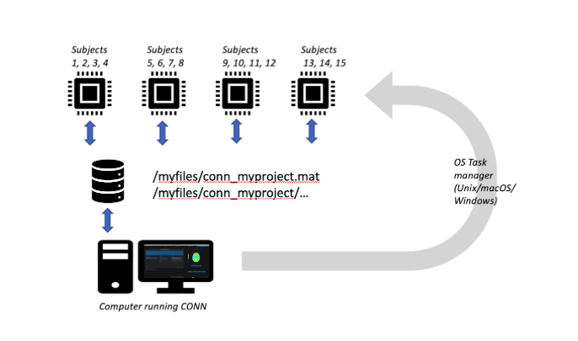
CONN’s Parallel Processing

Slide 57
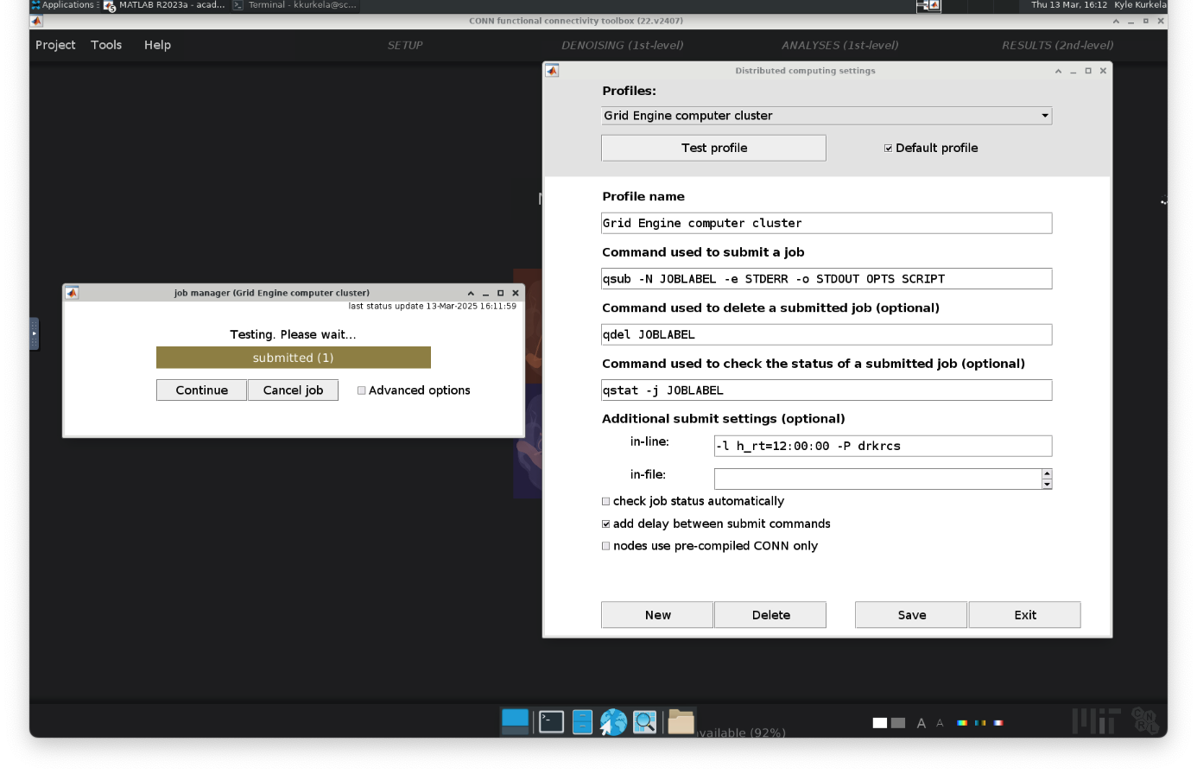
Test the HPC Configuration
Notes:
Step 2: Set up and test the parallel profile
Tools Dropdown → HPC Config
Make sure “Grid engine computer cluster” is your default profile
Make sure to add -P YOUR_PROJECT_NAME to the in-line submit setting
We can quickly test configuration using the test option. This will take a few minutes.
If we page over to a new workspace and open a terminal, you can use the “qstat -u” command to see that your job is submitted/waiting in the queue

Slide 58
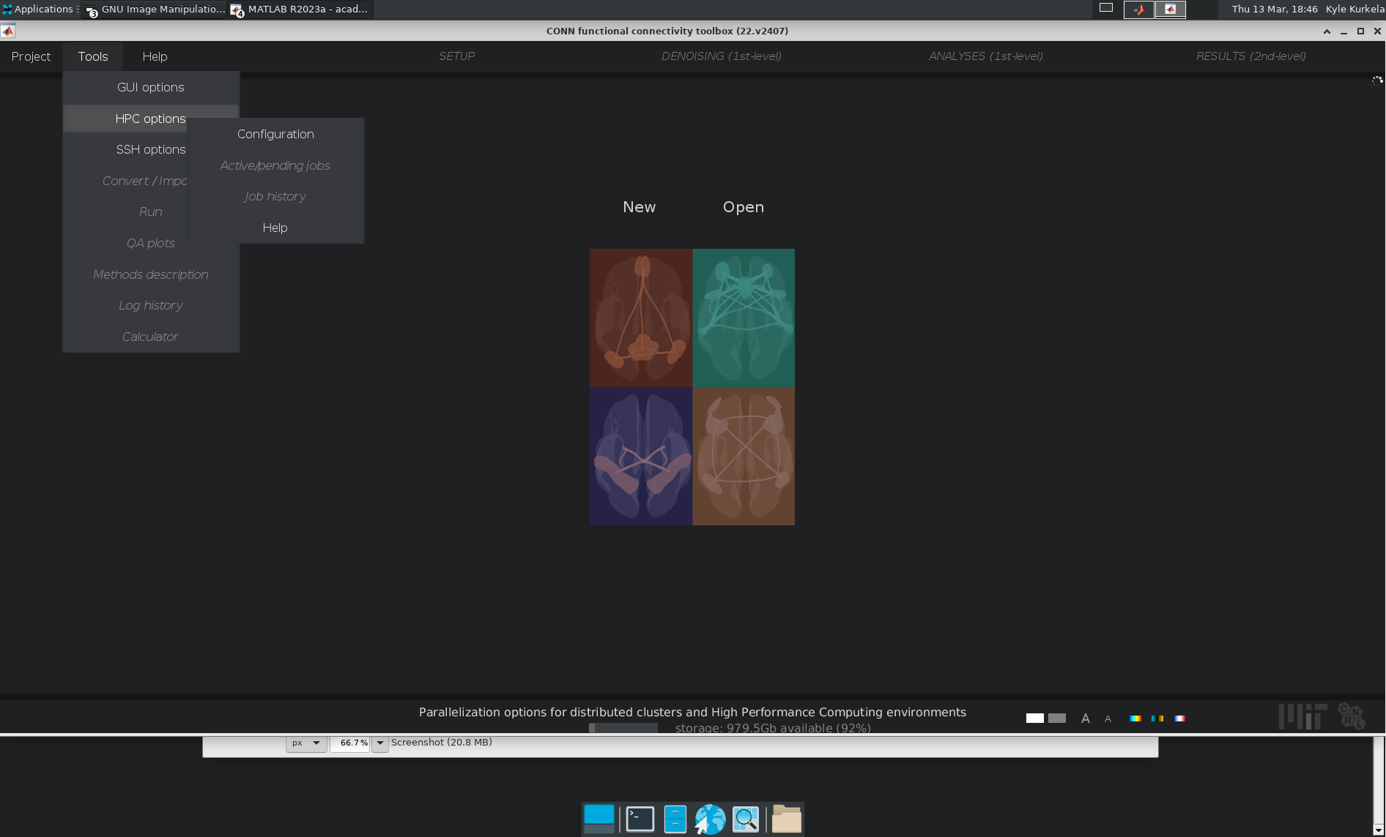
Test the HPC Configuration
Notes:
Step 2: Set up and test the parallel profile
Tools Dropdown → HPC Config
Make sure “Grid engine computer cluster” is your default profile
Make sure to add -P YOUR_PROJECT_NAME to the in-line submit setting
We can quickly test configuration using the test option. This will take a few minutes.
If we page over to a new workspace and open a terminal, you can use the “qstat -u” command to see that your job is submitted/waiting in the queue

Slide 59
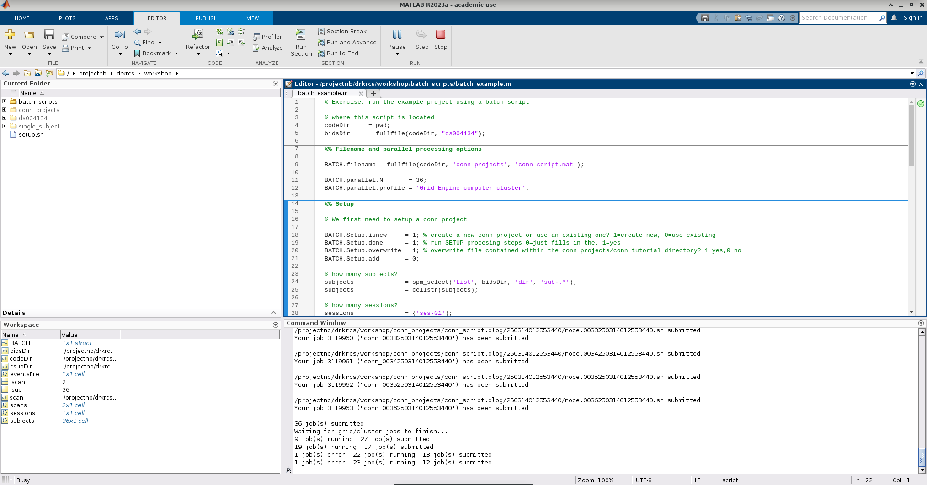
Batch Scripting Example
Notes:
The intimate details and MATLAB specific programming are outside the scope of todays workshop.
I would like to show you guys how this script basically works and how it interacts with the Grid Engine batch system.

Slide 60
External CONN Resources
The CONN Website:
https://web.conn-toolbox.org/home
The CONN Manual:
https://web.conn-toolbox.org/resources/conn-documentation/manual
Andy’s Brain Book:
https://web.conn-toolbox.org/tutorials#h.p_oUwCZYzbF9y8

Slide 61
Tutorial Resources
Code and example data will be made available here:
https://rcs.bu.edu/examples/imaging/tut_conn/
Questions? Comments? Concerns?
help@scc.bu.edu
kkurkela@bu.edu

