Slide 1
Introduction to the SCC and Linux
Dr. Kyle Kurkela
kkurkela@bu.edu
Research Computing Services
Information Services & Technology
Boston University
Notes:
Introduce myself

Slide 2
Class poll
How many of you have used a Linux operating system?
How many of you have heard of/have used the SCC?
Computer programming experience?
Know what a variable is?
Know what a script is?
Notes:
Informal poll

Slide 3
Class Overview
What is the SCC?
How does the SCC work?
Why the SCC?
Connecting to the SCC
The Linux command line
The Linux directory hierarchy and navigation
Copying files
Unzipping files
Viewing raw MRI data with fsleyes
Preprocessing your MRI data with fmriprep
Notes:
This is what we will be covering today.
I will lecture a little bit and we will connect to the SCC together and we will be introduced to some basic linux commands.

Slide 4
What is the SCC?
A linux cluster with over 1000 computers, 28000 processors, 400 GPUs and over 14 petabytes of storage.
Located in Holyoke, MA
A collaboration between 5 major universities in MA
Went into production in June, 2013
Has many of the most popular software packages for performing research – including many neuroimaging processing packages
Notes:
The SCC is a group of computers. They do not have monitors. They are not designed to have nice user interfaces – they are designed and optimized to compute heavy duty, usually scientific, computations.

Slide 5
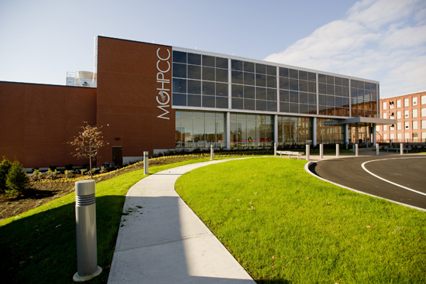
What is the SCC?
Notes:
The SCC is a group of computers. They do not have monitors. They are not designed to have nice user interfaces – they are designed and optimized to compute heavy duty, usually scientific, computations.

Slide 6
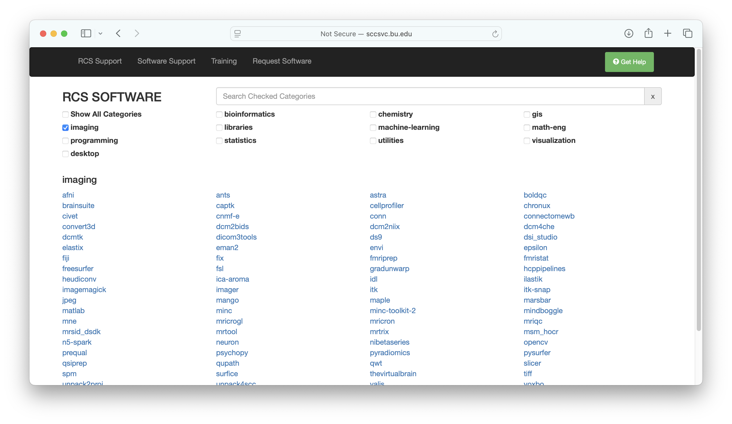
What is the SCC?
Notes:
The SCC is a group of computers. They do not have monitors. They are not designed to have nice user interfaces – they are designed and optimized to compute heavy duty, usually scientific, computations.

Slide 7
Workshop Overview
What is the SCC?
How does the SCC work?
Why the SCC?
Connecting to the SCC
The Linux command line
The Linux directory hierarchy and navigation
Copying files
Unzipping files
Viewing raw MRI data with fsleyes
Preprocessing your MRI data with fmriprep

Slide 8
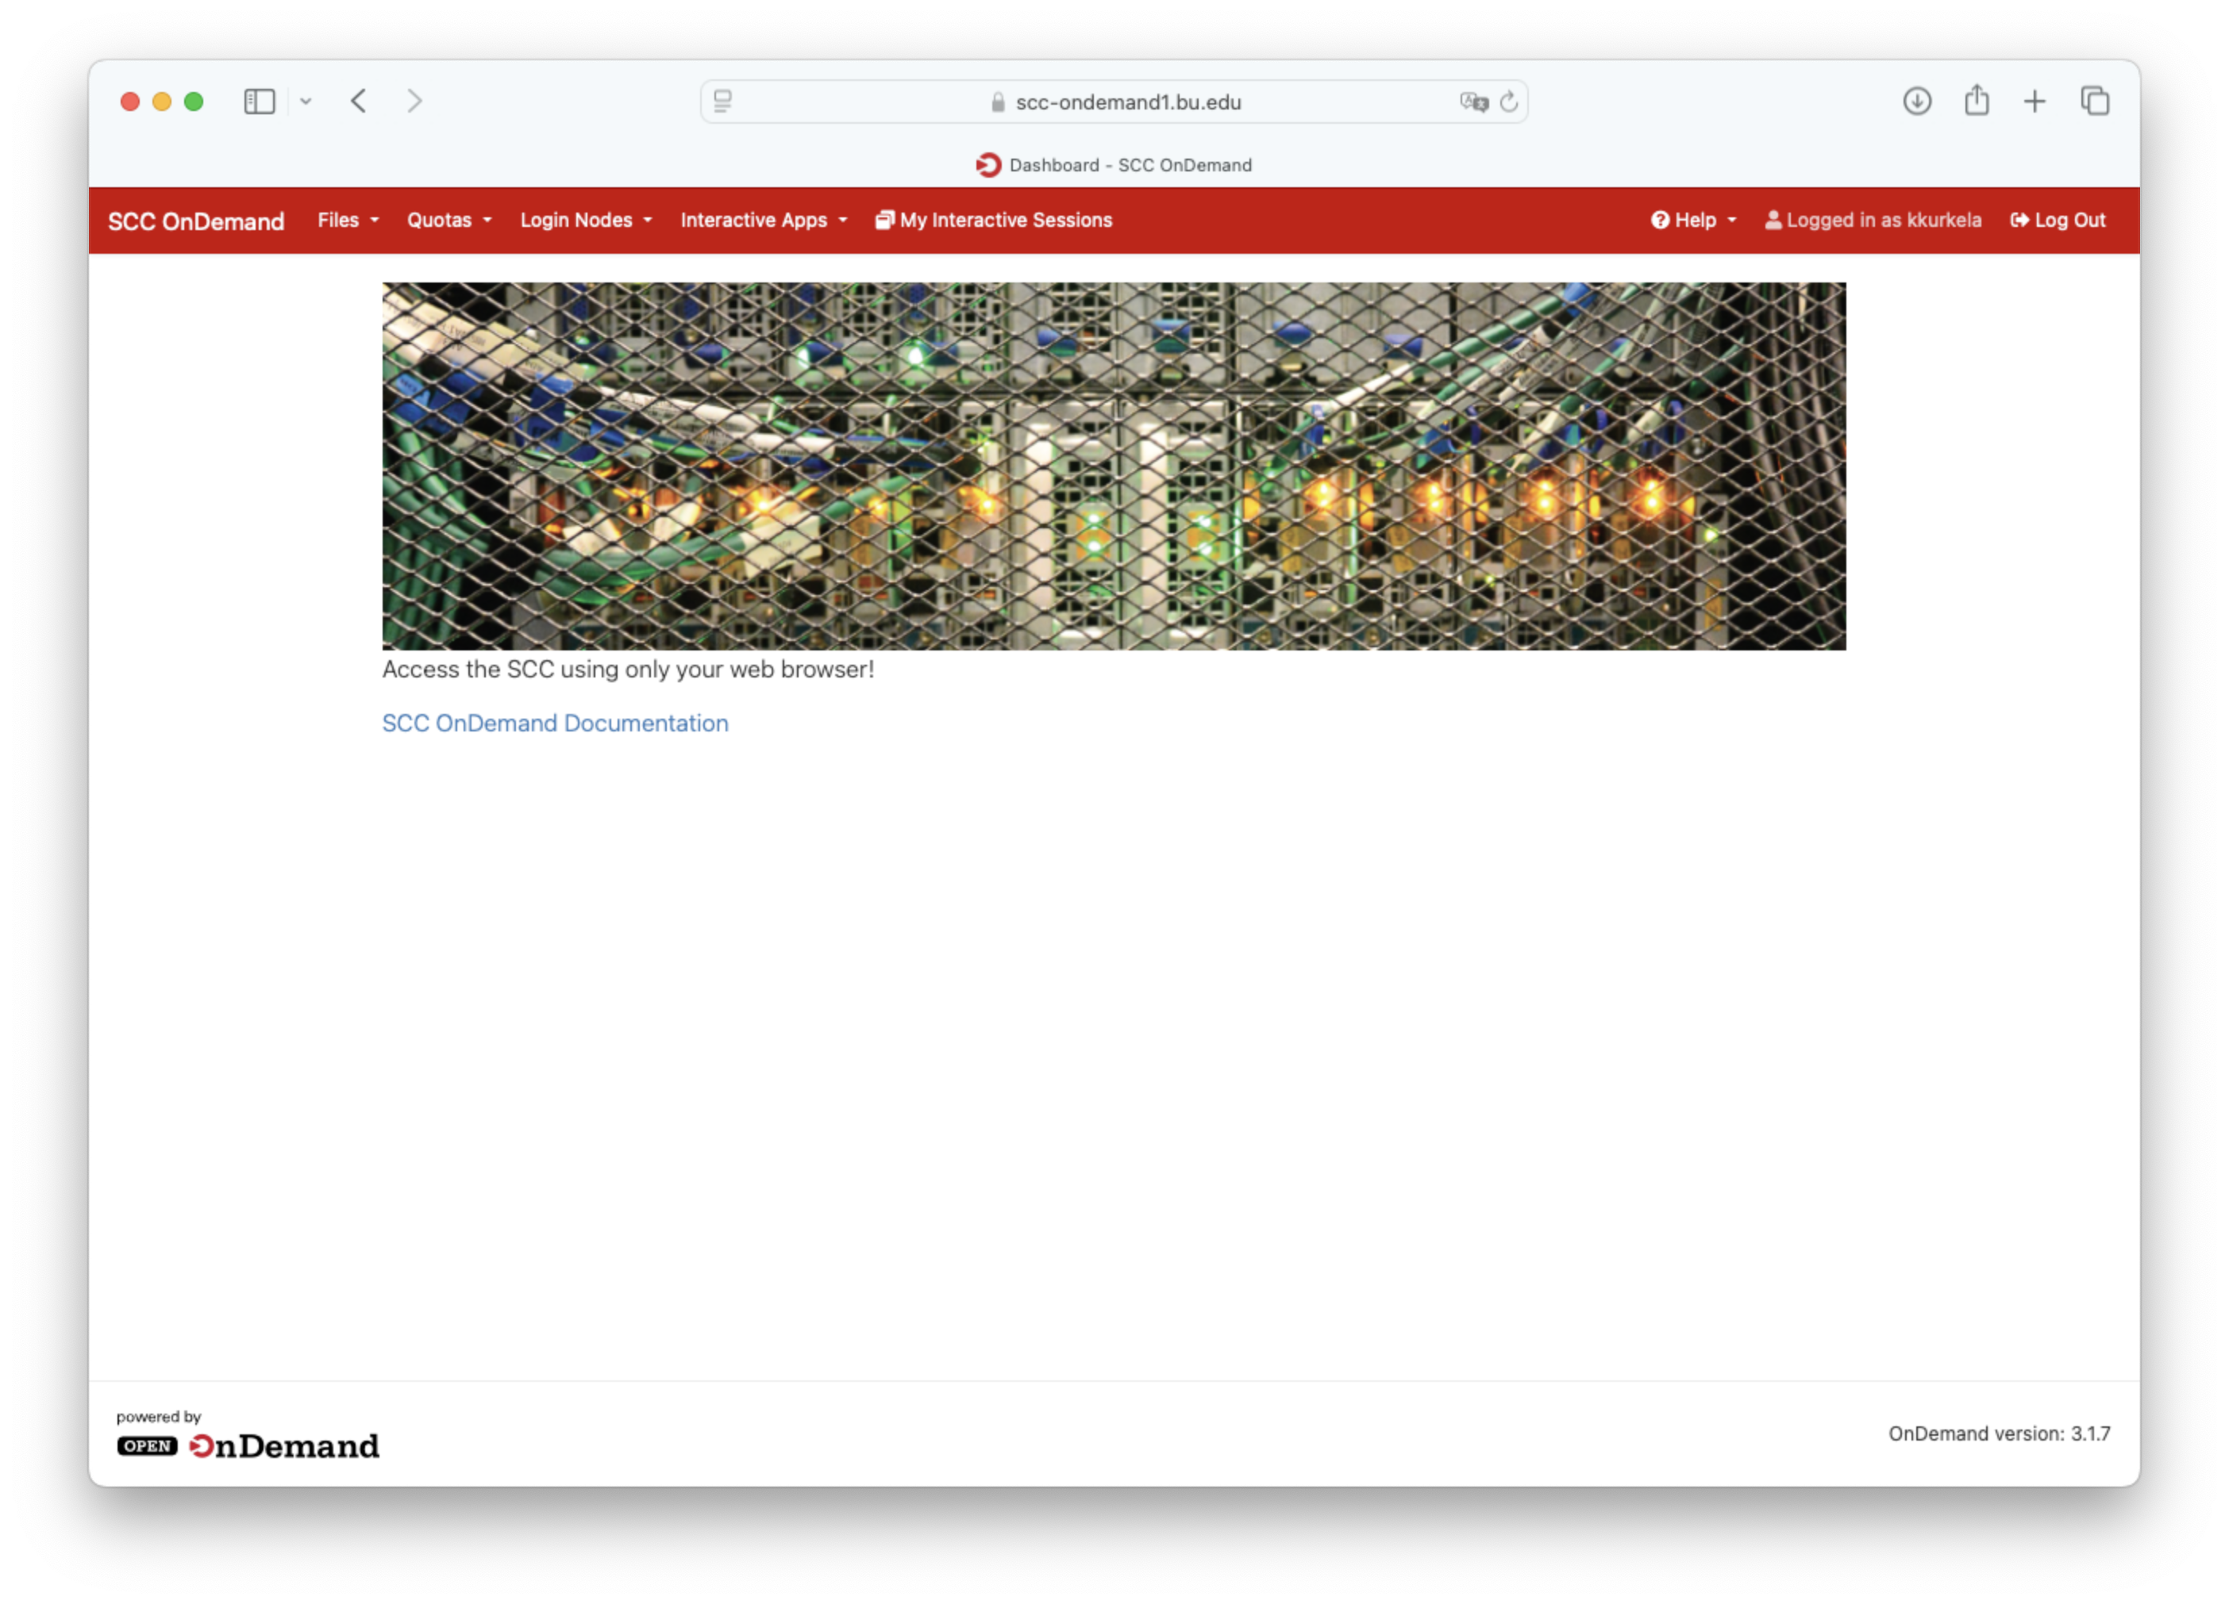
How does the SCC work?
Public Network (AKA the Internet)
Your Computer
SCC OnDemand
Private Network
Compute Nodes
Job Scheduler
Notes:
DESIGN
Talk about SCC OnDemand
Talk about the job scheduler – think of it as a person. He/she takes your requests for a computer and follows a set of rules for allocation. Has built in rules for things like fairness – you cannot use all of the compute nodes, for example. Also takes into account supply and demand.

Slide 9
Workshop Overview
What is the SCC?
How does the SCC work?
Why the SCC?
Connecting to the SCC
The Linux command line
The Linux directory hierarchy and navigation
Copying files
Unzipping files
Viewing raw MRI data with fsleyes
Preprocessing your MRI data with fmriprep

Slide 10
Why the SCC?
Personal Computer
Notes:
Great! three-dimensional the SCC is a whole bunch of computers organized in a specific way. So what is the big deal? Why would you want to use it as a neuroimager.
To illustrate why, lets look at an example.
Say your name is Suzy Graduate Student and you want to process and analyze some MRI data for your dissertation. The typical way you would go about doing so would be to take your personal computer, downloading some MRI data, and processing locally on that computer. Say you want to generate some three-dimensional cortical surfaces from subjects that you have scanned using freesurfer.

Slide 11
Why the SCC?
~ 6 Hours
Personal Computer
Notes:
Depending on the specs of your computer, using freesurfer to generate cortical surfaces make take as long as six hours to complete. Suzy the graduate student may be thinking – well that is pretty long, but not that big of a deal. I can just set the program to run in the evening and it will be completed in the morning. No harm done, right?

Slide 12
Why the SCC?
Personal Computer

Slide 13
Why the SCC?
Personal Computer
Notes:
Well, now imagine Suzy Graduate Student is given 5 subjects to analyze and her PI expects to present the results of her study during lab meeting tomorrow.

Slide 14
Why the SCC?
6 Hours x 5 subjects = 30 hours!
Personal Computer
Notes:
Using her personal computer setup, it would take Suzy 30 hours to process all 5 subjects. There is only 24 hours until her lab meeting! What is she to do?

Slide 15
Why the SCC?
Personal Computer

Slide 16
Why the SCC?
The SCC
Notes:
In comes the SCC to the rescue.
The SCC, as previously mentioned, is a whole bunch of computers. These computers can be used in parallel, greatly increasing the speed with which Suzy can process her data.

Slide 17
Why the SCC?
The SCC

Slide 18
Why the SCC?
6 Hours x 5 subjects = 30 6 hours!
The SCC
Notes:
So instead of it taking Suzy 30 hours to process these 5 subjects, she can process her subjects in parallel on the SCC and the whole process will instead take just 6 hours to complete. Plenty of time for her to inspect the results and present her data during lab meeting.
The power of the SCC, and the reason to use it as a neuroimager, is that it greatly increases the speed with which you can process and analyze your large, high dimensional neuroimaging datasets.

Slide 19
Why the SCC?
The power of the SCC is that it greatly increases the speed with which you can process and analyze your large, high dimensional neuroimaging datasets.
The SCC
Notes:
So instead of it taking Suzy 30 hours to process these 5 subjects, she can process her subjects in parallel on the SCC and the whole process will instead take just 6 hours to complete. Plenty of time for her to inspect the results and present her data during lab meeting.
The power of the SCC, and the reason to use it as a neuroimager, is that it greatly increases the speed with which you can process and analyze your large, high dimensional neuroimaging datasets.

Slide 20
Workshop Overview
What is the SCC?
How does the SCC work?
Why the SCC?
Connecting to the SCC
The Linux command line
The Linux directory hierarchy and navigation
Copying files
Unzipping files
Viewing raw MRI data with fsleyes
Preprocessing your MRI data with fmriprep

Slide 21
Login to SCC OnDemand
Open a web browser
Go to scc-ondemand.bu.edu
Login with your Kubernetes credentials

Slide 22
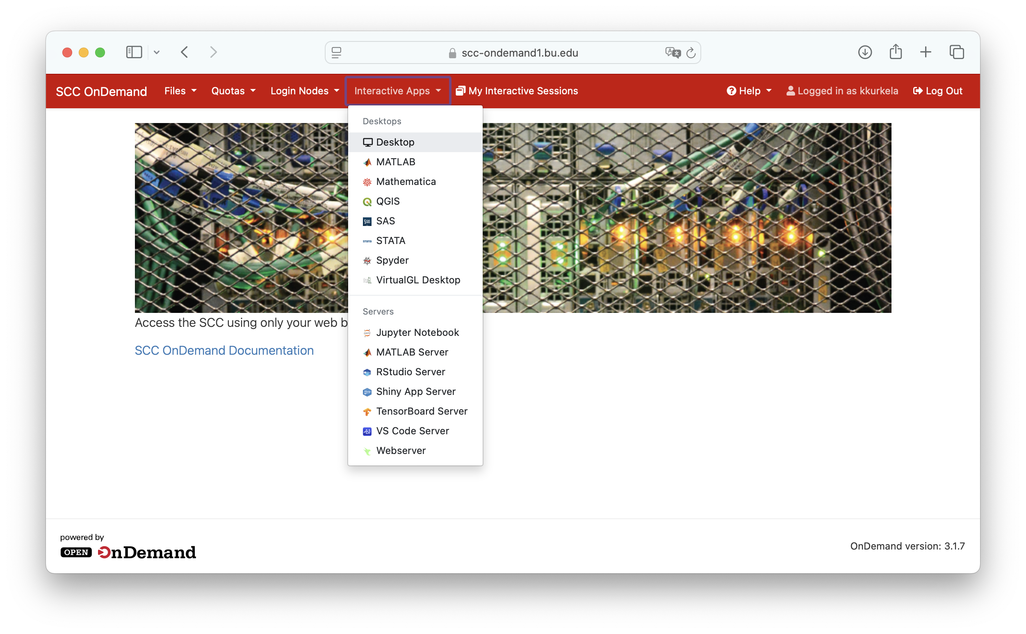
Request an interactive desktop session
Click the “Interactive Apps” dropdown menu
Select “Desktop”

Slide 23
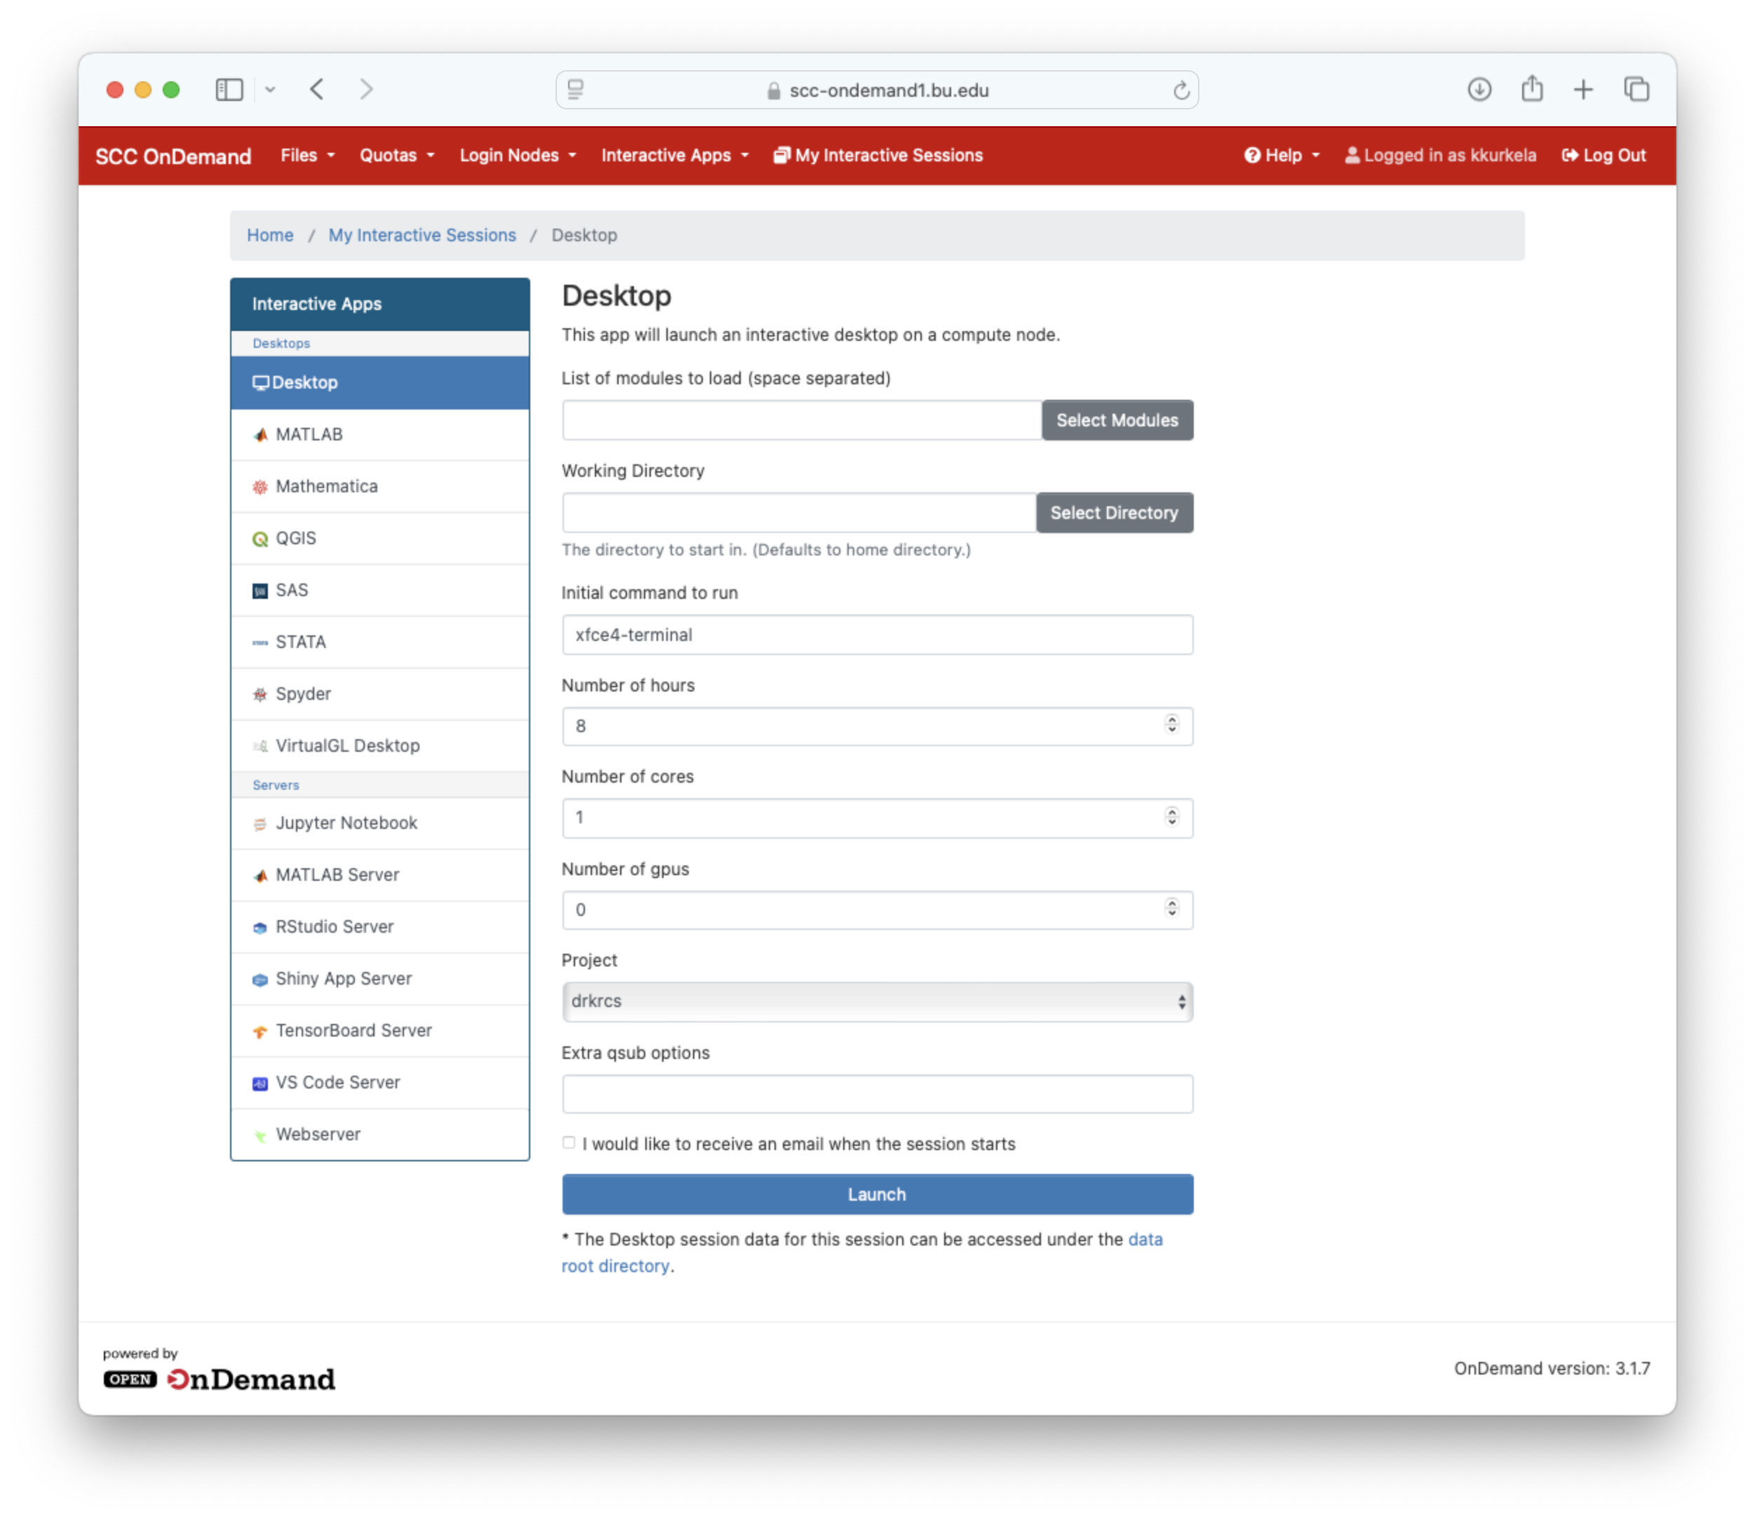
Request an interactive desktop session
Request an interactive desktop on a compute node by:
Filling in the appropriate options
Clicking blue “launch” button

Slide 24
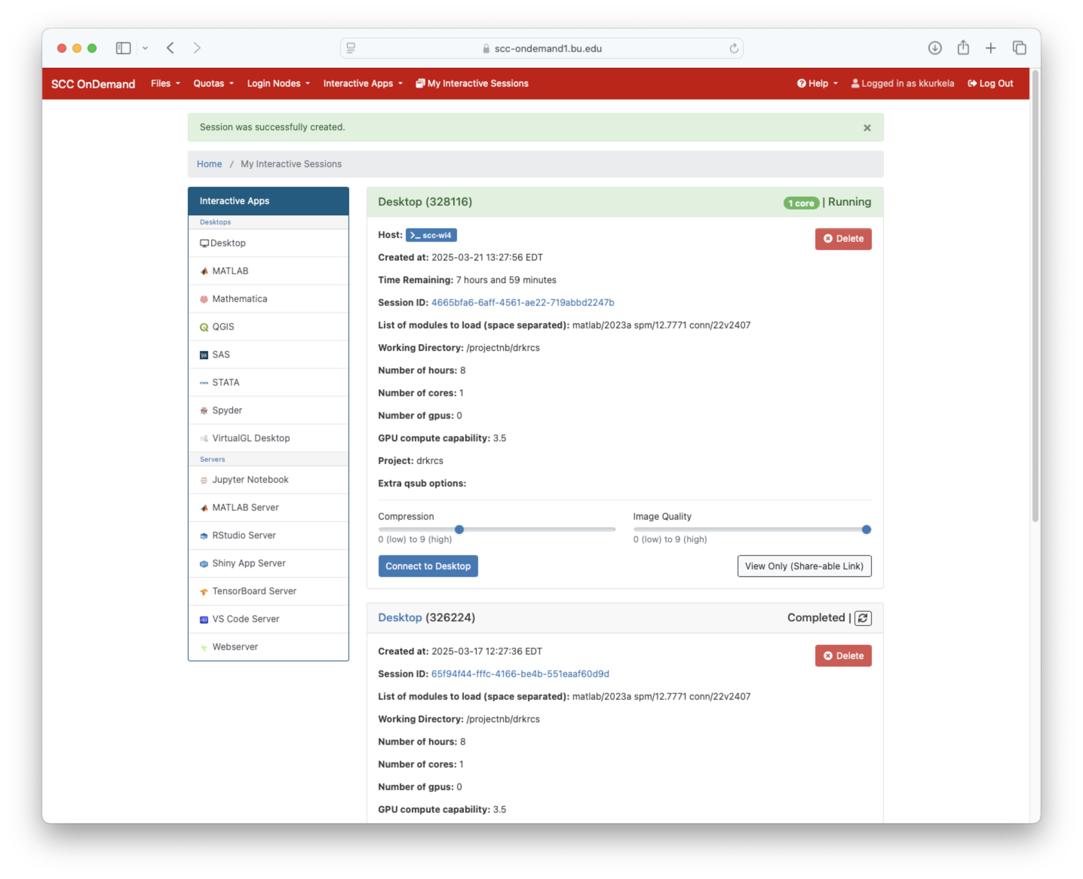
Request an interactive desktop session
The job scheduler will then begin searching for an available node for you to use. This may take a minute or two
Once you are assigned a node, click “Connect to Desktop”

Slide 25
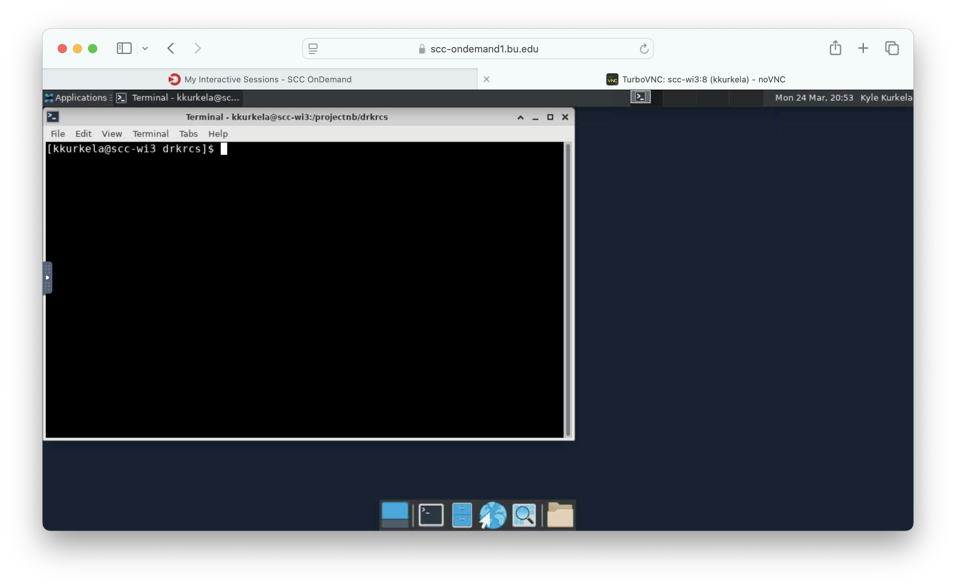
Request an interactive desktop session
A new tab will open and you will be connected to a compute node on the SCC
You will be presented with an interactive desktop interface running a Linux OS
A terminal should open automatically

Slide 26
Workshop Overview
What is the SCC?
How does the SCC work?
Why the SCC?
Connecting to the SCC
The Linux command line
The Linux directory hierarchy and navigation
Copying files
Unzipping files
Viewing raw MRI data with fsleyes
Preprocessing your MRI data with fmriprep

Slide 27
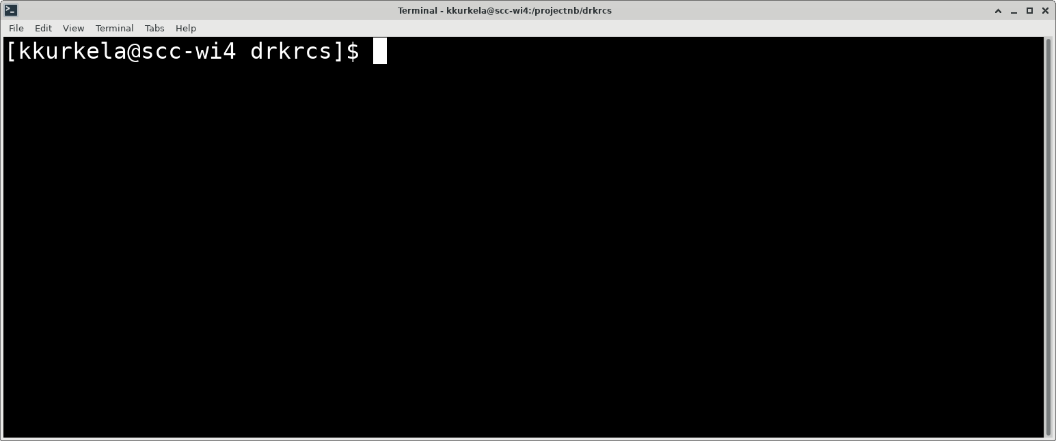
The linux command line
Where you begin typing commands
username
computer name
working directory name
This is referred to as the “command line” or “terminal”. It is how you primarily interact with a linux operating system

Slide 28
The linux command line
Where you begin typing commands
username
computer name
working directory name
Let’s break down what we are looking at.

Slide 29
The linux command line
Username

Slide 30
The linux command line
Computer Name

Slide 31
The linux command line
Working Directory Name

Slide 32
The linux command line
A cursor waiting for new commands.

Slide 33
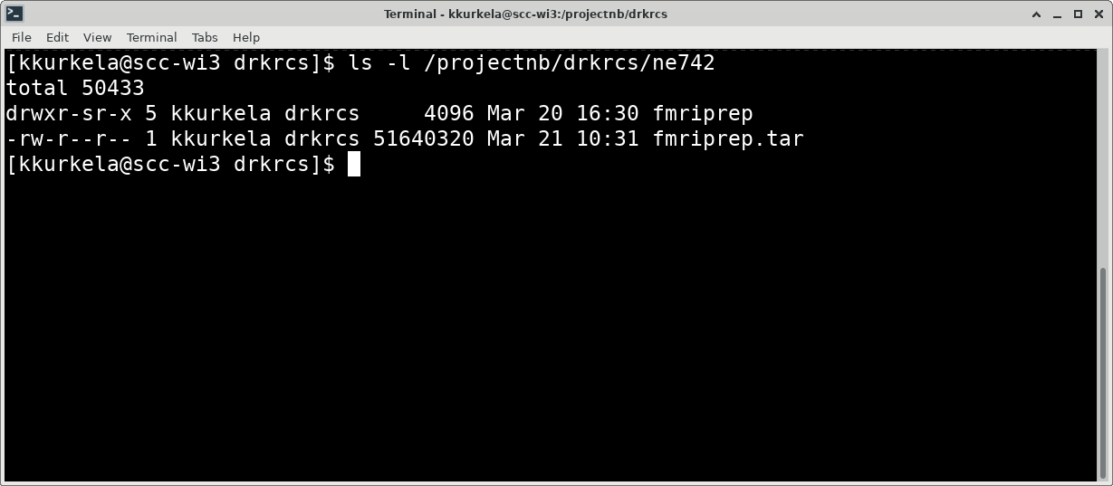
The linux command line
Where you begin typing commands
username
computer name
working directory name
This is what the command line looks like when you type in a command. Let’s break down what we are looking at.

Slide 34
The linux command line
This is a command. A command performs some action on your machine.
Where you begin typing commands
username
computer name
working directory name

Slide 35
The linux command line
This is a flag. Flags start with ”-” and change how a command works. They are typically optional.
Where you begin typing commands
username
computer name
working directory name
Notes:
.

Slide 36
The linux command line
This is an input argument. It is an object that gets acted on by the command.
Where you begin typing commands
username
computer name
working directory name

Slide 37
The linux command line
Where you begin typing commands
username
This is an example of the output of a command. Not all commands have output.
computer name
working directory name

Slide 38
The linux command line
Where you begin typing commands
username
computer name
working directory name

Slide 39
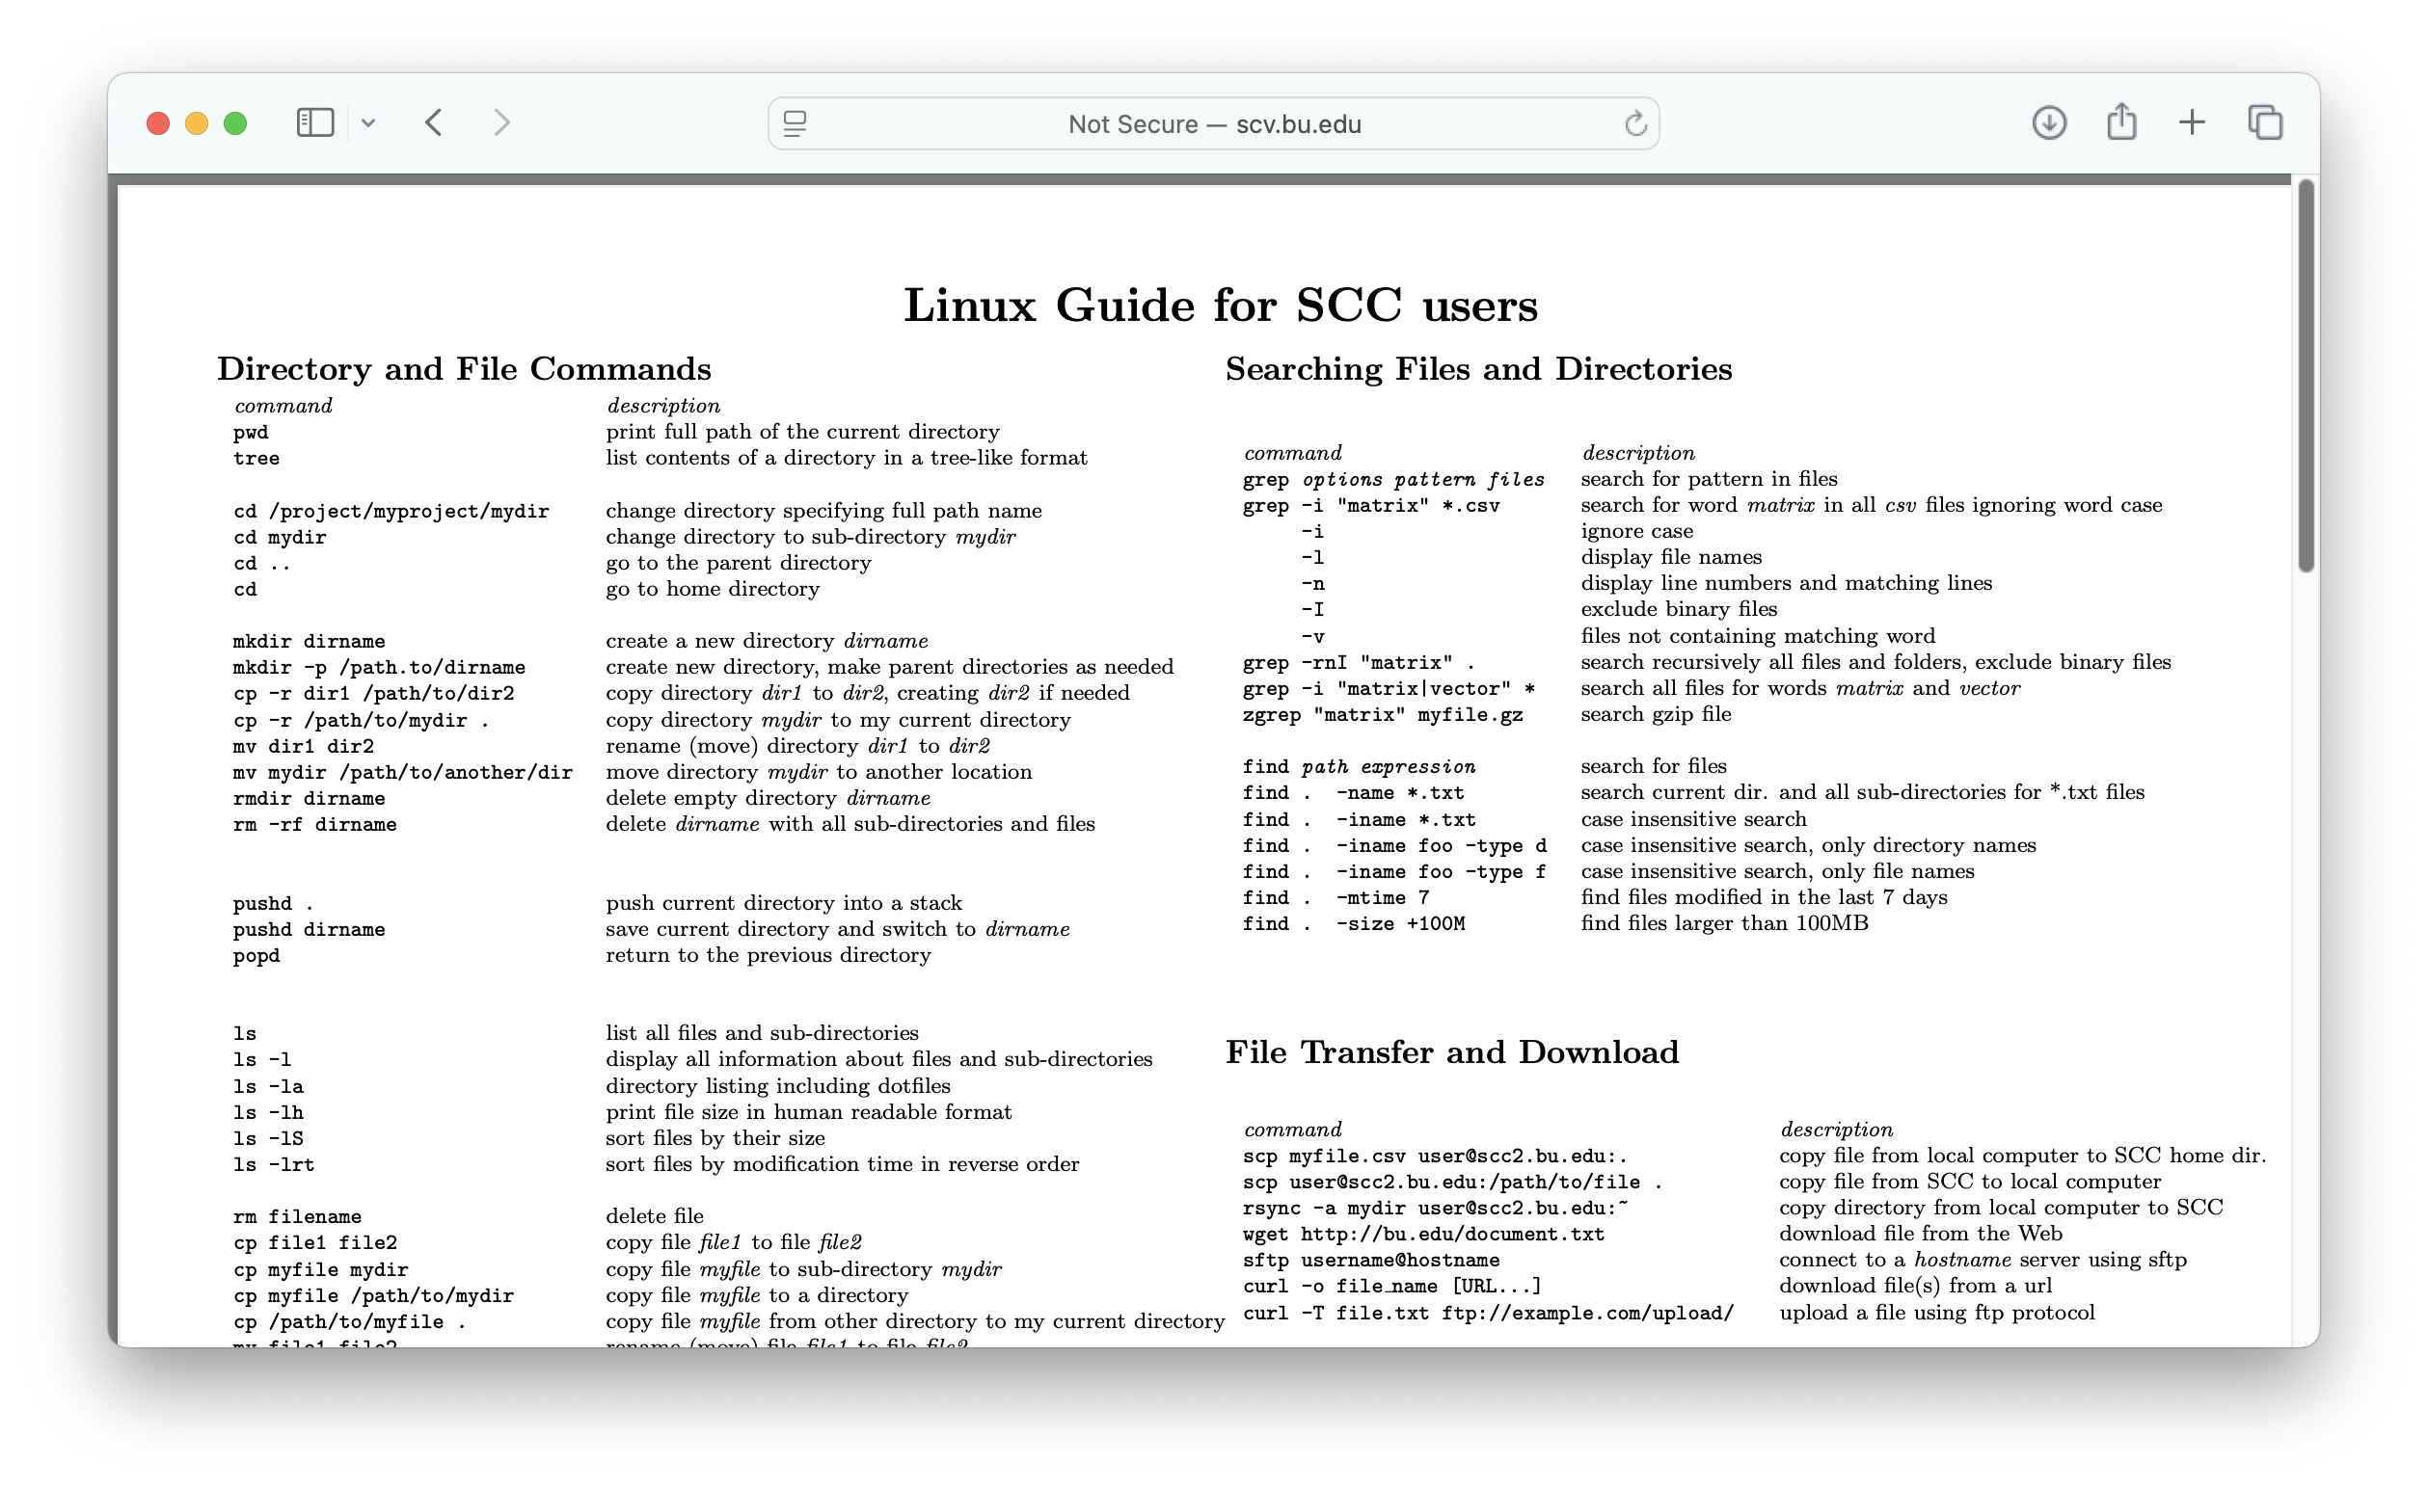
SCC Linux Cheat Sheet
The BU RCS Linux Cheat Sheet contains a list of the most commonly used Linux commands.
http://scv.bu.edu/documents/Linux_SCC_CheatSheet.pdf

Slide 40
Workshop Overview
What is the SCC?
How does the SCC work?
Why the SCC?
Connecting to the SCC
The Linux command line
The Linux directory hierarchy and navigation
Copying files
Unzipping files
Viewing raw MRI data with fsleyes
Preprocessing your MRI data with fmriprep

Slide 41
Linux File System
/
ne742
projectnb
students
kylekurk
materials
kylieisen
fmriprep.tar
code.py
Linux file systems are organized into hierarchical trees

Slide 42
Linux File System
/
ne742
projectnb
students
kylekurk
materials
kylieisen
fmriprep.tar
code.py
A directory is unique identified via its path. A path describes how to navigate to a directory on the tree.

Slide 43
Linux File System
/
ne742
projectnb
students
kylekurk
materials
kylieisen
fmriprep.tar
code.py
Paths start at what is called the root (represented by “/”)
Paths list all of the directories that you need to descend into to reach your destination from the root

Slide 44
Linux File System
/
ne742
projectnb
students
kylekurk
materials
kylieisen
fmriprep.tar
code.py
For example, the path to the directory “kylieisen” is:
/projectnb/ne742/students/kylieisen

Slide 45
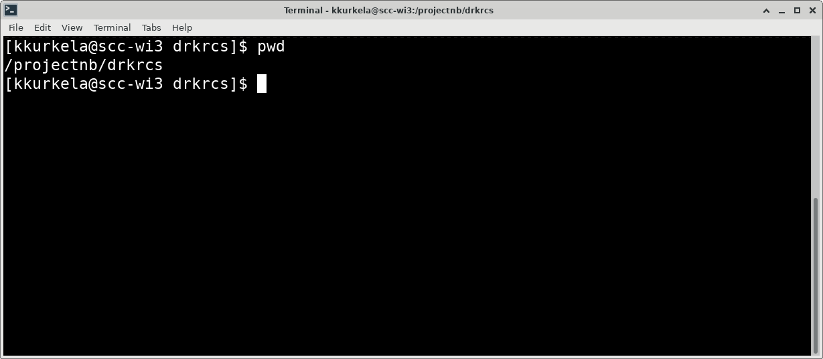
Linux navigation
Command Spotlight : “pwd” prints the full path to your current working directory. This is where you currently reside within the filesystem.

Slide 46
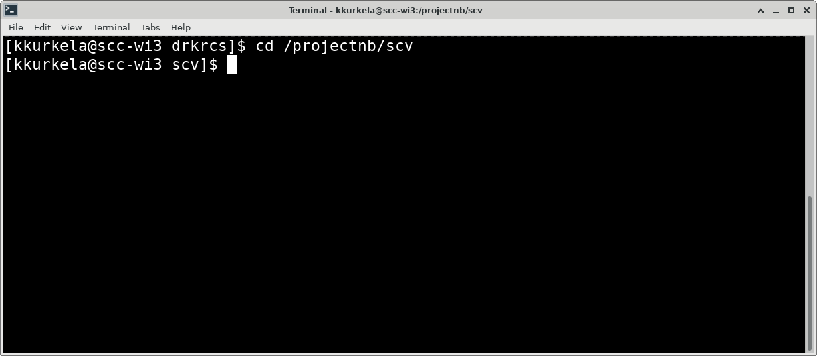
Linux navigation
Command Spotlight: The command “cd” allows you to change your working directory. It takes a path as input.

Slide 47
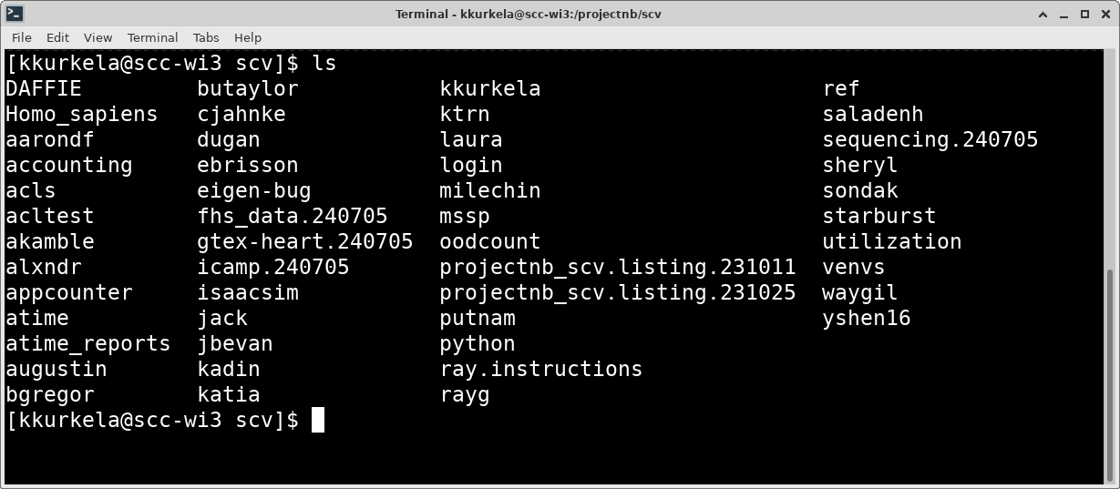
Linux navigation
Command Spotlight: the ”ls” command will print contents of a directory. If you invoke it without an input argument, it will print the contents of the working directory

Slide 48
Linux navigation
EXERCISE: Navigate to the materials directory for our class and list the directories contents.

Slide 49
Workshop Overview
What is the SCC?
How does the SCC work?
Why the SCC?
Connecting to the SCC
The Linux command line
The Linux directory hierarchy and navigation
Copying files
Unzipping files
Viewing raw MRI data with fsleyes
Preprocessing your MRI data with fmriprep

Slide 50
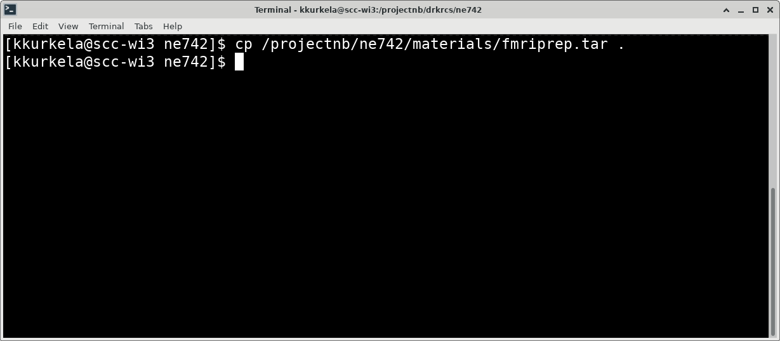
Linux Basics – copying files
Command spotlight: the ”cp” command allows you to copy files from one directory to another. It takes two inputs arguments. The path to the file you want to copy and the path to the destination directory. Hint: you can use the “.” to indicate the present working directory.

Slide 51
Linux Basics – copying files
EXERCISE: copy the file “fmriprep.tar” from the directory “/projectnb/ne724/materials” to your student directory.

Slide 52
Workshop Overview
What is the SCC?
How does the SCC work?
Why the SCC?
Connecting to the SCC
The Linux command line
The Linux directory hierarchy and navigation
Copying files
Unzipping files
Viewing raw MRI data with fsleyes
Preprocessing your MRI data with fmriprep

Slide 53
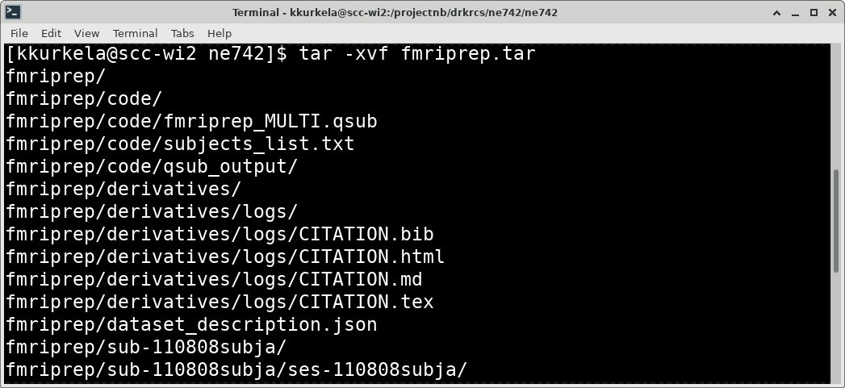
Linux Basics – tar
The file that you just copied is called a tar ball. It is a zip archive that contains a bunch of files and directories within it.

Slide 54
Linux Basics – tar
To see these files/directories, we need to “untar” this file. You can do that using the “tar” command as you see here.

Slide 55
Linux Basics – tar
EXERCISE: unpack the fmriprep tarball using the tar command. Inspect the resulting files/directories using the “cd” and “ls” commands.

Slide 56
Workshop Overview
What is the SCC?
How does the SCC work?
Why the SCC?
Connecting to the SCC
The Linux command line
The Linux directory hierarchy and navigation
Copying files
Unzipping files
Viewing raw MRI data with fsleyes
Preprocessing your MRI data with fmriprep

Slide 57
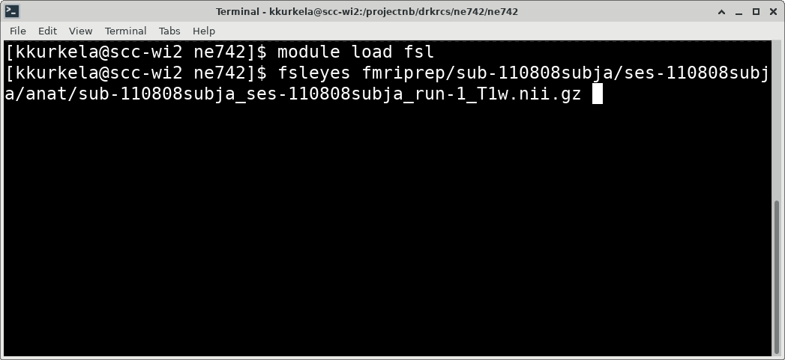
Load software using module load
Let’s examine the raw example data by loading the software package fsl. To load software on the SCC, use the “module load” command.

Slide 58
Load software using module load
Once you load fsl, you now have access to fsl commands. Use the command “fsleyes” with the path to an *.nii.gz image as the first input argument.

Slide 59
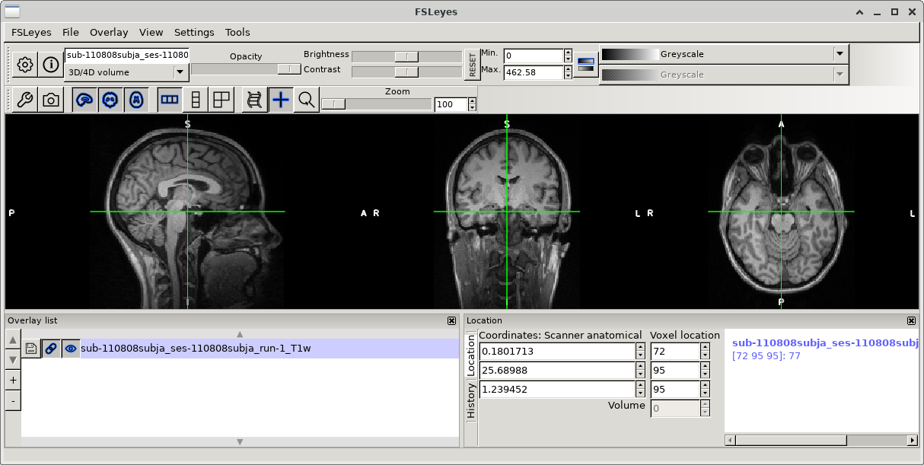
Load software using module load
This will open the fsleyes user interface with the input scan. Play around and examine this scan.

Slide 60
Workshop Overview
What is the SCC?
How does the SCC work?
Why the SCC?
Connecting to the SCC
The Linux command line
The Linux directory hierarchy and navigation
Copying files
Unzipping files
Viewing raw MRI data with fsleyes
Preprocessing your MRI data with fmriprep

Slide 61
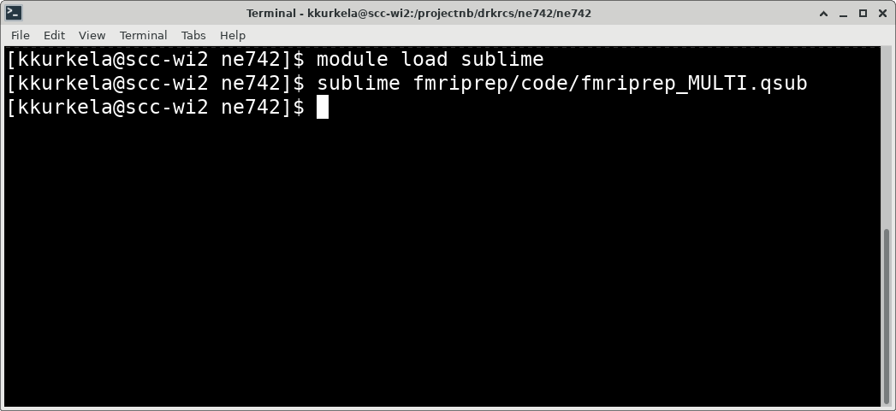
Linux Basics – job submission
We are now going to submit a job to the job scheduler. We submit jobs to the job scheduler using job scripts.

Slide 62
Linux Basics – job submission
An example job script has been written for you. Open this script up using a text editor and we will edit it to work for you.

Slide 63
Linux Basics – job submission
EXERCISE: follow the steps above to open the example job submission script in the text editor sublime.
Notes:
Edit line 10 → path for output files
Edit line 35 → use older version of fmriprep
Edit line 42 → path to your dataset
Delete lines 53-58
Edit line 59 “subjectid=“ to be the subjects id contained in the subject list

Slide 64
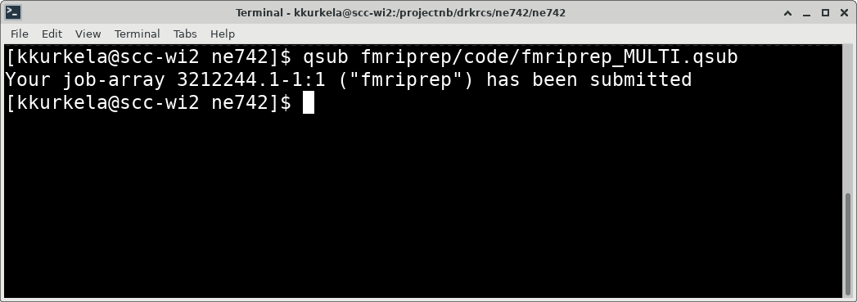
Linux Basics – job submission
Once you have properly edited your job script you can submit it to the job scheduler using the command “qsub” with the path to your job script as the input argument.

Slide 65
Linux Basics – job submission
You can check the status of your job using the command “qstat –u USERNAME”. Try it out.

Slide 66
Linux Basics – job submission
This job should take few hours to run. You will receive an email from nobody@scc.bu.edu telling you that your job completed (or encountered an error).

Slide 67
Linux Basics – job submission
We will pick up from here next week to examine the output of fmriprep. Kylie will be your teacher.

Slide 68
Questions? Comments? Concerns?

