Slide 1


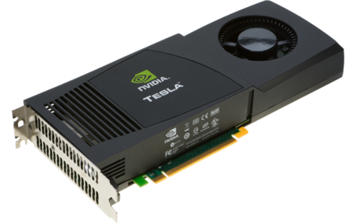
GPU Programming and PyCUDA
Brian Gregor
Shuai Wei
June 28, 2018
Research Computing Services
Boston University
Notes:
This version of the slides was updated for the Fall of 2017.
This tutorial is an introduction to the use of GPUs and an overview of the various ways to make use of them on the SCC.

Slide 2
GPU Programming
Access to the SCC
Login: tuta#
Password: VizTut#
Notes:
GPU (The graphics processing unit) is a specialized and highly
parallel microprocessor designed to offload CPU and accelerate 2D or 3D
rendering.
Up until 1999, the term "GPU" didn't actually exist, and
NVIDIA coined the term during it's launch of the GeForce 256.
The 3dfx Voodoo (1996) was considered one of the first true
3D game cards

Slide 3
GPU Programming
Access to the SCC GPU nodes
# copy tutorial materials:
% cp –r /project/scv/examples/gpu/tutorials .
or
% cp –r /scratch/tutorials .
% cd tutorials
# request a node with GPUs:
% qsh –l gpus=1
Notes:
GPU (The graphics processing unit) is a specialized and highly
parallel microprocessor designed to offload CPU and accelerate 2D or 3D
rendering.
Up until 1999, the term "GPU" didn't actually exist, and
NVIDIA coined the term during it's launch of the GeForce 256.
The 3dfx Voodoo (1996) was considered one of the first true
3D game cards

Slide 4
GPU Programming
Tutorial Materials
# tutorial materials online:
scv.bu.edu/examples
# on the cluster:
/project/scv/examples
Notes:
GPU (The graphics processing unit) is a specialized and highly
parallel microprocessor designed to offload CPU and accelerate 2D or 3D
rendering.
Up until 1999, the term "GPU" didn't actually exist, and
NVIDIA coined the term during it's launch of the GeForce 256.
The 3dfx Voodoo (1996) was considered one of the first true
3D game cards

Slide 5
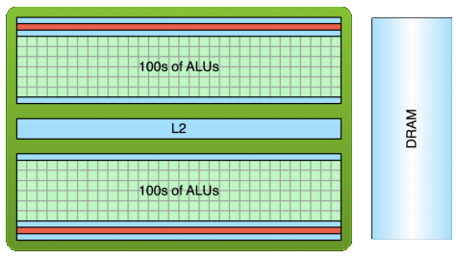
GPU Programming
GPU computing
  GPU: Graphics Processing Unit
  Traditionally used for real-time rendering of computer graphics
  High Computational density and memory bandwidth
  Throughput processor: 1000s of concurrent threads to hide latency
Notes:
GPUs can be
found in a wide range of systems, from desktops and laptops to
mobile phones and super computers

Slide 6
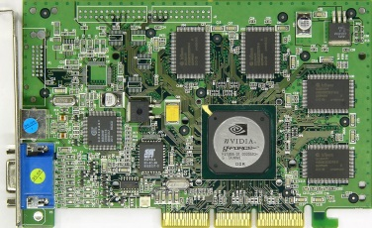
GPU Programming
GPU – graphics processing unit
Originally designed as a graphics processor
NVIDIA GeForce 256 (1999) – first GPU
  single-chip processor for mathematically-intensive tasks
  transforms of vertices and polygons
  lighting
  polygon clipping
  texture mapping
  polygon rendering
NVIDIA Geforce 3, ATI Radeon 9700 – early 2000’s
  Now programmable!
Notes:
GPU (The graphics processing unit) is a specialized and highly
parallel microprocessor designed to offload CPU and accelerate 2D or 3D
rendering.
Up until 1999, the term "GPU" didn't actually exist, and
NVIDIA coined the term during it's launch of the GeForce 256.
The 3dfx Voodoo (1996) was considered one of the first true
3D game cards

Slide 7

GPU Programming
Modern GPUs are present in
  Embedded systems
  Personal Computers
  Game consoles
  Mobile Phones
  Workstations
Notes:
GPUs can be
found in a wide range of systems, from desktops and laptops to
mobile phones and super computers

Slide 8
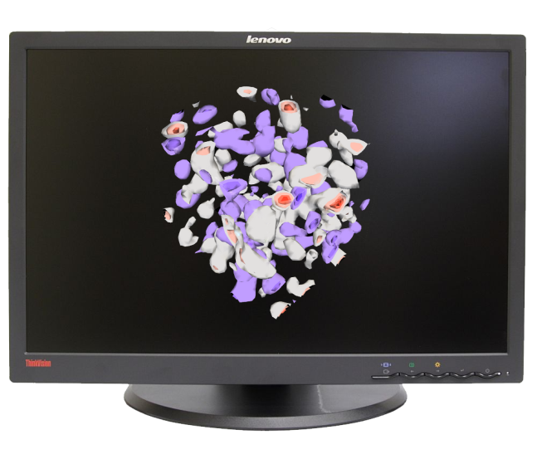
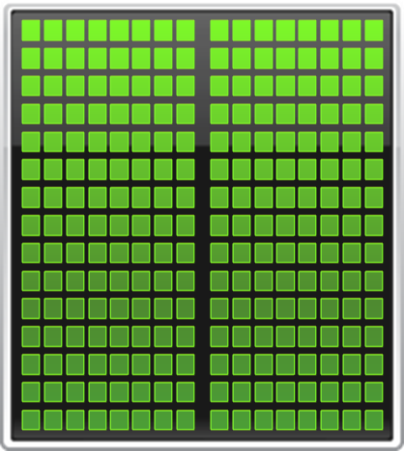
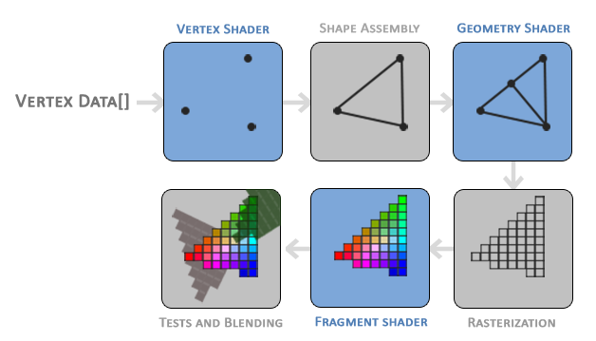
GPU Programming
Traditional GPU workflow
https://learnopengl.com/#!Getting-started/Hello-Triangle
Notes:
The original GPUs were modelled after the concept of a
fixed graphics pipeline. This pipeline simply transforms coordinates from 3D space
(specified by programmer) into 2D pixel space on the screen.
Early GPUs implemented only the rendering stage in hardware,
requiring the CPU to generate triangles for the GPU to operate on.
As GPU technology progressed, more and more stages of the
pipeline were implemented in hardware on the GPU, freeing up
more CPU cycles.

Slide 9
GPU Programming
GPGPU
1999-2000 computer scientists from various fields started using GPUs to accelerate a range of scientific applications.
GPU programming required the use of graphics APIs such as OpenGL and Cg.
2001 – LU factorization implemented using GPUs
2002 James Fung (University of Toronto) developed OpenVIDIA.
NVIDIA greatly invested in GPGPU movement and offered a number of options and libraries for a seamless experience for C, C++ and Fortran programmers.
Notes:
The next step in the evolution of GPU hardware was the
introduction of the programmable pipeline on the GPU. In 2001,
NVIDIA released the GeForce 3 which gave programmers the
ability to program parts of the previously non-programmable
pipeline.
Instead of sending all the graphics description data to
the GPU and have it simply flow through the fixed pipeline, the
programmer can now send this data along with vertex "programs"
(called shaders) that operate on the data while in the pipeline [1].
These shader programs were small "kernels", written in
assembly-like shader languages. For the first time, there was limited
amount of programmability in the vertex processing stage of the
pipeline.

Slide 10
GPU Programming
GPGPU timeline
In November 2006 NVIDIA launched CUDA, an API that allows to code algorithms for execution on GeForce GPUs using the C programming language.
Khronus Group defined the OpenCL programming language in 2008. It is supported on AMD, NVIDIA and ARM GPU platforms. OpenCL code can also be compiled to run on CPUs.
In 2012 NVIDIA presented and demonstrated OpenACC - a set of directives that greatly simplify parallel programming of heterogeneous systems.
Notes:
The GPU hardware evolution thus far has gone from an
extremely specific, single core, fixed function hardware pipeline
implementation just for graphics rendering, to a set of highly
parallel and programmable cores for more general purpose
computation.

Slide 11
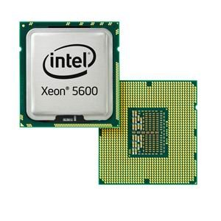
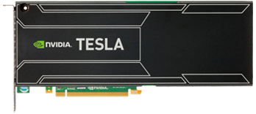


GPU Programming
CPU
GPU
CPUs consist of a few cores optimized for serial processing and general purpose calculations.
GPUs consist of hundreds or thousands of smaller, efficient cores designed for parallel performance. The hardware is designed for specific calculations.
Notes:
Modern CPU's nowadays typically have 2 to 12 cores and are highly optimized for serial processing.
GPUs consist of hundreds or even thousands of smaller efficient cores designed for parallel processing

Slide 12
GPU Programming
SCC CPU
SCC GPU
Intel Xeon E5-2680v4:
Clock speed: 2.4 GHz
4 instructions per cycle with AVX2
CPU - 28 cores
2.4 x 4 x 28 =
268.8 Gigaflops double precision
NVIDIA Tesla P100:
Single instruction per cycle
3584 CUDA cores
4.7 Teraflops double precision
Notes:
As an example we can look at the CPUs and GPUs that are used on our Linux cluster.

Slide 13
GPU Programming
SCC CPU
SCC GPU
Intel Xeon E5-2680v4 :
Memory size: 256 GB
Bandwidth: 76.8 GB/sec
NVIDIA Tesla P100:
Memory size: 12GB total
Bandwidth: 549 GB/sec
Notes:
There is a significant difference in memory size and bandwidth that should be taken into account while deciding where to perform the calculations.

Slide 14
GPU Programming
10x GPU Computing Growth
2008
2015
6,000
Tesla GPUs
150K
CUDA downloads
77
Supercomputing Teraflops
60
University Courses
4,000
Academic Papers
450,000
Tesla GPUs
3M
CUDA downloads
54,000
Supercomputing Teraflops
800
University Courses
60,000
Academic Papers
Notes:
If we look back only 5 years and compare some the number of CUDA-capable GPU's used or CUDA downloads, we can see a significant rise in GP using GPU.
Future GPU generations will look more and more like wide-vector
general purpose CPUs, and eventually both will be seamlessly
combined as one.

Slide 15
GPU Programming
GPU Acceleration
Applications
GPU-accelerated libraries
OpenACC Directives
Programming Languages
Seamless linking to GPU-enabled libraries.
Simple directives for easy GPU-acceleration of new and existing applications
Most powerful and flexible way to design GPU accelerated applications
cuFFT, cuBLAS, Thrust, NPP, IMSL, CULA, cuRAND, etc.
PGI Accelerator
C/C++, Fortran, Python, Java, etc.
Notes:
There are 3 basic approaches to adding GPU acceleration to your applications.
But first, many applications are already GPU-accelerated. So first, find out if the
application you are interested in already uses GPUs.
If you are developing your own application, you can add GPU acceleration by:
1. Dropping in pre-optimized GPU-accelerated libraries as an alternative to MKL, IPP, FFTW and other widely used libraries
2. Adding some directives (or compiler “hints”) in your source code to automatically parallelize loops
3. Using the programming languages you already know to implement your own parallel algorithms
For each performance-critical area in your application, these approaches can be used independently or together.
For example you can use a GPU-accelerated library to perform some initial calculations on your data and then write your own code to perform custom calculations not (yet) available in a library.
The CUDA parallel computing platform and programming model supports all of these approaches.
So, let’s take a closer look at each approach.

Slide 16
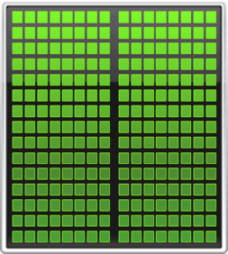
GPU Programming
Minimum Change, Big Speed-up
Application Code
Rest of Sequential
CPU Code
GPU
Compute-Intensive Functions
CPU
Use GPU to Parallelize
+

Slide 17
GPU Programming
Will Execution on a GPU Accelerate My Application?
Computationally intensive—The time spent on computation significantly exceeds the time spent on transferring data to and from GPU memory.
Massively parallel—The computations can be broken down into hundreds or thousands of independent units of work.
Well suited to GPU architectures – some algorithms or implementations will not perform well on the GPU.
Notes:
Will Execution on a GPU Accelerate My Application?
A GPU can accelerate an application if it fits all of the following criteria:

Slide 18
GPU Programming
C
OpenACC, CUDA
C++
Thrust, CUDA C++
Fortran
OpenACC, CUDA Fortran
Python
PyCUDA, PyOpenCL
Numerical analytics
MATLAB, Mathematica
Machine Learning
Theano, Tensorflow, Caffe, Torch, etc.

Slide 19
GPU Programming
GPU resources on the SCC
There are several sets of nodes that incorporate GPUs and are available to the SCC users:
20 nodes with 8 NVIDIA Tesla M2070 GPUs each:
scc-ha1, …, scc-he2 and scc-ja1, …, scc-je2
24 buy-in nodes with 3 NVIDIA Tesla M2050 GPUs each:
scc-ea1, …, scc-fc4
14 K40m cards (2 shared and 12 buy-in):
scc-c01 (2gpus), scc-c04 (4), scc-c05(4), scc-sc1(2), scc-sc2(2)
28 P100 cards:
scc-c08-scc-c11 (2 gpus each), scc-c12-scc-c14 & scc-x01-x04 (4 gpus each)

Slide 20
GPU Programming
Interactive GPU job
Request xterm with access to 1 GPU for the 12 hours default time limit:
> qrsh -V -l gpus=1
Med.Campus users need to add project name:
> qrsh -V -P project -l gpus=1

Slide 21
GPU Programming
Flags related to GPU jobs
-l gpus=# # number of gpus
-l gpu_type=GPUtype # M2070, K40m, P100
-l gpu_c=#.# # compute capability (at least)
# 2.0(default), 3.5(K40), 6.0(P100)

Slide 22
GPU Programming
Flags related to GPU jobs
-pe omp N # number of cpu slots
-l gpus=G
If M gpus are required then G = M/N (rounded down)
Example (request a whole node with 2 GPUs and 20 CPUs):
-pe omp 20 –l gpus=0.1
Example (request a 1 GPU, 4 CPUs, and the K40m or P100 GPUs):
-pe omp 4 –l gpus=0.25,gpu_c=3.5

Slide 23
GPU Programming
Interactive Batch
Examine GPU hardware and driver
> nvidia-smi
-h for help
-q for long query of all GPUs
PCIe Bus ID
Power State/Fans/Temps/Clockspeed

Slide 24
Tutorial examples
> cd /project/scv/examples/gpu/tutorials/deviceQuery
> ls -l
drwxr-xr-x 2 koleinik scv 4096 Jun 25 15:45 deviceQuery/
drwxr-xr-x 2 koleinik scv 4096 Jun 23 08:26 gemm/
drwxr-xr-x 2 koleinik scv 4096 Jun 23 08:49 gpu_matlab/
drwxr-xr-x 2 koleinik scv 4096 Jun 10 08:49 gpu_r/
drwxr-xr-x 2 koleinik scv 4096 Jun 25 13:51 helloCuda/
drwxr-xr-x 2 koleinik scv 4096 Jun 25 15:11 vectorAdd/
// add CUDA software to the user's path
module load cuda
// OR do it by specifying the version
module load cuda/8.0
// go to the deviceQuery example
> cd deviceQuery
// execute the program
> ./deviceQuery
GPU Programming

Slide 25
GPU Programming
CUDA: Device Query
Device: "Tesla M2050"
CUDA Driver Version / Runtime Version 4.2 / 4.2
CUDA Capability Major/Minor version number: 2.0
Total amount of global memory: 2687 MBytes (2817982464 bytes)
(14) Multiprocessors x ( 32) CUDA Cores/MP: 448 CUDA Cores
GPU Clock rate: 1147 MHz (1.15 GHz)
Total amount of constant memory: 65536 bytes
Total amount of shared memory per block: 49152 bytes
Total number of registers available per block: 32768
Warp size: 32
Maximum number of threads per block: 1024
Maximum sizes of each dimension of a block: 1024 x 1024 x 64
Maximum sizes of each dimension of a grid: 65535 x 65535 x 65535
Concurrent copy and kernel execution: Yes with 2 copy engine(s)
Run time limit on kernels: No
. . .
intro_gpu/deviceQuery/deviceQuery.cpp

Slide 26
GPU Programming
CUDA: Hello, World! example
#define NUM_BLOCKS 4
#define BLOCK_WIDTH 8
/* Main function, executed on host (CPU) */
int main( void) {
/* print message from CPU */
printf( "Hello Cuda!\n" );
/* execute function on device (GPU) */
hello<<<NUM_BLOCKS, BLOCK_WIDTH>>>();
/* wait until all threads finish their job */
cudaDeviceSynchronize();
/* print message from CPU */
printf( "Welcome back to CPU!\n" );
return(0);
}
Kernel:
A parallel function that runs on the GPU
intro_gpu/helloCuda/helloCuda.cu

Slide 27
GPU Programming
PyCUDA – why C code?
As we will see…one way to use CUDA with Python is to embed CUDA C code directly into the Python code.
Custom C code is how maximum control over the GPU operation is achieved.
We’ll cover some CUDA C code approaches which also explain how to use the GPU before getting into PyCUDA.

Slide 28
GPU Programming
CUDA: Hello, World! example
/* Function executed on device (GPU */
__global__ void hello( void) {
printf( "\tHello from GPU: thread %d and block %d\n",
threadIdx.x, blockIdx.x );
}
intro_gpu/helloCuda/helloCuda.cu

Slide 29
GPU Programming
CUDA: Hello, World! example
Compile and build the program using NVIDIA's nvcc compiler:
nvcc -o helloCuda helloCuda.cu -arch sm_20
Running the program on the GPU-enabled node:
helloCuda
Hello Cuda!
Hello from GPU: thread 0 and block 0
Hello from GPU: thread 1 and block 0
. . .
Hello from GPU: thread 6 and block 2
Hello from GPU: thread 7 and block 2
Welcome back to CPU!
Note:
Threads are executed on "first come, first serve" basis. Can not expect any order!
intro_gpu/helloCuda/helloCuda.cu

Slide 30
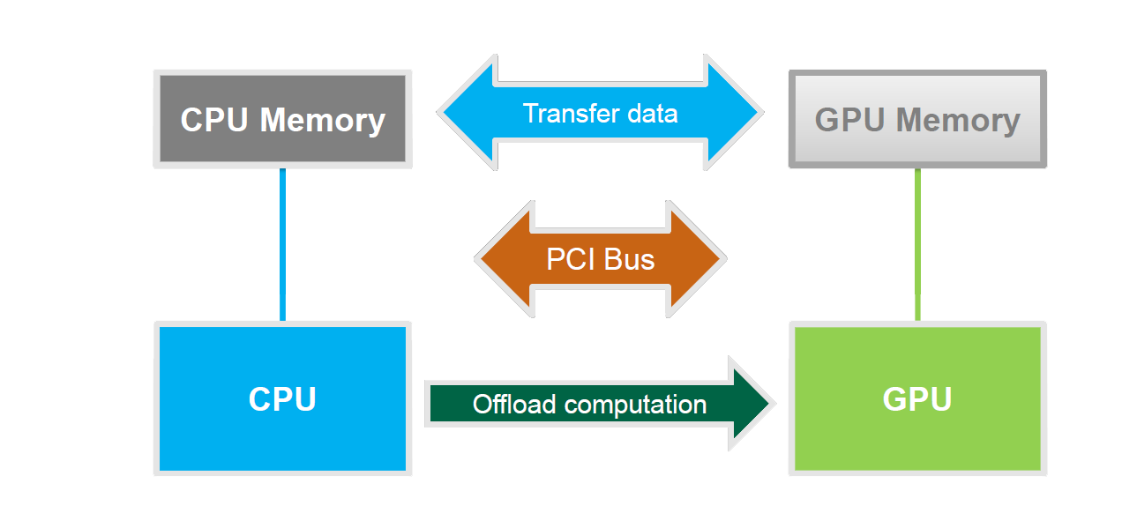
GPU Programming
Basic Concepts

Slide 31
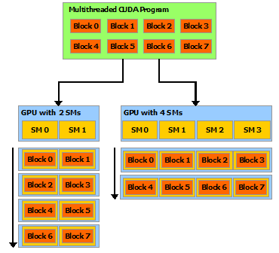
GPU Programming
CUDA: Blocks, Threads, Grids, and more!
Threads – Parallelized computations.
Warp – A group of 32 threads.
Blocks – Groups of threads arranged in 1, 2, or 3 dimensions assigned to a grid.
Grids – The set of blocks in the computation, arranged in 1, 2, or 3 dimensions.
SM – Streaming Multiprocessor. A set of CUDA cores that handle a block or a set of blocks.
For more detail please see the RCS CUDA tutorial.
http://docs.nvidia.com/cuda/cuda-c-programming-guide/index.html#scalable-programming-model__automatic-scalability

Slide 32
GPU Programming
Host
Device
Grid 1
Kernel 1
Block
(0, 0)
Block
(1, 0)
Block
(2, 0)
Block
(0, 1)
Block
(1, 1)
Block
(2, 1)
Grid 2
Kernel 2
Block (1, 1)
Thread
(0, 0)
Thread
(1, 0)
Thread
(2, 0)
Thread
(3, 0)
Thread
(4, 0)
Thread
(0, 1)
Thread
(1, 1)
Thread
(2, 1)
Thread
(3, 1)
Thread
(4, 1)
Thread
(0, 2)
Thread
(1, 2)
Thread
(2, 2)
Thread
(3, 2)
Thread
(4, 2)

Slide 33
GPU Programming
CUDA: Vector Addition example
/* Main function, executed on host (CPU) */
int main( void) {
/* 1. allocate memory on GPU */
/* 2. Copy data from Host to GPU */
/* 3. Execute GPU kernel */
/* 4. Copy data from GPU back to Host */
/* 5. Free GPU memory */
return(0);
}
intro_gpu/vectorAdd/vectorAdd.cu

Slide 34
GPU Programming
CUDA: Vector Addition example
/* 1. allocate memory on GPU */
float *d_A = NULL;
if (cudaMalloc((void **)&d_A, size) != cudaSuccess)
exit(EXIT_FAILURE);
float *d_B = NULL;
cudaMalloc((void **)&d_B, size); /* For clarity we'll not check for err */
float *d_C = NULL;
cudaMalloc((void **)&d_C, size);
intro_gpu/vectorAdd/vectorAdd.cu

Slide 35
GPU Programming
CUDA: Vector Addition example
/* 2. Copy data from Host to GPU */
cudaMemcpy(d_A, h_A, size, cudaMemcpyHostToDevice);
cudaMemcpy(d_B, h_B, size, cudaMemcpyHostToDevice);
intro_gpu/vectorAdd/vectorAdd.cu

Slide 36
GPU Programming
CUDA: Vector Addition example
/* 3. Execute GPU kernel */
/* Calculate number of blocks and threads */
int threadsPerBlock = 256;
int blocksPerGrid =(numElements + threadsPerBlock - 1) / threadsPerBlock;
/* Launch the Vector Add CUDA Kernel */
vectorAdd<<<blocksPerGrid, threadsPerBlock>>>(d_A, d_B, d_C, numElements);
/* Wait for all the threads to complete */
cudaDeviceSynchronize();
intro_gpu/vectorAdd/vectorAdd.cu

Slide 37
GPU Programming
CUDA: Vector Addition example
/* 4. Copy data from GPU back to Host */
cudaMemcpy(h_C, d_C, size, cudaMemcpyDeviceToHost);
intro_gpu/vectorAdd/vectorAdd.cu

Slide 38
GPU Programming
CUDA: Vector Addition example
/* 5. Free GPU memory */
cudaFree(d_A);
cudaFree(d_B);
cudaFree(d_C);
intro_gpu/vectorAdd/vectorAdd.cu

Slide 39
GPU Programming
CUDA: Vector Addition example
v₀
v₁
v₂
v₃
v₄
v₅
v₆
v₇
v₈
v₉
v₁₀
v₁₁
v₁₂
Block # 0
Block # 1
/* CUDA Kernel */
__global__ void vectorAdd( const float *A,
const float *B,
float *C,
int numElements) {
/* Calculate the position in the array */
int i = blockDim.x * blockIdx.x + threadIdx.x;
/* Add 2 elements of the array */
if (i < numElements) C[i] = A[i] + B[i];
}
intro_gpu/vectorAdd/vectorAdd.cu

Slide 40
GPU Programming
CUDA: Vector Addition example
/* To build this example, execute Makefile */
> make
/* To run, type vectorAdd: */
> vectorAdd
[Vector addition of 50000 elements]
Copy input data from the host memory to the CUDA device
CUDA kernel launch with 196 blocks of 256 threads *
Copy output data from the CUDA device to the host memory
Done
* Note: 196 x 256 = 50176 total threads
intro_gpu/vectorAdd/vectorAdd.cu

Slide 41

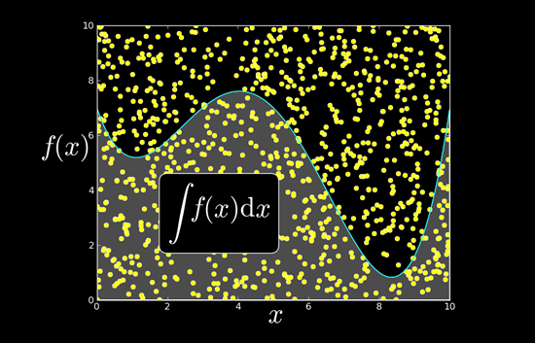


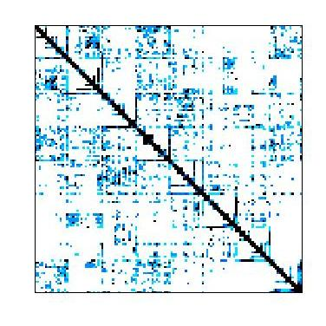


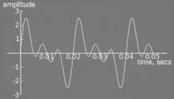
GPU Programming
GPU Accelerated Libraries
NVIDIA cuBLAS
NVIDIA cuRAND
NVIDIA NPP
Sparse Linear Algebra
C++ STL Features for CUDA
NVIDIA cuSPARSE
NVIDIA cuFFT

Slide 42

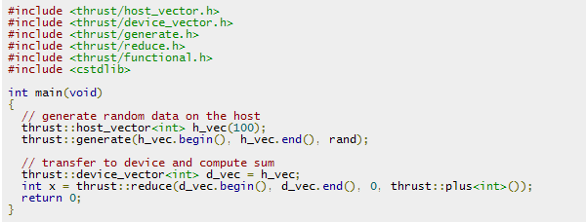
GPU Programming
GPU Accelerated Libraries
powerful library of parallel algorithms and data structures;
provides a flexible, high-level interface for GPU programming;
For example, the thrust::sort algorithm delivers 5x to 100x faster sorting performance than STL and TBB
Notes:
Resembles C++ STL
High-level interface
Enhances developer productivity
Enables performance portability between GPUs and multicore CPUs
Flexible
CUDA, OpenMP, and TBB backends
Extensible and customizable
Integrates with existing software
Open source
If you are a C++ programmer you are more than likely familiar with the Standard Template Library, or STL.
Thrust is an open-source parallel algorithms library which resembles the C++ STL.
Thrust's high-level interface greatly enhances developer productivity while enabling performance portability
between GPUs and multicore CPUs. Thrust includes back-end implementations for established technologies including
CUDA, Intel Threading Building Blocks, and the OpenMP standard. The latest version of Thrust also enables custom
back ends to be implemented. This interoperability facilitates integration with existing software.
Thrust is extremely flexible and powerful – its high-level interface enables efficient GPU code to be written
without directly writing any CUDA kernel calls. Thrust provides a GPU data container called device_vector that
abstracts copying data to and from the GPU, and it provides a large set of efficient algorithms for operating on these
vectors, including sorting, searching, reductions, set operations, and transformations. The example on the right shows
the creation of a vector on the host CPU, where it is filled with random values. The vector is then copied to the GPU
by assigning it to a device vector, and then the device vector is sorted. Thrust’s radix sort is extremely fast, sorting well
over a billion keys per second on GPUs.

Slide 43
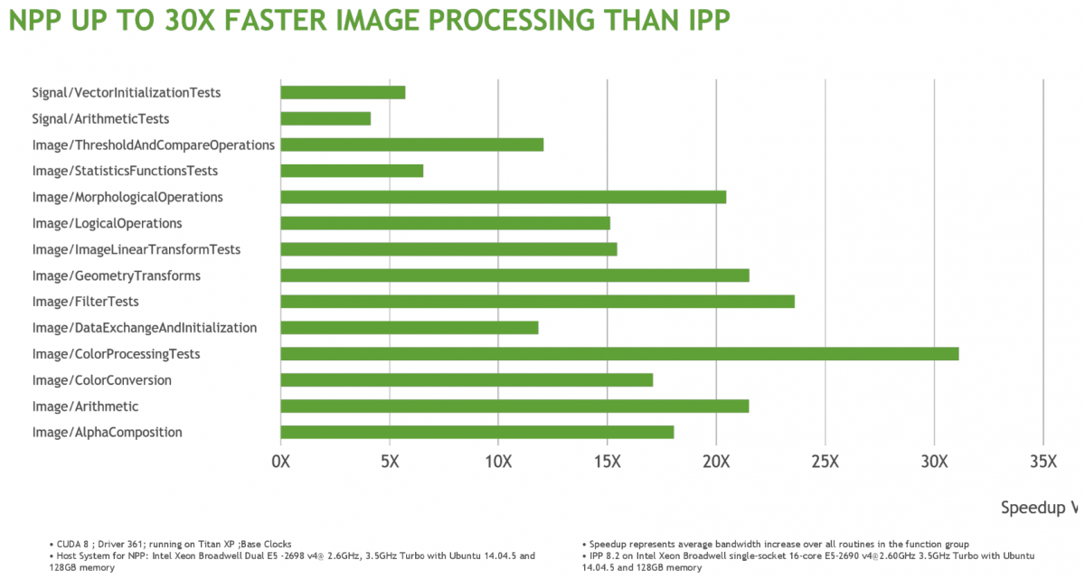
GPU Accelerated Libraries
GPU Programming
GPU-enabled version of Intel’s Performance Primitives library.
>5000 primitives for image and signal processing.
Applications include image manipulation, thresholding, filtering, color conversions, and lots more.
NVIDIA NPP
Intel 2.6 GHz Broadwell 2698v4 CPU
Titan XP GPU (variant of P100)
Notes:
The Intel IPP library is higher level than the MKL and contains a wide variety of routines.
The NPP is mostly a drop-in replacement with updated function names (e.g. nppCopy vs. ippCopy) that executes on the GPU.
From a programming point of view the NPP acts just like function calls in a library and all of the direct GPU code for allocations, copies, etc. are hidden from the programmer.

Slide 44

GPU Programming
GPU Accelerated Libraries
a GPU-accelerated version of the complete standard BLAS library;
6x to 17x faster performance than the latest MKL BLAS
Complete support for all 152 standard BLAS routines
Single, double, complex, and double complex data types
Fortran binding
cuBLAS
Notes:
Developing applications around libraries offers a range of benefits:
- Being callable from your host application, the CUDA accelerated libraries can hide a lot of the architectural details of the GPUs and therefore significantly shorten your application development
cycle.
CUDA-accelerated libraries often use APIs similar to well established libraries widely used
in scientific applications, thus enabling a drop-in acceleration experience. In some cases, the
libraries will offer exactly the same interface for both the GPU accelerated Version and the CPU
only version, resulting in code portable between the worlds. In other cases, some with a minimal
amount of code changes will be necessary to accommodate both CPU and GPU support.
Designing an application around libraries is also good software engineering practice, as it
reuses well tested code and therefore enhancing the overall quality of your application.
- Finally, CUDA accelerated libraries developed by NVIDIA engineers are highly tuned for
Performance, delivering excellent performance on every generation of GPUs, while maintaining generality.

Slide 45
GPU Programming
GEMM: C = αAB + βC
/* General Matrix Multiply (simplified version) */
static void simple_dgemm( int n, double alpha,
const double *A, const double *B,
double beta, double *C) {
int i, j, k;
for (i = 0; i < n; ++i) {
for (j = 0; j < n; ++j){
double prod = 0;
for (k = 0; k < n; ++k) prod += A[k * n + i] * B[j * n + k];
C[j * n + i] = alpha * prod + beta * C[j * n + i];
}
}
}
intro_gpu/gemm/cuGEMM.cpp

Slide 46
GPU Programming
BLAS GEMM: C = αAB + βC
/* dgemm from BLAS library */
extern "C"{
extern void dgemm_(char *, char * ,
int *, int *, int *,
double *, double *, int *,
double *, int *,
double *, double *, int *); };
/* Main */
int main(int argc, char **argv)
{
. . .
/* call gemm from BLAS library */
dgemm_("N","N", &N, &N, &N, &alpha, h_A, &N, h_B, &N, &beta, h_C_blas,&N);
. . .
intro_gpu/gemm/cuGEMM.cpp

Slide 47
GPU Programming
cuBLAS GEMM: C = αAB + βC
/* Main */
int main(int argc, char **argv)
{
/* 0. Initialize CUBLAS */
cublasCreate(&handle);
/* 1. allocate memory on GPU */
cudaMalloc((void **)&d_A, n2 * sizeof(d_A[0]));
/* 2. Copy data from Host to GPU */
status = cublasSetVector(n2, sizeof(h_A[0]), h_A, 1, d_A, 1);
/* 3. Execute GPU kernel */
cublasDgemm( handle,
CUBLAS_OP_N, CUBLAS_OP_N, N, N, N, &alpha, d_A, N, d_B, N, &beta, d_C, N );
/* 4. Copy data from GPU back to Host */
cublasGetVector(n2, sizeof(h_C[0]), d_C, 1, h_C, 1);
/* 5. Free GPU memory */
cudaFree(d_A)
}
intro_gpu/gemm/cuGEMM.cpp

Slide 48
GPU Programming
Submitting CUDA job
qsub -l gpus=1 -b y cuGEMM

Slide 49
GPU Programming
Timing GEMM
Time in milliseconds
Matrix Size

Slide 50
GPU Programming
SCC Development Environment
Nsight IDE: Linux, Mac & Windows - GPU Debugging and profiling. Based on the Eclipse IDE system.
CUDA-GDB debugger (NVIDIA Visual Profiler)
In addition to Python development environments: Spyder and Pycharm.

Slide 51
GPU Programming
CUDA Resources
RCS CUDA Tutorial
CUDA and CUDA libraries examples: http://docs.nvidia.com/cuda/cuda-samples/;
NVIDIA's Cuda Resources: https://developer.nvidia.com/cuda-education
Online course on Udacity: https://www.udacity.com/course/cs344
CUDA C/C++ & Fortran: http://developer.nvidia.com/cuda-toolkit
PyCUDA (Python): http://mathema.tician.de/software/pycuda
Notes:
The other way to add GPU acceleration to application is through a set of OpenACC directives

Slide 52
GPU Programming
PyCUDA
https://mathema.tician.de/software/pycuda/
Provides access to the CUDA API from Python
Integrates with numpy, i.e. can automatically handle passing numpy arrays to and from the GPU.
Full CUDA support.
CUDA kernels are still C code that is embedded into the Python code.
Four versions of PyCuda example codes can be found on the SCC:
/project/scv/examples/pycuda/
Notes:
The other way to add GPU acceleration to application is through a set of OpenACC directives

Slide 53
GPU Programming
PyCUDA
In the GPU compute node session:
cd /project/scv/examples/pycuda/
module purge
module load python/2.7.13
module load cuda/8.0
module load gcc/4.9.2
module load pycuda/2017.1.1
Notes:
The other way to add GPU acceleration to application is through a set of OpenACC directives

Slide 54
GPU Programming
PyCUDA
We’ll look at some PyCUDA variations on hello.py, which computes a vector product:
import numpy
a = numpy.random.randn(400).astype(numpy.float32)
b = numpy.random.randn(400).astype(numpy.float32)
dest = numpy.zeros_like(a)
for i in range(400):
dest[i] = a[i]*b[i]
print(dest-a*b)
# run:
python hello.py
Notes:
The other way to add GPU acceleration to application is through a set of OpenACC directives

Slide 55
GPU Programming
PyCUDA
Now look at hello_gpu_0.py. This uses a CUDA kernel.
Import and initialize PyCUDA
import pycuda.driver as drv
import pycuda.autoinit
import numpy
from pycuda.compiler import SourceModule
mod = SourceModule("""
__global__ void multiply_them(float *dest, float *a, float *b)
{
const int i = threadIdx.x;
dest[i] = a[i] * b[i];
}
""")
multiply_them = mod.get_function("multiply_them")
# … the rest of the file continues
CUDA kernel and Python handle.
SourceModule compiles the CUDA code.
Notes:
The other way to add GPU acceleration to application is through a set of OpenACC directives

Slide 56
GPU Programming
PyCUDA
Now look at hello_gpu_0.py. This uses a CUDA kernel.
# … continuing the file
a = numpy.random.randn(400).astype(numpy.float32)
b = numpy.random.randn(400).astype(numpy.float32)
dest = numpy.zeros_like(a)
# mem allocation on gpu side
a_gpu = drv.mem_alloc(a.nbytes)
b_gpu = drv.mem_alloc(b.nbytes)
dest_gpu = drv.mem_alloc(dest.nbytes)
# data transfer to gpu # skipped
drv.memcpy_htod(a_gpu,a)
drv.memcpy_htod(b_gpu,b)
multiply_them(
dest_gpu, a_gpu, b_gpu,
block=(400,1,1))
# mem copy from gpu to cpu
drv.memcpy_dtoh(dest,dest_gpu)
print(dest-a*b)
Numpy arrays
GPU memory
Transfer to GPU
Call kernel
Transfer back to numpy
Notes:
The other way to add GPU acceleration to application is through a set of OpenACC directives

Slide 57
GPU Programming
PyCUDA
Now look at hello_gpu_0.1.py. This reduces overhead when calling the kernel.
PPP is the type signature of the kernel: 3 pointers
# … continuing the file
# Prepared Invocations to reduce overhead
grid = (1,1)
block = (400,1,1)
multiply_them.prepare("PPP")
multiply_them.prepared_call(grid,
block,
dest_gpu,
a_gpu,b_gpu)
Call the kernel.
Notes:
The other way to add GPU acceleration to application is through a set of OpenACC directives

Slide 58
GPU Programming
PyCUDA
Now look at hello_gpu_1.py. This adds automatic handling of the numpy array getting memory allocated on the GPU to store it, passing it to the GPU, and retrieving the result.
This has higher overhead than manually allocating on the GPU has and cannot run as a prepared call:
# version 0
#multiply_them(
# dest_gpu, a_gpu, b_gpu,
# block=(400,1,1))
# version 1
multiply_them(
drv.Out(dest), drv.In(a), drv.In(b),
block=(400,1,1))
Notes:
The other way to add GPU acceleration to application is through a set of OpenACC directives

Slide 59
GPU Programming
PyCUDA
Now look at hello_gpu_2.py. Using the PyCUDA gpuarray type the memory management is abstracted and no SourceModule is used. PyCUDA will auto-generate the CUDA code itself.
import pycuda.gpuarray as gpuarray
import pycuda.driver as drv
import pycuda.autoinit
import numpy
a = numpy.random.randn(400).astype(numpy.float32)
b = numpy.random.randn(400).astype(numpy.float32)
a_gpu = gpuarray.to_gpu(a)
b_gpu = gpuarray.to_gpu(b)
dest = (a_gpu*b_gpu).get()
print(dest-a*b)
Notes:
The other way to add GPU acceleration to application is through a set of OpenACC directives

Slide 60
GPU Programming
PyCUDA
Timing – how do they compare?
500 iterations of the call to the GPU were timed for each approach.
Array size – 10,000
Lower-level approach == highest performance.
Why is the CPU the fastest here?
Version | Time per kernel run(sec) | Notes
CPU | 2.918e-07
0 | 7.251e-05 | Manual memory moving: drv.memcpy_htod() etc.
0.1 | 6.502e-05 | Same as 0 but with prepared function call
1 | 12.76e-05 | Use drv.Out() and drv.In()
2 | 40.58e-05 | gpuarray, no CUDA source

Slide 61
GPU Programming
Scikit-CUDA
https://github.com/lebedov/scikit-cuda
PyCUDA cannot call the various CUDA libraries from within its CUDA kernels.
If you want to use cuBLAS, cuFFT, etc. the Scikit-CUDA library is installed.
This uses the PyCUDA gpuarray data structures in its calls to the CUDA libraries.
Take a look at some of the examples.
module purge
module load python/2.7.13
module load cuda/8.0
module load gcc/4.9.2
module load pycuda/2017.1.1
module load scikit-cuda/0.5.1
cd $SCC_SCIKIT_CUDA_EXAMPLES
Notes:
The other way to add GPU acceleration to application is through a set of OpenACC directives

