Slide 1
Introduction to Fortran
Kadin Tseng
Boston University
Scientific Computing and Visualization

Slide 2
Outline
Goals
Introduction
Fortran History
Basic syntax
Makefiles
Additional syntax

Slide 3
Goals are to be able to . . .
write simple Fortran programs
understand and modify existing Fortran code
manage programming projects with makefiles

Slide 4
Introduction
Two fundamentally different types of high-level languages:
Interpreted language
  MATLAB, Python, Java
  Translation to machine-language is performed incrementally at run time
Compiled language
  Fortran, C, C++
  Translation is performed once, then executable is run as frequently as needed without further translation

Slide 5
Introduction (cont’d)
Compiled languages run faster.
  Large-scale computing is usually done with compiled language
Interpreted languages more convenient but slower
  e.g., no need to declare variables; do things on-the-fly
  MATLAB can be an order of magnitude slower than C/fortran (code dependent)

Slide 6
Fortran History
Before Fortran, programs were written in assembly language (very tedious to say the least)
  low-level commands such as “load x from memory into register 7” or “add values in registers 10 and 11 and write result to register 4”
Fortran was the first widely-used high-level computer language
  1957
  Developed by IBM for scientific applications
  Program written on a specially formatted green sheet, then entered as punched cards

Slide 7
Fortran History
Fortran 66 (1966)
Fortran 77 (1978)
Fortran 90 (1991)
  “fairly” modern (structures, etc.)
  Current “workhorse” Fortran
Fortran 95 (minor tweaks to Fortran 90)
Fortran 2003
  Gradually being implemented by compiler companies
  Object-oriented support
  Interoperability with C is in the standard

Slide 8
What Language Should I Use?
Generally, use the language you know best
Interpreted languages are great for
  Interactive applications
  Code development and debugging
  Algorithm development
For major number crunching, compiled langauages are preferred (Fortran, C, C++)

Slide 9
Fortran Syntax
Program is contained in a text file
  called source code or source file
Source code must be processed by a compiler to create an executable
Source file suffix can vary, but we will always use .f90
(.for, .f, .F, .f90, .F90, …)
Since source file is simply text, can be written using any text editor
  usually emacs, vi, gedit

Slide 10
Fortran Syntax (cont’d)
First statement in code is program statement
  Followed by program name
    program myprog (first line in source code)
  Suggestion: give the source file the same name as the program
    myprog.f90 (name of source file)
Last statement is a corresponding end program myprog
(myprog optional)
Language is not case sensitive ( PROGRAM myProg works)
Single blank space serves as delimiter
But white space (multiple consecutive blanks) is ignored (program myprog is the same as program myprog)

Slide 11
Fortran Syntax (3)
Variables have types
For now, we’ll look at 3 types: real, integer, and character
Real variables have decimals
  Real can be a whole number, but decimal places are stored internally
  Even when a real is a whole number, it’s good practice to write one decimal place
    3.0 rather than 3

Slide 12
Fortran Syntax (4)
Integer variables do not have decimals
Integer arithmetic is truncated, not rounded
  3/2 = 1
  2/3 = 0
If these were reals, results would be
  3.0/2.0 = 1.5
  2.0/3.0 = 0.6666667
Character variables contain literal text
  Enclosed in single quotes
    ‘T’
  Character strings contain groups of characters
  ‘This is a character string.’
  Blank spaces within quotes are significant. They are part of the string

Slide 13
Fortran Syntax (5)
Need to declare the type for every variable
  real :: velocity, mass, pi
  integer :: imax, jdim
  character :: p
Variables must start with a letter (a-z); can mix with digits (0-9); also underscores ( _ ); but no blanks; name length <= 31
For backward compatibility with obsolecent f77, variables that starts with i, j, k, l, m, n are defaulted to the integer type.
Strongly recommend to adopt the practice of declaring with
implicit none
  This promises the compiler that you will declare all variables
  This goes before any type declaration statements (with one exception that we’ll cover later)

Slide 14
Fortran Syntax (6)
Comment character is !
  Anything from ! to end of line ignored by the compiler
  Use comments liberally to document source code
  Fortran 77 comment starts with “c” on column 1
print*
  “list-directed” output
  Simple way to produce output on the screen
  Follow by comma, then stuff to print
  print*, ’This is my character string.’

Slide 15
Fortran Syntax (7)
Ampersand, &, at end of line tells compiler that statement is continued on next source line
  With Fortran 77, put any alphanumeric character on column 6 of the second and subsequent continuation lines
Spaces don’t matter except within literal character strings
  use them liberally to make code easy to read, e.g., before and after equal signs
Note that source lines do not end with semicolons (as in C or MATLAB)

Slide 16
Exercise 1
Write a “hello world” program with editor (gedit, vi, Emacs)
  Program should print a character string
  4 lines of code
  Save it to a file name with a .f90 suffix (for example, hello.f90)
Solution

Slide 17
Compilation
A compiler is a program that reads source code and converts it to a form usable by the computer
Internally, three steps are performed:
  preprocess source code
  check source code for syntax errors
  compiler translates source code to assembly language
  assembler translates assembly language to machine language
  linker gathers machine-language modules and libraries
  All these steps sometimes loosely referred to as “compiling”

Slide 18
Compilation (cont’d)
Code compiled for a given processor architecture will not generally run on other processors
  AMD and Intel are compatible
On the SCC & katana, we have Portland Group compilers (pgf90) and GNU compilers (gfortran)
We’ll use pgf90, since it usually results in faster-executing code
    PGI Fortran reference is at http://www.pgroup.com/doc/pgifortref.pdf

Slide 19
Compilation (3)
Compilers have huge numbers of options
  See doc at http://www.pgroup.com/doc/pgiug.pdf or
  scc1:~ % man pgf90
Compile hello.f90 on the SCC :
  scc1:~ % pgf90 –o hello hello.f90 (-o lets you set executable name)
If it simply returns a Unix prompt, it worked
If you get error messages, read them carefully and see if you can fix the source code and re-compile
Once it compiles correctly, type the executable name at the Unix prompt, and it will print your string

Slide 20
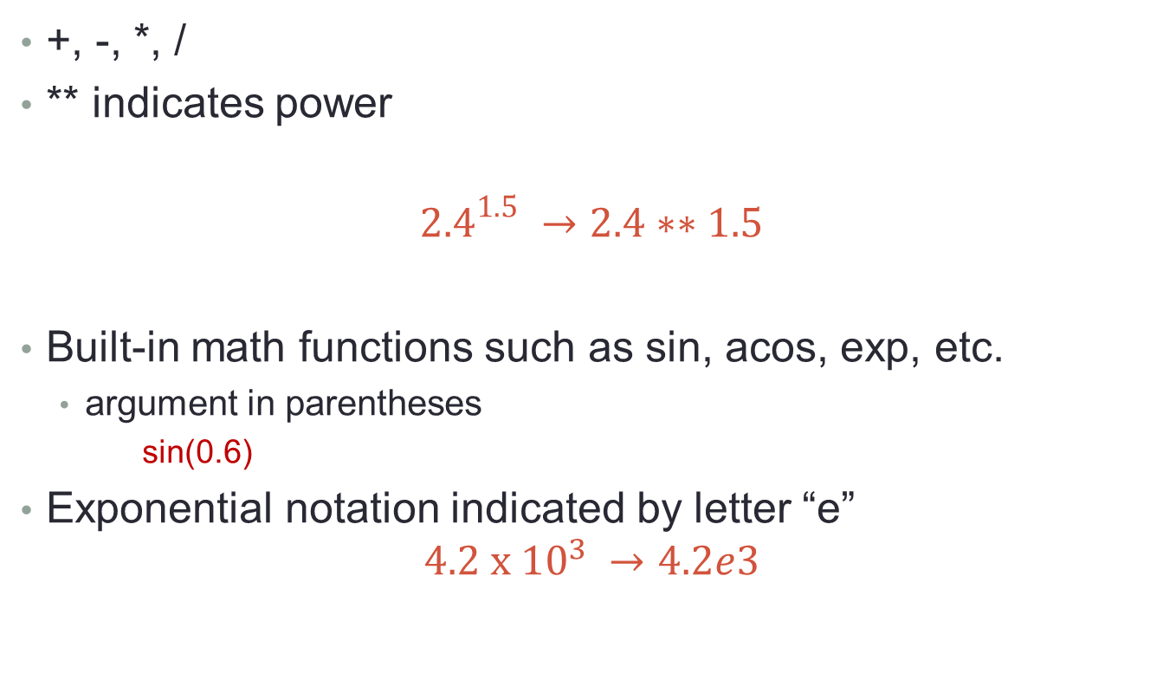
Arithmetic
+, -, *, /
** indicates power
$${2.4}^{1.5} →2.4∗∗1.5$$
Built-in math functions such as sin, acos, exp, etc.
  argument in parentheses
    sin(0.6)
Exponential notation indicated by letter “e”
$$4.2 x {10}^{3} →4.2e3$$

Slide 21
More List-Directed i/o
read* is list-directed read, analogous to print*
Follow with comma, then comma-delimited list of variables you want to read
  read*, x, j
Often use list-directed read and write together
  print*, ‘Enter a float and an integer:’
  read*, x, j
  print*, ‘float = ‘, x, ‘ integer = ‘, j
  Alternatively, you can use read(*,*) or write(*,*).

Slide 22
Exercise 2
Write program to prompt for a Celcius temperature, convert it to Fahrenheit, and print the result.
  make sure you declare all variables
  use decimal points with all reals, even if they’re whole numbers
  F = (9/5)C + 32
solution

Slide 23
Arrays
Specify static dimensions in declaration:
  real, dimension(10,3,5) :: x
  integer, dimension(10) :: i
Can also specify ranges of values
  integer, dimension(3:11, -15:-2) :: ival, jval
Access array elements using parenthesis
  a = y(3) + y(4)

Slide 24
Arrays (cont’d)
Dynamic allocation
  Useful when size is not known at compile time, e.g., input value
  Need to specify number of dimensions in declaration
  Need to specify that it’s an allocatable array
  real, dimension(:,:,:), allocatable :: x, y
  allocate function performs allocation
  allocate( x(ni,nj,nk), y(ldim,mdim,ndim) )
  When you’re done with the variables, deallocate with
  deallocate(x, y)
    not necessary at very end of code; Fortran will clean them up for you
I usually avoid using “l” because it could be mistaken for “1” or “i” (You could use “L”)
Good idea to establish your own naming conventions and follow through with them

Slide 25
Parameters
If variable has known, fixed, value, declare as parameter and initialize in declaration
  integer, parameter :: idim = 100, jdim = 200
  Compiler substitutes values wherever variables appear in code
  Efficient, since there are no memory accesses
  Often used for declaring arrays
  integer, parameter :: idim = 100, jdim = 200
  real, dimension(idim, jdim) :: x
  integer, dimension(idim) :: iarray

Slide 26
Exercise 3
Write program to prompt for 2 floating-point vectors of length 3, calculate the dot product, and print the result
  Don’t name the code “dot_product” or “dot”
    Fortran has a “dot_product” intrinsic function
    there is a Unix command called “dot”
  Can use array name in list-directed read, and it will expect the appropriate number of values (dimension) separated by spaces
solution

Slide 27
Control
Do loop repeats calculation over range of indices
  do i = 1, 10
  a(i) = sqrt( b(i)**2 + c(i)**2 )
  enddo
Can use increment that is not equal to 1
  Goes at end of do statement, unlike Matlab
  do i = 10, -10, -2

Slide 28
Exercise 4
Modify dot product program to use a do loop
  Declare scalar real variable to hold the summation
  Initialize it to zero before the do loop
solution

Slide 29
If-Then-Else
Conditional execution of block of source code
Based on relational operators
  < less than
  > greater than
  == equal to
  <= less than or equal to
  >= greater than or equal to
  /= not equal to
  .and.
  .or.

Slide 30
If-Then-Else (cont’d)
  if( x > 0.0 .and. y > 0.0 ) then
  z = 1.0/(x+y)
  elseif ( x < 0.0 .and. y < 0.0) then
  z = -2.0/(x+y)
  else
  print*, ’Error condition’
  endif

Slide 31
Exercise 5
In dot product code, check if the magnitude of the dot product is less than 10⁻⁶ using the absolute value function abs. If it is, print a message. In either case, print the result as before.
Solution
Never check if a real number equals a specific value. Instead, check if it is within a certain range, e.g., with abs

Slide 32
Array Syntax
Fortran can perform operations on entire arrays
  Like MATLAB, unlike C.
To add two arrays, simply use
  c = a + b ! a, b, c are arrays of the same shape and size
Can also operate on array sections
  c(-5:10) = a(0:15) + b(0:30:2) ! all sections must have same length
  Here we use b(0), b(2), b(4), etc. due to increment specification
  Numbers of elements must be consistent
Don’t assume that all MATLAB matrix rules apply
  c = a * b ! * is elemental multiply, not matrix multiply

Slide 33
Array Syntax (cont’d)
There are intrinsic functions to perform some operations on entire arrays
  sum
  sum(x) is the same as x(1) + x(2) + x(3) + …
  product
  minval
  maxval
  matmul

Slide 34
Exercise 6
Modify dot product code to use array syntax instead of do loop
  use “sum” intrinsic to sum components
solution

Slide 35
Subprograms
Calculations may be grouped into subroutines and functions to perform specific tasks such as:
    read or write data
    initialize data
    solve a system of equations
Function returns a single object (number, array, etc.), and usually does not alter the arguments
  Fortran uses pass-by-reference; change of variables’ values pass into subprogram will be changed after returning
  Altering certain argument’s value in a subprogram, considered a “side effect,” is bad programming practice. Changing a pre-defined constant is an example. It may either cause a segmentation fault or worse, the variable got changed.
Subroutine transfers calculated values (if any) through arguments

Slide 36
Functions
Definition starts with a return type
End with “end function” analogous to “end program”
Example: distance between two vectors
  real function fahrenheit(c)
  real :: c
  fahrenheit = (9.0/5.0)*c + 32.0 ! Convert Celsius to fahrenheit
  end function fahrenheit
Use:
  f = fahrenheit(0.0) ! 0 degree Celsius equals 32 degrees fahrenheit
  Names of dummy arguments don’t have to match actual names
  Function name must be declared in calling routine
  real :: fahrenheit

Slide 37
Subroutines
End with “end subroutine” analogous to “end program”
Distance subroutine
  subroutine temp_conversion(celsius, fahrenheit)
  real :: celsius, fahrenheit
  fahrenheit = (9.0/5.0)*celsius + 32.0
  end subroutine temp_conversion
Use:
  call temp_conversion(c, f)
  As with function, names of dummy arguments don’t have to match actual names

Slide 38
Exercise 7
Modify dot-product program to use a subroutine to compute the dot product
  The subroutine definition may go before or after the main program in source code
  Don’t forget to declare arguments
  Give the subroutine a name different than the program
    I called mine dp
solution

Slide 39
Exercise 7a, 7b
Modify dot-product program to use a function to compute the dot product
  The function definition may go before or after the main program in source code
  Don’t forget to declare arguments
  Name the function different than the program name, like dotp
Solution
Modify the fahrenheit function into a function, converts,
such that if input is in fahrenheit, it returns the Celsius
equivalence. If input is in Celsius, it returns fahrenheit.
(Hint: extra input parameter)

Slide 40
Basics of Code Management
Large codes usually consist of multiple files
  Bad practice to have everything in the same file
  I usually create a separate file for each subprogram
    Easier to edit
    Can recompile one subprogram at a time
Files can be compiled, but not linked, using –c option; then object files can be linked
  pgf90 –c mycode.f90
  pgf90 –c myfunc.f90
  pgf90 –o mycode mycode.o myfunc.o

Slide 41
Exercise 8
Put dot-product subroutine and main program in separate files
Give main program same name you have been using for code, e.g., “program dotprod” and dotprod.f90
Give subroutine same name you used for subroutine, e.g., “subroutine dp” and dp.f90
Compile, link, and run
solution

Slide 42
Makefiles
Make is a Unix utility to help manage codes
When you make changes to files, it will
  Automatically deduce which files need to be compiled and compile them
  Link latest object files
Makefile is a file that tells the make utility what to do
Default name of file is “makefile” or “Makefile”
  Katana% make (to generate the executable)
  Can use other names if you’d like
  katana% make –f name-of-make-file

Slide 43
Makefiles (cont’d)
Makefile contains different sections with different functions
  The sections are not executed in order!
Comment character is #
There are defaults for some values, but I like to define everything explicitly

Slide 44
Makefiles (3)
example makefile:
### suffix rule
.SUFFIXES:
.SUFFIXES: .f90 .o
.f90.o:
$(F90) $(COMPFLAGS) $*.f90
### compiler
F90 = pgf90
COMMONFLAGS = -O3
COMPFLAGS = -c $(COMMONFLAGS)
LINKFLAGS = $(COMMONFLAGS)
### objects
OBJ = mymain.o sub1.o sub2.o fun1.o
### compile and link
myexe: $(OBJ)
$(F90) –o $@ $(LINKFLAGS) $(OBJ)

Slide 45
Makefiles (4)
variables
  Some character strings appear repeatedly in makefiles
  It’s convenient to give them names so if they are changed, you only have to do it in one place
  To define variable:
  name = string
  No quotes are required for the string
  String may contain spaces
  “name” is any name you want
  Variable names are usually all capitals
  To continue line, use \ character

Slide 46
Makefiles (5)
Variables (cont’d)
  To use variable, either of these work:
    $(name)
    ${name}
Example:
  Define compiler
    F90 = pgf90
  To use elsewhere in makefile:
    $(F90)

Slide 47
Makefiles (6)
Good practice to define compiler info in variables
  F90 = pgf90
  COMMONFLAGS = -O3
  COMPFLAGS = -c $(COMMONFLAGS)
  LINKFLAGS = $(COMMONFLAGS)

Slide 48
Makefiles (7)
Have to define all file suffixes that may be encountered
  .SUFFIXES: .o .f90
Just to be safe, delete any default suffixes first with a null .SUFFIXES: command
  .SUFFIXES:
  .SUFFIXES: .o .f90

Slide 49
Makefiles (8)
Have to tell how to create one file suffix from another with a suffix rule
  .f90.o:
  $(F90) $(COMPFLAGS) $*.f90
The first line indicates that the rule tells how to create a .o file from a .f90 file
The second line tells how to create the .o file
The big space before $(F90) is a tab, and you must use it!
$* is automatically the root of the first file

Slide 50
Makefiles (9)
Usually define variable with all object file names
  OBJ = mymain.o sub1.o anothersub.o \
  firstfunc.o func2.o

Slide 51
Makefiles (10)
Finally, everything falls in place with the definition of a rule
  target: prerequisites
  recipe
The target is any name you choose
  Often use name of executable
Prerequisites are files that are required by target
  e.g., executable requires object files
Recipe tells what you want the makefile to do

Slide 52
Makefiles (11)
### suffix rule
.SUFFIXES:
.SUFFIXES: .f90 .o
.f90.o:
$(F90) $(COMPFLAGS) $*.f90
### compiler
F90 = pgf90
COMMONFLAGS = -O3
COMPFLAGS = -c $(COMMONFLAGS)
LINKFLAGS = $(COMMONFLAGS)
### objects
OBJ = mymain.o sub1.o sub2.o fun1.o
### compile and link
myexe: $(OBJ)
$(F90) –o $@ $(LINKFLAGS) $(OBJ)
Automatic variable for target

Slide 53
Makefiles (12)
When you type “make,” it will look for a file called “makefile” or “Makefile”
It then searches for the first target in the file
In our example (and the usual case) the object files are prerequisites
It checks the suffix rule to see how to create an object file
In our case, it sees that .o files depend on .f90 files
It checks the time stamps on the associated .o and .f90 files to see if the .f90 is newer
If the .f90 file is newer it performs the suffix rule
  In our case, compiles the routine

Slide 54
Makefiles (13)
Once all the prerequisites are updated as required, it performs the recipe
In our case it links the object files and creates our executable
Many makefiles have an additional target, “clean,” that removes .o and other files
  clean:
  rm –f *.o
When there are multiple targets, specify desired target as argument to make command
  make clean

Slide 55
Exercise 9
Create a makefile for your dot product code
Include two targets
  executable
  clean
Delete your old object files using “make clean”
Build your code using the makefile
solution

Slide 56
Kind
Declarations of variables can be modified using “kind” parameter
Often used for precision of reals
Intrinsic function selected_real_kind(n) returns kind that will have at least n significant digits
  n = 6 will give you “single precision”
  n = 12 will give you “double precision”

Slide 57
Kind (cont’d)
integer, parameter :: rk = selected_real_kind(12)
real(rk) :: x, y, z
real(rk), dimension(101,101,101) :: a
If you want to change precision, can easily be done by changing one line of code

Slide 58
Exercise 10
Modify dot-product code to use kinds to declare double-precision reals
  Don’t forget to modify all files
  “make” will automatically compile and link
solution

Slide 59
Modules
Program units that group variables and subprograms
Good for global variables
Checking of subprogram arguments
  If type or number is wrong, linker will yell at you
Can be convenient to package variables and/or subprograms of a given type

Slide 60
Modules (cont’d)
module module-name
  implicit none
  … variable declarations …
  contains
  … subprogram definitions …
end module module-name

Slide 61
Modules (3)
Only need “contains” if module contains subprograms
I usually name my modules (and associated files) with _mod in the name, e.g., solvers_mod, solvers_mod.f90
In program unit that needs to access components of module use module-name
use statement must be before implicit none

Slide 62
Modules (4)
use statement may specify specific components to access by using “only” qualifier:
  use solvers_mod, only: nvals, x
A Fortran style suggestion:
  Group global variables in modules based on function
  Employ “use only” for all variables required in program unit
  All variables then appear at top of program unit in declarations or “use” statements

Slide 63
Modules (5)
When linking object files, modules must come first in the list
  In my makefiles I create a MODS variable analogous to OBJS
  Link command then contains $(MODS) $(OBJS)

Slide 64
Exercise 11
Create module prec_mod
  Separate file called prec_mod.f90
  Parameter rk
  Real kind for double
Use this module in dot-product program units
Modify makefile to compile module
  add module list to dependencies and link recipe
solution

Slide 65
Derived Types
Analogous to structures in C
Can package a number of variables under one name
  type grid
  integer :: nvals
  real, dimension(100,100) :: x, y, jacobian
  end type grid

Slide 66
Derived Types (cont’d)
To declare a variable
  type(grid) :: airfoil
Components are accessed using %
  airfoil%nvals = 20
  airfoil%x = 0.0 !... array notation, initialize entire array
Handy way to transfer lots of data to a subprogram
  call calc_jacobian(airfoil)

Slide 67
Exercise 12
Create module with definition of rvec3 type
  Size of vector nvals = 3
    not a parameter – can’t have parameter in derived type
  Real 3-component vector
  Use prec_mod
Modify code to use rvec3
Modify makefile to include new module
solution

Slide 68
Interface
On occasions, you may need to help the compiler a bit on what you are trying to do with interface
  For C programmers, this is roughly the same as prototype
  Previously, we learn to compute dot product with a function which returns a scalar. To compute cross product of two cartesian vectors, we need to warn the compiler ahead of time that the return value is not a scalar.
  interface
  function xprod(x, y)
  implicit none
  real, dimension(3) :: x, y, xprod
  end function xprod
  end interface

Slide 69
Interface (cont’d)
The complete xprod function is
function xprod(x, y)
  implicit none
  real, dimension(3) :: x, y, xprod
  xprod(1) = x(2)*y(3) – x(3)*y(2)
  xprod(2) = x(3)*y(1) – x(1)*y(3)
  xprod(3) = x(1)*y(2) – x(2)*y(1)
  return
  end function xprod

Slide 70
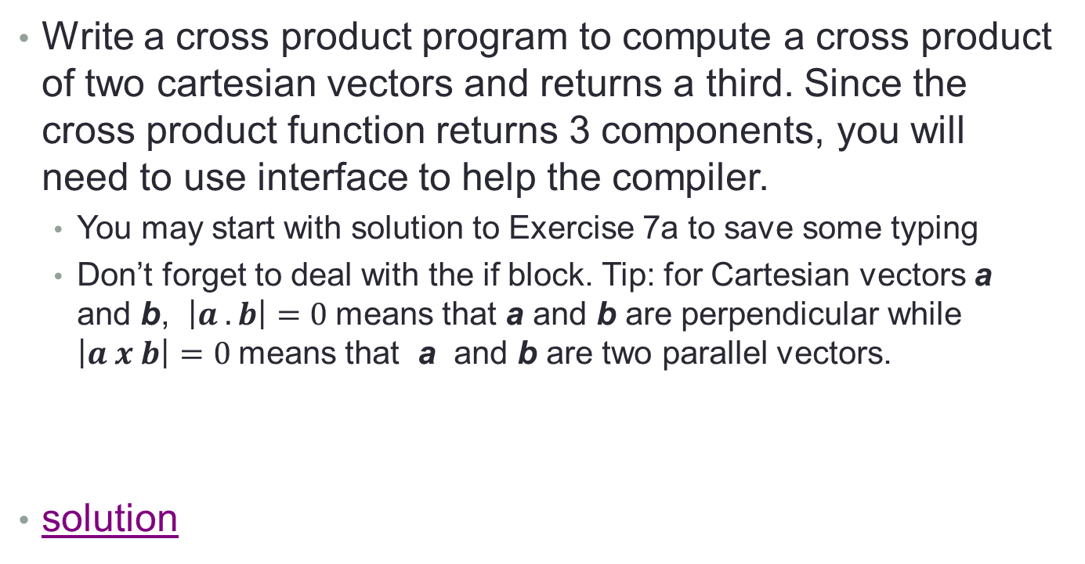
Exercise 13
Write a cross product program to compute a cross product of two cartesian vectors and returns a third. Since the cross product function returns 3 components, you will need to use interface to help the compiler.
  You may start with solution to Exercise 7a to save some typing
  Don’t forget to deal with the if block. Tip: for Cartesian vectors a and b, $\left|a . b\right|=0$means that a and b are perpendicular while $\left|a x b\right|=0$means that a and b are two parallel vectors.
solution

Slide 71
i/o
List-directed output (print*) gives little control
write statement allows formatted output
  write(unit, format) variables
Unit is a number indicating where you want to write data
  The number 6 is std out (write to screen)

Slide 72
i/o (cont’d)
im
  For integers
  m is total number of places in field
    i3 125
am
  For character strings
  m is number of characters
    a5 hello
  Left-justifies
  If m isn’t specified, writes number of characters in variable declaration

Slide 73
i/o (3)
fm.n
  For floating-point (real) numbers
  m is total number of characters in field
  n is number of decimal places
    f5.3 1.234
    f5.2 -1.23
  If m is larger than required, right-justifies
em.n
  Exponential notation
    e9.2 -0.23e-01
  Always zero left of decimal

Slide 74
i/o (4)
esm.n
  scientific notation
    es9.2 -2.30e-02
In format statement, put formats within ‘()’
Example write statement
  write(6, ‘(a, f6.2, i5, es15.3)’) ‘answers are ’, x, j, y

Slide 75
i/o (5)
Suppose you want to write to a file?
  open statement
  open(11, file=‘mydata.d’)
  “11” is unit number
    Don’t use 5 or 6
      Reserved for std in, std out
  Use this unit in your write statement
  When you’re finished writing, close the file
  close(11)

Slide 76
i/o (6)
Can also read from file
  read rather than write
  Can use * instead of format specifier
  read(11,*) j, x

Slide 77
Exercise 14
Write your dot-product result to a file
Only have to change very end of main program
solution

Slide 78
Unformatted i/o
Binary data take less disk space than ascii (formatted) data
Data can be written to file in binary representation
  Not directly human-readable
  open(199, file=‘unf.d’, form=‘unformatted’)
  write(199) x(1:100000), j1, j2
  read(199) x(1:100000), j1, j2
  Note that there is no format specification
Fortran unformatted slightly different format than C binary
  Fortran unformatted contains record delimiters

Slide 79
Exercise 15
Modify dot-product program to:
  Write result to unformatted file
    don’t write character string, just number
  After file is closed, open it back up and read result
  Print result to make sure it wrote/read correctly
solution

Slide 80
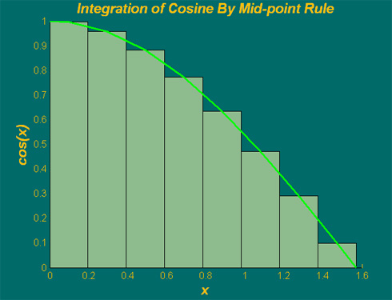
Integration Example
Integration of cosine from 0 to π/2 with mid-point rule
Integral ≈ sum of rectangles (height * width)
mid-point of increment
cos(x)
a = 0; b = pi/2; % range
m = 8; % # of increments
h = (b-a)/m; % increment
h

Slide 81
Exercise 16
Write a program to perform integration of cosine using the mid-point rule
  Write a function integral to perform integration
    m, a, h are input to integral
  The main program calls integral a few times (using do loop), each time with a larger m than the previous time. The purpose is to study the convergence trend. (hint: m=25*2**n; n is the loop index)
solution

Slide 82
References
Lots of books available
  “Fortran 95/2003 Explained” by Metcalf, Reid, and Cohen is good
PGI
  Compiler
    http://www.pgroup.com/doc/pgiug.pdf
  Fortran language reference
    http://www.pgroup.com/doc/pgifortref.pdf
gfortran
  http://gcc.gnu.org/wiki/GFortran
Feel free to e-mail me with any questions

